Slide 1
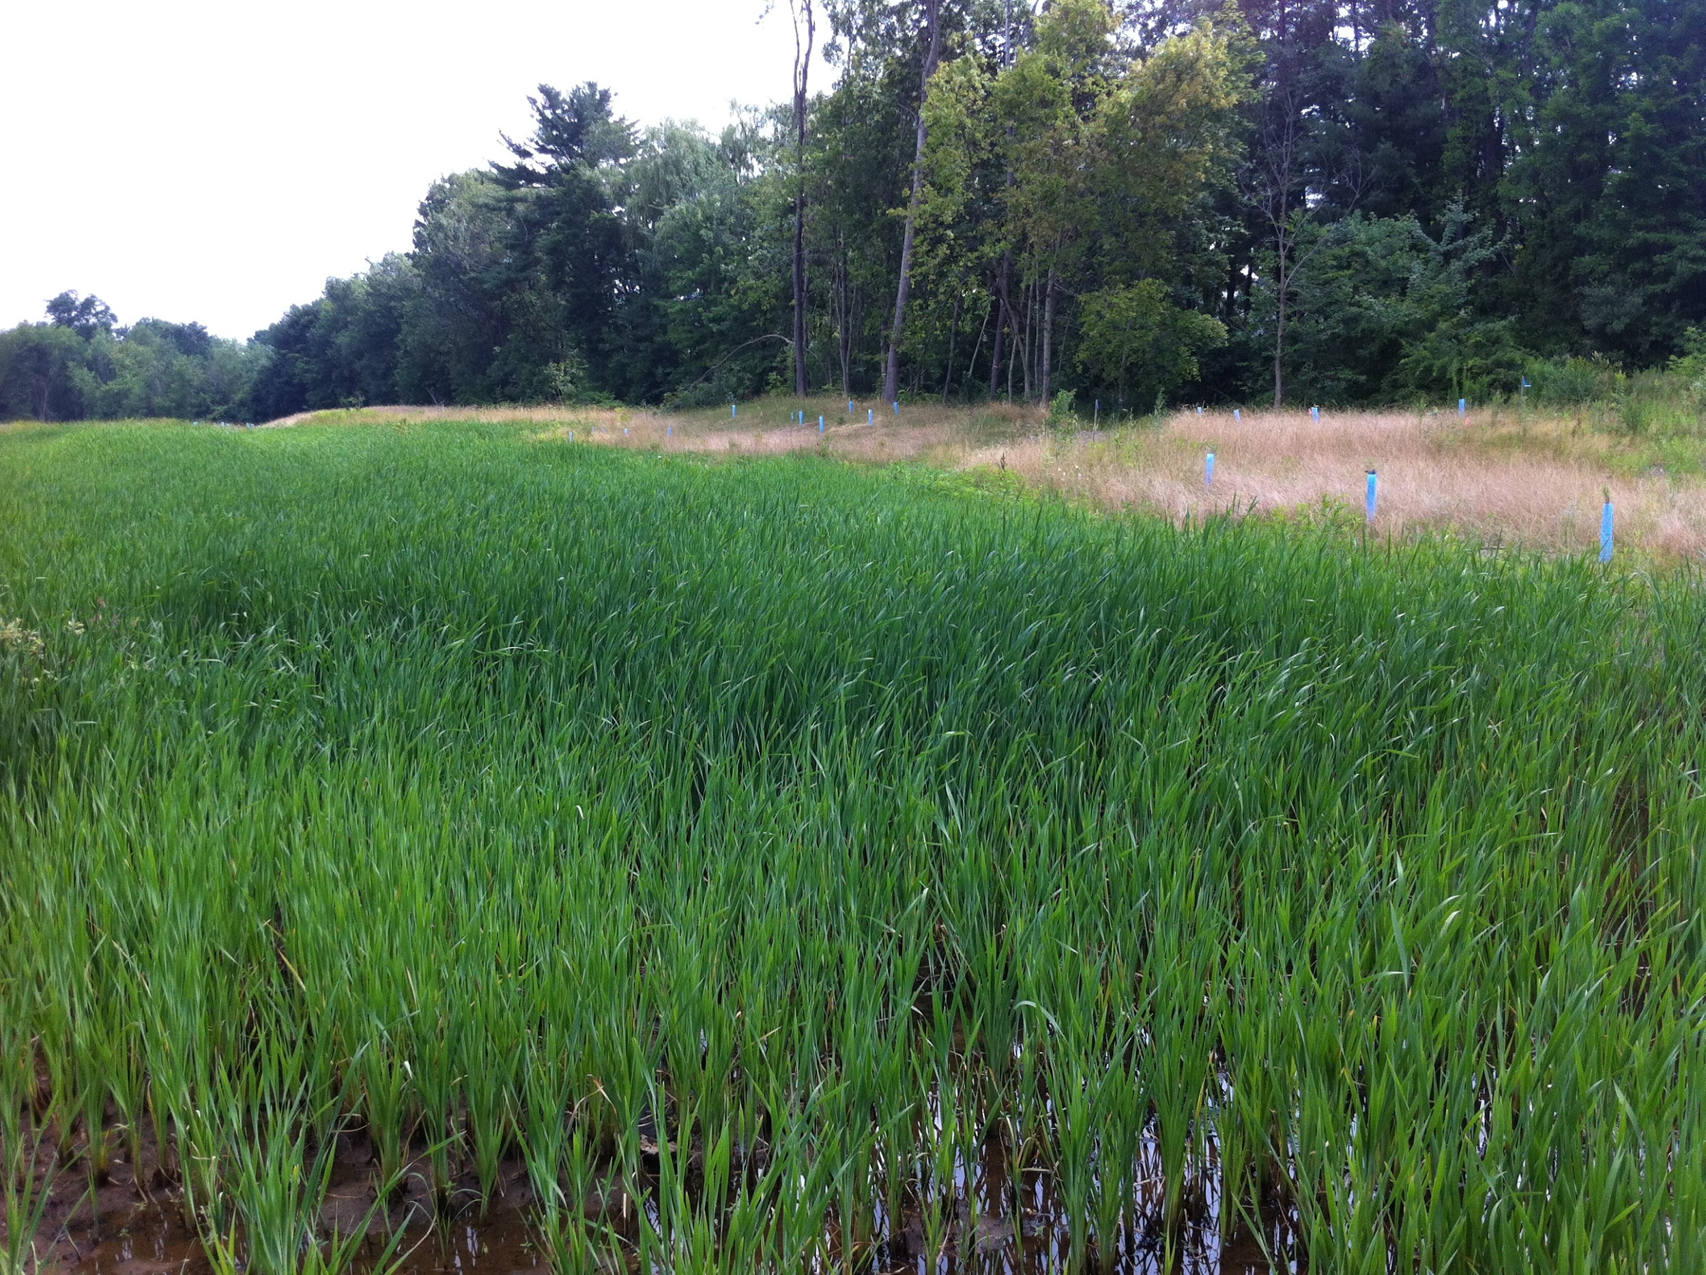
Credit for Going Green
Pollutant Removal Credits for Buffers in MS4 Permits

Slide 2
Partners & Advisors
Partners
University of New Hampshire Stormwater Center
Great Bay National Estuarine Research Reserve
Roca Communications
Narragansett Bay National Estuarine Research Reserve
Waquoit Bay National Estuarine Research Reserve
Advisors
New Hampshire Department of Environmental Services
United States Environmental Protection Agency Region 1

Slide 3
We Are Grateful to Our Sponsor
National Estuarine Research Reserve System Science Collaborative, which advances collaborative research to address coastal management problems important to reserves and their communities.
The Science Collaborative is funded by the National Oceanic and Atmospheric Administration and managed by the University of Michigan Water Center.

Slide 4
Our Goal
Help New Hampshire communities use buffers to help meet pollution reduction targets for stormwater permits

Slide 5
Our Process
Weight of evidence approach that engaged experts in recommending pollutant load reduction performance curves for restored or constructed buffers in projects involving land use change
Notes:
Restored buffers are water quality BMPs with multiple benefits.
Science-based approach to assigning pollutant removal credits for buffer restoration or construction
Ability to compare the performance of restored or constructed buffers to other water quality BMPs.
Tool to enhance water quality protection in development, redevelopment, restoration, and other projects involving land use change
Opportunity to meet water quality standards, while getting additional benefits

Slide 6
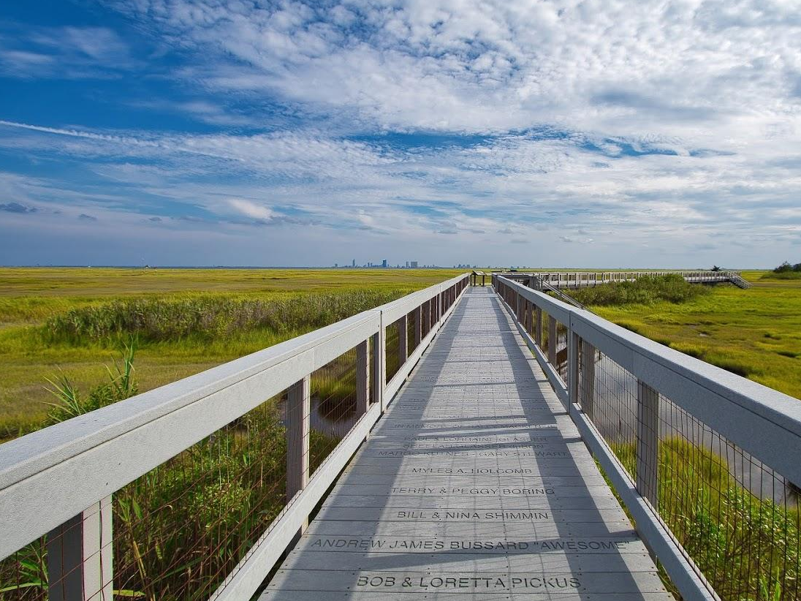
Get the guide!
‹#›
Notes:
What is it? Way to synthesize expert opinion on a subject or question around which there is uncertainty due to insufficient or unattainable science or data Iterative, weight of evidence approach to reaching general agreement, though not necessarily unanimity, around science-based recommendations for resource management Adaptable process that can be approached with different levels of rigor, depending on the situation at hand
When to go FAST:
When science-based solutions are needed, but available data and science is vague or insufficient When a question that could be addressed with intensive site specific original research, but you lack the time and other resources When there are differences in expert opinion around the most appropriate solutions When you have access to professionals with the right expertise and enough time to help When you have sufficient resources (time, funding, and expertise) to make it all work
About FAST FAST was modeled after Protocol for the Development, Review, and Approval of Loading and Effectiveness Estimates for Nutrient and Sediment Controls in the Chesapeake Bay Watershed Model, a process based on independent peer reviews at the National Academy of Sciences. It was refined as part of the Credit for Going Green project, which developed consensus-based recommendations to help New Hampshire stakeholders use restored or constructed buffers to meet pollution reduction targets in development, restoration projects, and others involving land use change.

Slide 7
Frame Your Question
Review Previous Work
Check in with Stakeholders
Look for case studies
Find a mentor
Secure the resources you need
Notes:
Consider your objective—timely, expert agreement on a solution to a critical, local resource management question. While FAST typically requires less time and money than new site specific research, it is not without cost. In this step, you’ll lay the table for an efficient collaboration that makes best use of previous work, ensures you are asking a question that really matters to stakeholders, and focuses your panel’s expertise appropriately.
Build on What You Know Review local work that has been done related to the management need you would like experts to address. Reserves typically have access to a wealth of knowledge about local management priorities, including needs assessments conducted by the NERRS, NOAA, Sea Grant, and other groups. Likewise, Reserve staff are often members of local professional networks or advisory committees that hold regular meetings or workshops focused on new and persistent management needs. Through these and other resources, can you confirm that there are persistent challenges related to the management need? What resources, scientific or otherwise, are reportedly lacking to address it? Is it impacted by new or existing regulations? Is it a high conflict issue? Your goal is to enrich your understanding of the issue and frame a draft question for experts to answer. The more specific your question, the more precise you can be when selecting experts. Check with Stakeholders No doubt framing your question involved some judgement. Before you go further, make sure you landed on a question for which stakeholders really need an answer. Which groups will use the solution the experts will generate? Touch base with a few representatives of these groups through a call, meeting, or focus group. Ask whether the question make sense as framed. How would they use the answer? Can they recommend thought leaders you should consult in your process? What related work is happening that the panel should know about? Refine your question with their input and save your notes for designing the process.
Find a Mentor Odds are your question is inherently complex and impacts many diverse stakeholders—this is coastal resource management after all! A mentor with experience convening panels related to your issue can help you anticipate thorny topics and decision points the panel will wrestle with. Look for case studies that illustrate how your question has been addressed in other places; this can help build credibility for your project.
Secure Resources
FAST does not mean cheap. Running a panel requires time and expertise, the cost of which varies depending on the rigor of your process, staff and skills you have in house, and what experts can contribute. At a minimum, staffing will include a panel chair who is a subject matter expert (two months); a project coordinator with strong group process skills (two to three months); someone who can channel local stakeholder needs (one month). You may also need a communication specialist to develop outreach products. You will need to convene up to eight virtual or face-to-face meetings and up to four advisory committee meetings. Be prepared to also offer an honorarium to panelists.
Going Green: Lessons Learned Our goal was to quantify the ability of buffers to reduce pollutant loads so communities could use this information to help meet New Hampshire’s regulatory standards for water quality. The need for this was identified by previous local initiatives. These included an assessment of community values related to buffers; a regional effort to track nonpoint source pollutants, and the issuance of a new state stormwater permit. We identified a mentor who had convened a panel to address a similar goal in the Chesapeake Bay region and worked with him to refine our approach and develop a proposal for funding. Some lessons learned along the way:
Even though our question was informed by an assessment of community values, it evolved with the input of regulators on our panel. As a result, the panel developed a solution that may not have been what communities initially wanted. For example, they may have hoped for regulatory credit for existing buffers, not restored or constructed buffers. Had we conducted a focus group with community representatives beforehand, we might have chosen a panel that was more firmly aligned with community needs.
Having a mentor was key. Ours provided examples of process tools and final products to give us a sense of what we were shooting for. He also helped us design a process that was flexible enough to manage forks in the road that would have been difficult to anticipate.
Referencing a successful case study was key. Ours demonstrated that experts could develop recommendations for calculating pollutant load reduction for green infrastructure that would be accepted by regulatory agencies and used by communities. This built confidence in our path and provided a reference as the panel’s conversation entered new waters. However, we also learned how important it was to be able to compare local contexts (for example, soil types) to those in the case study.
Expert panels require a lot of process support. This was noted when an early proposal for funding our project was rejected and was later corroborated by our mentor. We updated the next proposal to include someone to focus on group process and communications, leaving the chair to advance the technical thread of the conversation.
Tools and References
Projects that informed Going Green: Pollution Tracking and Accounting Pilot Program (PTAPP), Buffer Options for the Bay (BOB), general permit for stormwater discharges from Small Municipal Separate Storm Sewer Systems (MS4s) in New Hampshire.
Final Report: Protocol for the Development, Review, and Approval of Loading and Effectiveness Estimates for Nutrient and Sediment Controls in the Chesapeake Bay Watershed Model

Slide 8
Assemble the team
Form the Core
Convene Your Advisors
Recruit the Panel
Notes:
FAST engages three groups with mutually supporting responsibilities: a small core team that is responsible for getting the work done, an advisory committee that provides input throughout the project, and an expert panel that makes recommendations to address your management question. In this step, you’ll select people with the appropriate skills and organizational affiliations for each group—this is critical to the success of your project!
Form the Core The core team drives FAST. They provide overall vision and guidance, shepherd the panel’s deliberations, engage the advisory committee, develop products to share panel recommendations, and conduct outreach to make this information accessible to stakeholders. At a minimum, the core should include a subject matter expert who is willing to serve as panel chair and a group process professional who can support the chair during and between panel meetings. Additional desirable skills sets include communications (to support product development) and the ability to channel the perspectives of intended users. We recommend the core be as lean and nimble as possible! Second Gear: Convene Your Advisors The advisory committee is the sounding board for the core team. At the start of the process, the committee offers input on the management question, suggests panelists, and recommends literature for the preliminary review. They may provide input during the panel’s deliberations, however, it’s best to leave this up to the panelists. It may be easier for them to be candid if they know their conversations are confidential until they are ready to share them. Ultimately, the committee provides input the utility of panel recommendations and how to package them for wider dissemination. Hopefully, they will serve as ambassadors for the recommendations. The advisory committee should include intended users of panel decisions and representatives of important stakeholder groups. Develop a solicitation for your advisory committee that clearly lays out the goals of the project, their role in relation to the panel, and their time commitment. Recruit the Panel The six to eight-person expert panel makes science-based recommendations to address the management question. Selecting panelists could be the most significant step of the FAST process. Not only is it critical to have the right expertise in the mix, it’s important to choose people who understand the management needs behind the question and work well with others. Be sincere about why you need their expertise; don’t waste their time just to be inclusive! Depending on the rigor of your process, panel participation could take two weeks of their time. Develop a solicitation to explain the panel’s purpose, time commitment, the type of expertise needed, and whether you are able to offer an honorarium.

Slide 9
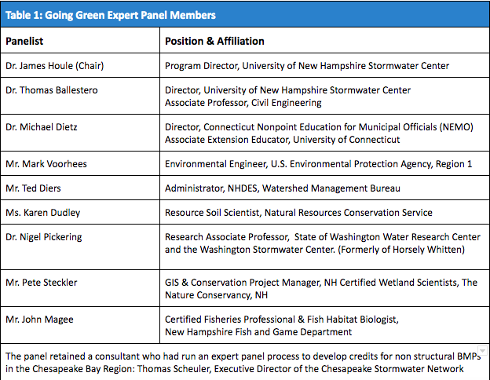

Slide 10
Sustain Momentum
Get Organized
Compile the Science
Keep Moving forward
Notes:
The name notwithstanding, FAST can feel more like a marathon than a sprint. You are asking experts from different disciplines to come to agreement on a solution for which the science is uncertain or insufficient. Progress will not always be linear, and you may have to revisit previous decisions as group understanding evolves. To shepherd the panel toward the goal, you need to be patient, persistent, flexible and above all, prepared. Get Organized Getting organized will help the panel (and you) focus on what’s really essential to meet your goal. Start by developing a draft charter that includes the panelists’ charge (to address your management question), a timeline with milestones, a process for decision making, and how panelists will communicate files and ideas in between meetings. Before the first meeting, ask the panelists to review the charter. Then revise it with their input when you meet. Some things to consider as you write up the charter:
How many meetings are really needed to cover the issue? What’s reasonable to ask panelists to commit to?
When possible, hold face-to-face meetings, this builds camaraderie and familiarity.
Spell out best practices you plan to follow, e.g., recognizing the validity of differing points of view and listening intently to understand others’ views.
Propose a decision making process that ensures that opposing points of view are respectfully discussed and supports a path toward agreement.
Select a platform that supports group file development, sharing, revision, and storage. Plan to have a “panel only” folder for meeting notes, and agendas during the process.
Compile the Science
The chair should establish a shared foundation of knowledge by conducting a scaled review of scientific literature before the first panel meeting. The goal is to compile locally relevant science that will support the decisions the panel will have to make. Be ready to drill down into existing literature reviews to identify specific publications of interest. Ask your advisory committee and mentor to suggest literature and help you identify specific topics around which to organize the review. One of the panel’s first tasks will be to read your review, decide whether it is sufficient to proceed with the process, and suggest additional citations to consider. This review will evolve throughout your process. Ultimately, it will support the panel’s final recommendations.
Keep Moving Forward
It’s critical to give the panel real work to do and decisions to make. The chair and process support person should work together to develop agendas for directional meetings that tee up assumptions and decision points for panelists to discuss in real time. Be sure to take good notes, or even better, record and transcribe meetings. You’ll need them to keep the conversation moving forward and when you develop the final panel recommendations. The panel may not get to a decision you had hoped they would make in a meeting—they may even revisit past decisions as new information is presented for group consideration. That’s okay! The important thing is to support them in continuing to exchange ideas and opinions in real time.
The time between meetings is often just as important to decision making. Leverage it by asking panelists to review and approve notes from the previous meeting, confirm whether decisions were really made, indicate whether further discussion is needed, or take on discrete tasks like finding additional literature. An online survey tool like survey monkey or google forms is a great way to capture this information. Use survey results to design the next agenda and send it to panelists at least a week in advance, along with all the survey responses. Ask them to be prepared to speak to their survey comments at the next meeting. Going Green: Lessons Learned Our project took three months longer to accomplish and more staff hours than initially anticipated, in part due to the complexity of the science and regulatory framework surrounding a buffer’s ability to mitigate nonpoint source pollution. The many physical factors that influence buffer performance are interdependent, which often made it difficult to decide which to address and in what order. Fortunately, our panelists were patient and respectful of each other and the process as it evolved. Some lessons we learned along the way:
Having a chair who was well-respected and was perceived as neutral was key. He conducted a preliminary analysis of the literature that gave the panel a common starting place, confirmed there was enough science for crediting, and helped framed initial discussions. That review helped him put forward strawmen for group decisions and work constructively with panelists.
While there are challenges associated with every online collaboration platform, we found google drive to be generally effective for file sharing, storage, and document development. Locking down previous drafts of reports and other work products so people don’t accidentally comment on them is important.
Our panel chose not to seek input from the advisory committee during their process. However, we did send out a few updates to keep the committee abreast of panel progress. In retrospect, checking in on the proposed solution with the committee may have led to recommendations that were closely aligned with community needs.
The Center for Leadership’s Continuum of Consensus was an excellent tool to support decision making during and between meetings. It gave panelists a range of options that kept us moving forward, i.e, to endorse a recommendation, agree with reservations, disagree but stand aside, hold and demand more work, or not agree and therefore stop the decision.
Getting to clear decisions is challenging when the subject so complex. Often it would not happen during a discussion. As a result, we used between meeting notes review and group surveys to confirm decisions or indicate more discussion was needed. All of this was accessible on google drive so panelists had a bread crumb trail to past decisions and could see how their input was influencing future agendas.
Our core team relied on a progress log to stay in touch and engaged in the project. We updated the log when a significant chunk of work was done, when we needed input from each other, and to record notes. This made it easier to plan panel meetings and make reports to our funder.
A survey toward the end of the panel indicated that panelists were generally satisfied with the process and would recommend it for other management questions, including permitting rules, street cleaning, leaf litter management, and standards for inspections and verification during and post BMP construction.
Tools
Panel Charter
Initial Literature Review
Center for Leadership and Organizational Change Continuum of Consensus
Sample between meeting survey Sample agenda & prep
Sample panel meeting powerpoint

Slide 11
Notes:
The Center for Leadership’s Continuum of Consensus was an excellent tool to support decision making during and between meetings. It gave panelists a range of options that kept us moving forward, i.e, to endorse a recommendation, agree with reservations, disagree but stand aside, hold and demand more work, or not agree and therefore stop the decision.

Slide 12
Take It On the Road
Develop recommendations
Advisory committee check in
Wrap it up and roll it out
Notes:
In this final phase, you will work with the panel to synthesize recommendations and package them in a technical memorandum and/or a more comprehensive final report. You will vet these with the advisory committee and solicit their input on how best to package and share them with intended users of results. Last, you will get the panel’s final approval to begin your outreach.
Developing Recommendations When it’s time to develop draft recommendations for panel review, you’ll be glad you kept good notes and a record of past decisions! These not only will support the synthesis, they will help you field input from panelists.
Start by considering your audience—who will use these recommendations in their work? Package the recommendations into a technical memorandum that includes information that will build credibility and makes it easier for this audience to use them. This could include a synopsis of panel expertise and key decisions, a glossary of relevant terms, and examples of how the recommendations could be used. In some cases, for example when the recommendations influence regulatory compliance, you may also need to create a final report that includes more information about the panel process and the local contexts that motivated the process. Share the draft with your panel for preliminary review. Be prepared for them to want to re-open old ideas and decisions—getting everything down in writing has a way of identifying topics that people were uncertain about or interpreted differently. You may need to hold an additional meeting to discuss substantial changes. When the chair is reasonably assured of general agreement by the panel, it’s time to put your advisory committee to work.
Advisory Committee Check In
Share the draft technical memorandum with your advisory committee and convene a meeting to discuss it. As you plan the agenda, allow time to provide an overview of the process and the recommendations and leave plenty of time for questions. Consider including a focus group-style component that allows each committee member discuss the relevance of the recommendations to his or her work and what additional information or communications products would be useful. Record or keep good notes, not only to support your decisions to develop products, but also to create messages that will support your outreach to different audiences.
Wrap it Up & Roll it Out
Review the technical memorandum with your advisory committee’s input in mind. Will additional information make it more clear or accurate? Language that needs to be translated to make it more accessible? Make final changes and circulate it to your panel for final review and approval. If any significant changes were suggested by the committee, be sure to flag them for panelists.
While the report is under review, develop an outreach plan. Consider not only the primary audience for the technical memorandum, but other groups who should be aware of the recommendations because they may be in a position to influence their use. As you think about how best to reach them, consider working through existing professional networks, piggybacking on meetings that are already planned, or presenting at local conferences. Depending on the audiences you have to reach, you may have to create different communications products, for example, non technical summaries, illustrative graphics, or a variety of slide decks.
Going Green Lessons Learned
We were fortunate to have a thoughtful advisory committee for provided excellent feedback on our technical memorandum and creative ideas on how to share the panel’s recommendations. There was interest in exploring whether the results could be applied in other New England states and using the FAST process to address other issues.
Tools
Technical memorandum Final Report Non technical summary
Panel Process Overview
Powerpoint Deck

Slide 13
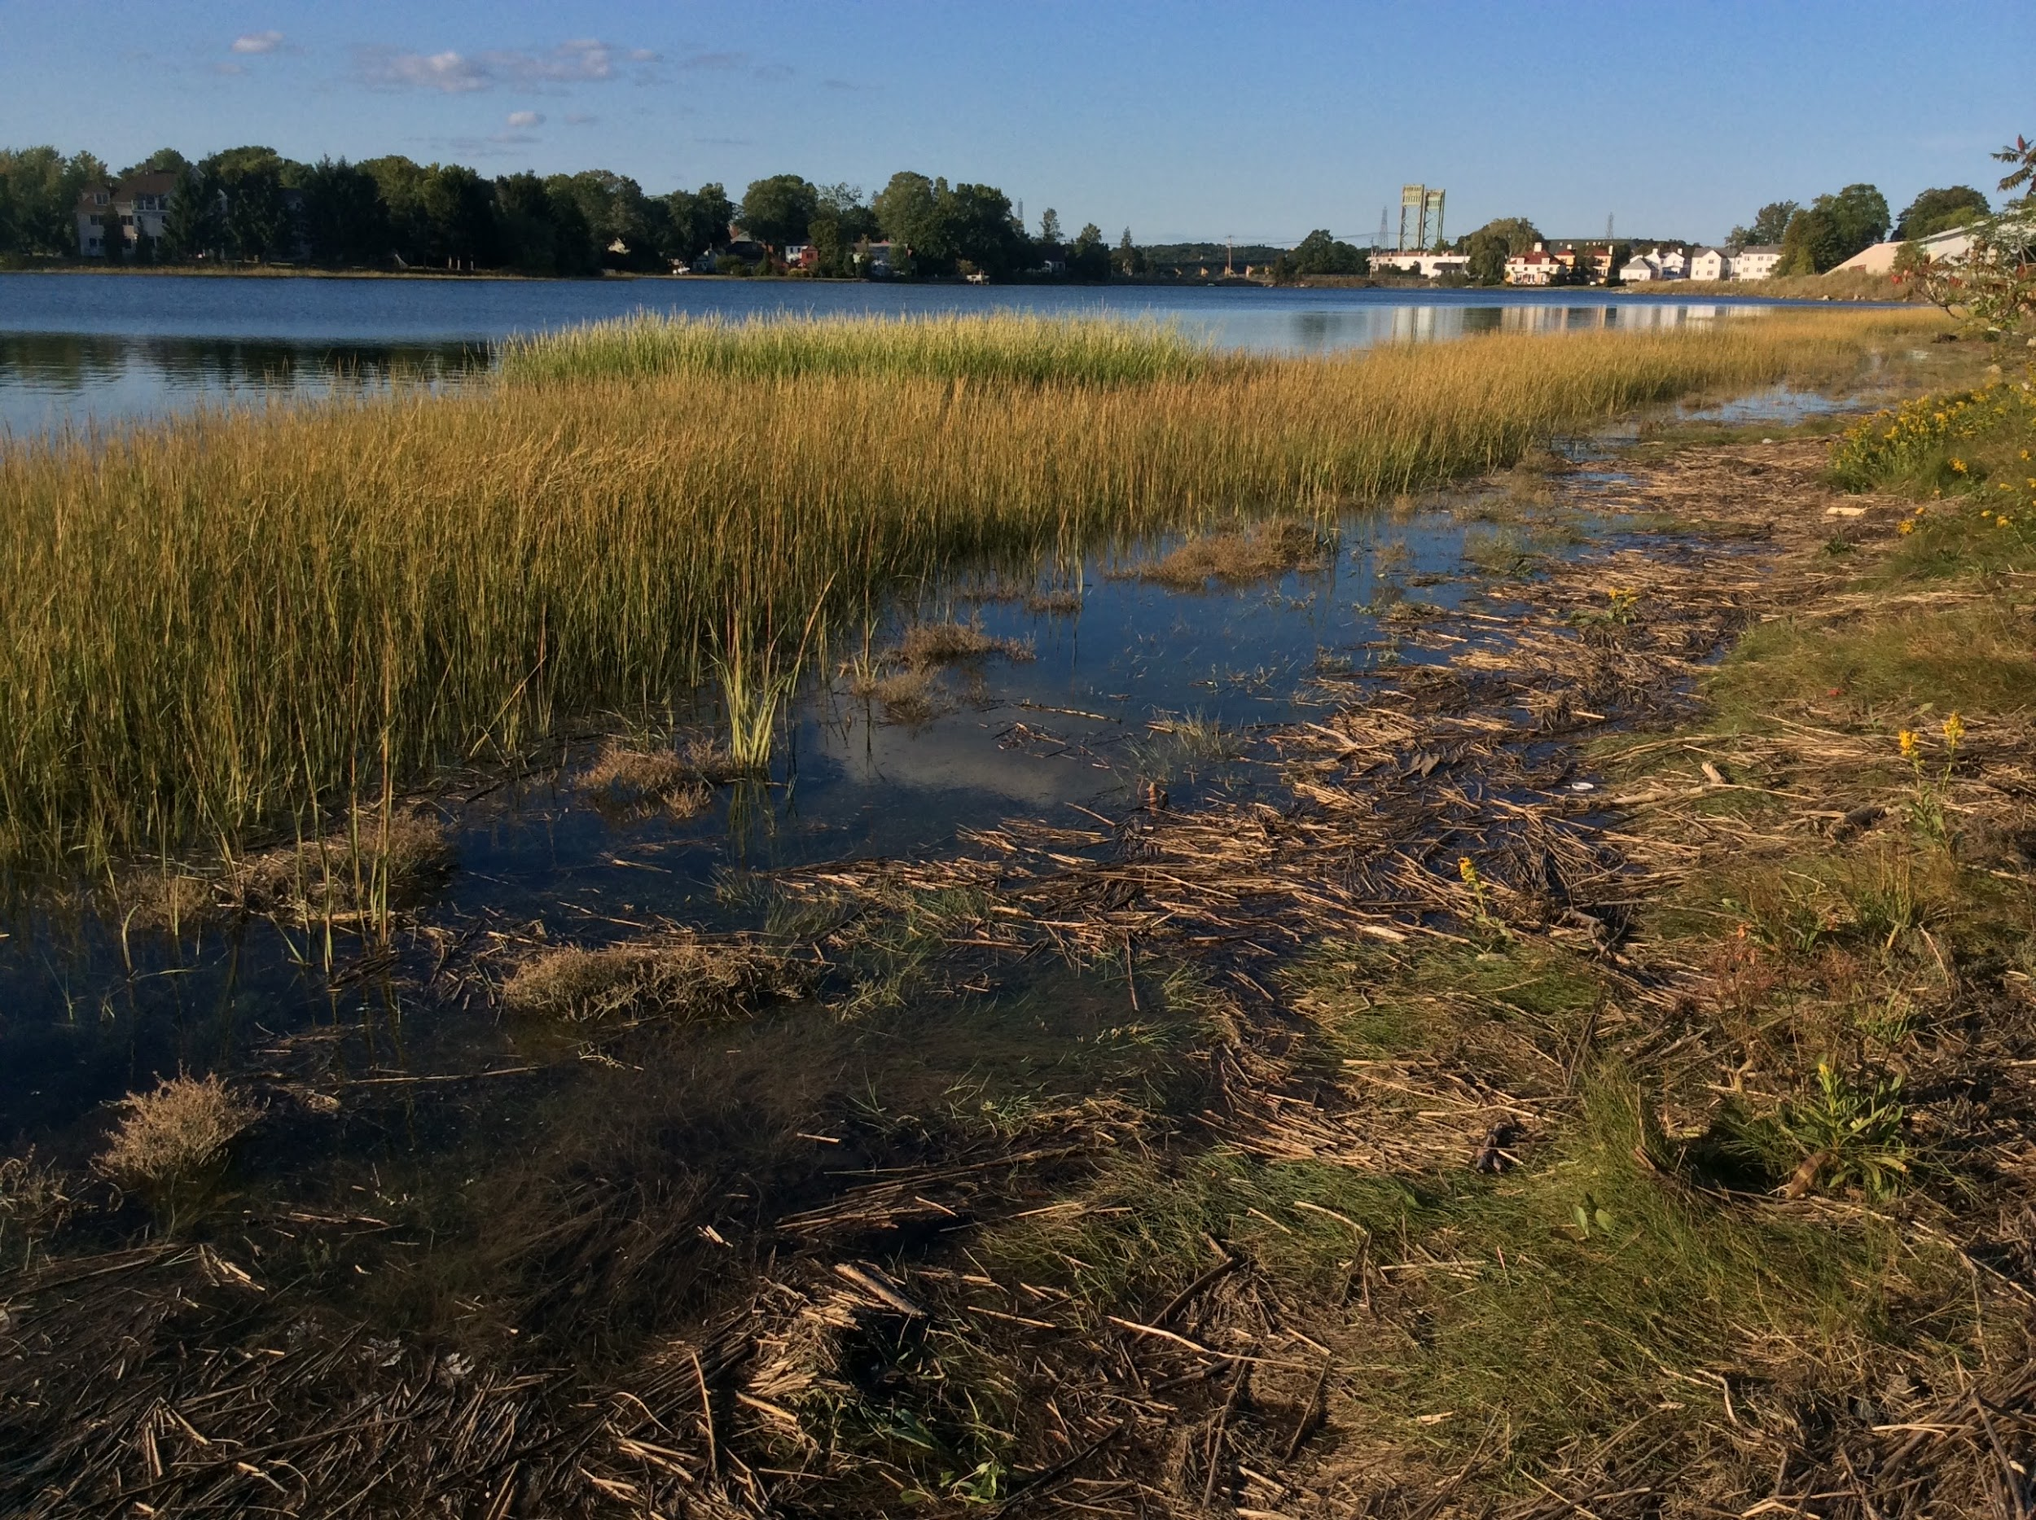
About the Panel Recommendations
‹#›

Slide 14
Key Terms
Removal Efficiency (RE): Buffer capacity to remove total nitrogen (TN), total suspended solids (TSS), & total phosphorus (TP)
Performance: Buffer’s ability to remove TN, TSS, and/or TP.
Credit: Estimated pollutant load reduction given for the use of buffers in regulatory permits issued for redevelopment projects under the NPDES Stormwater Permit Program and other efforts to manage stormwater
Penalty: Reduction in credit (from the total possible) that a buffer can receive. It reflects the impact of different conditions on the buffer’s ability to remove TN, TSS, and/or TP.
Notes:
Time to discuss your Reserve’s role in advocacy and how Friends can help.

Slide 15
Key Decisions
What Gets Credit Restored or constructed buffers in development, redevelopment, restoration & other projects involving land use change.
Optimal Buffer Condition for Credit Forested buffer with a width of 100 feet can achieve maximum removal efficiency values. Deviations from this condition result in penalties that reflect lower performance expectations.
Minimally Acceptable Buffer Width for Credit 20 feet—Narrower buffers, while valuable, will not receive credit.

Slide 16
Key Decisions
Grassed Buffers Receive a 20% reduction (penalty) in performance based on the Chesapeake values for nitrogen for grassed buffers (Lowrance 1998, Mayer et al. 2005). HSGs and Sediment and Phosphorus Removal
As hydrologic soil groups (HSGs) assist in pollutant reduction through infiltration, HSG A soils receive the maximum credit for total suspended solids and phosphorus removals.
HSGs and Nitrogen Removal As total nitrogen performance is enhanced by depth to ground water, removal efficiencies for nitrogen are inversely proportional to those for TSS and TP, i.e,, HSGs that are best for TN removal (HSG D) are the opposite of those that are optimal for TSS and TP removal (HSG A).
Notes:
Time to discuss your Reserve’s role in advocacy and how Friends can help.

Slide 17
Key Decisions
Contributing Area, Land Use, Impervious Cover, and Pollutant Loading
Contributing area is the amount of land that could generate runoff to the buffer. In a retrofit, this can include the buffer. The amount of contributing area (not including the buffer) that can be used to calculate pollutant loading is limited by the land use and impervious cover (IC). This is because pollutant loading depends on distributed, rather than concentrated, flow conditions. Concentrated flows create channels that decrease a buffer’s capacity for pollutant removal. Theoretically, the denser the IC, the more quickly concentrated flow occurs. As a result, the length of the contributing area that can be used to calculate pollutant loading decreases. TN and TP load export rates used here come from values developed by EPA Region 1 for the 2017 NH MS4 permit.
Notes:
Time to discuss your Reserve’s role in advocacy and how Friends can help.

Slide 18
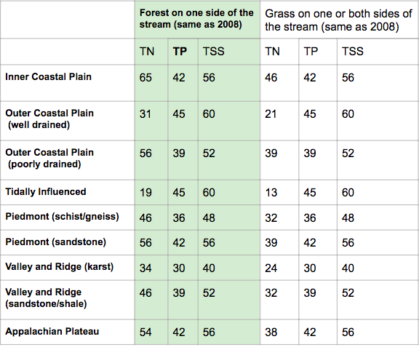
Chesapeake Bay Pollutant Removal Efficiencies for Buffers By Geology (source)

Slide 19
Performance Curves

Slide 20
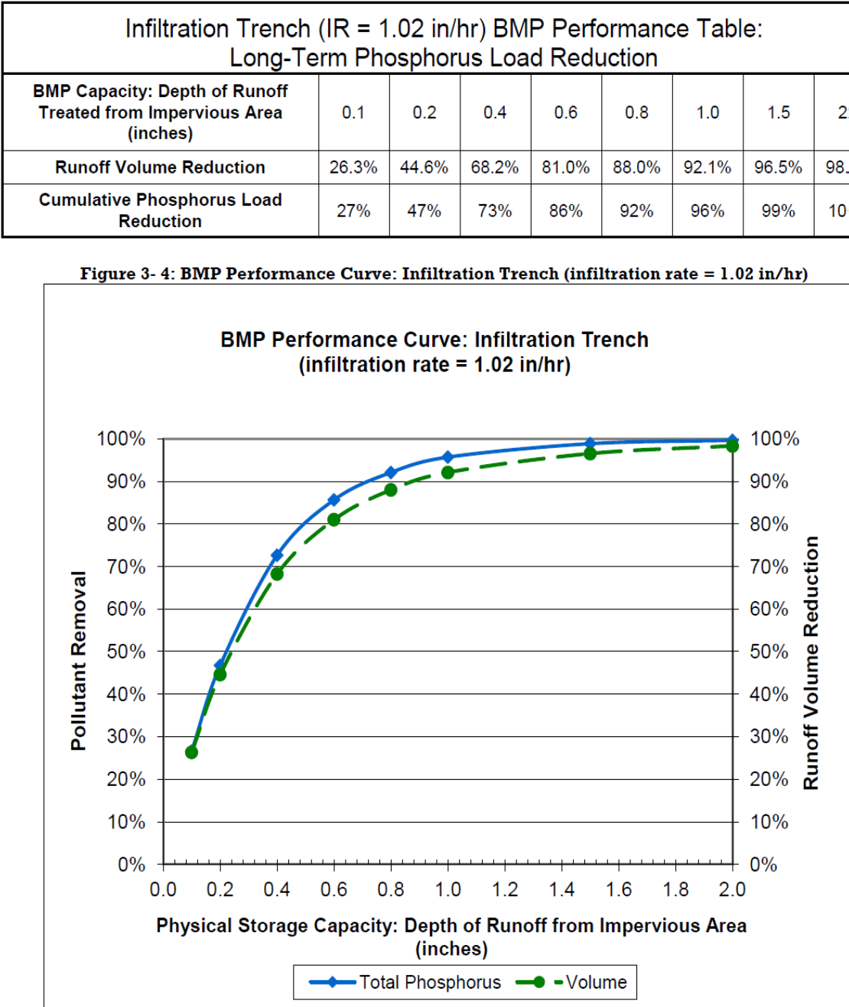
Design
Guidance

Slide 21
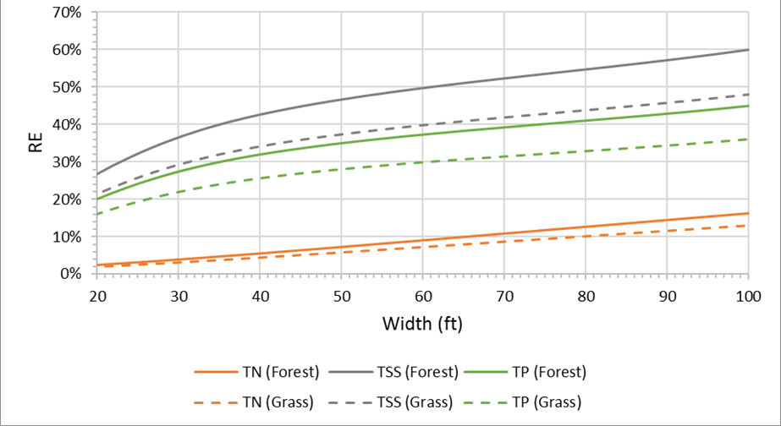
Removal Curves: Hydrologic Soil Group A

Slide 22
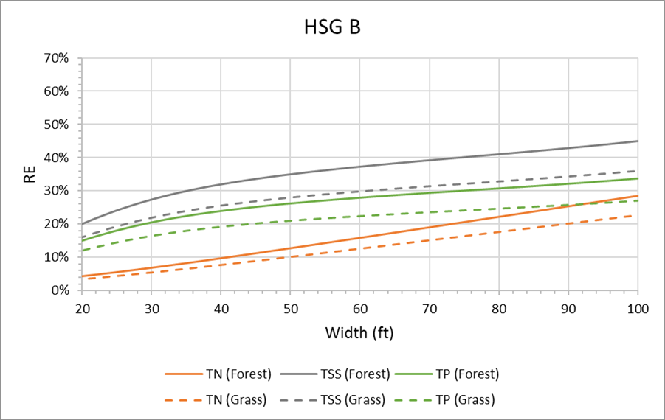
Removal Curves: Hydrologic Soil Group B

Slide 23
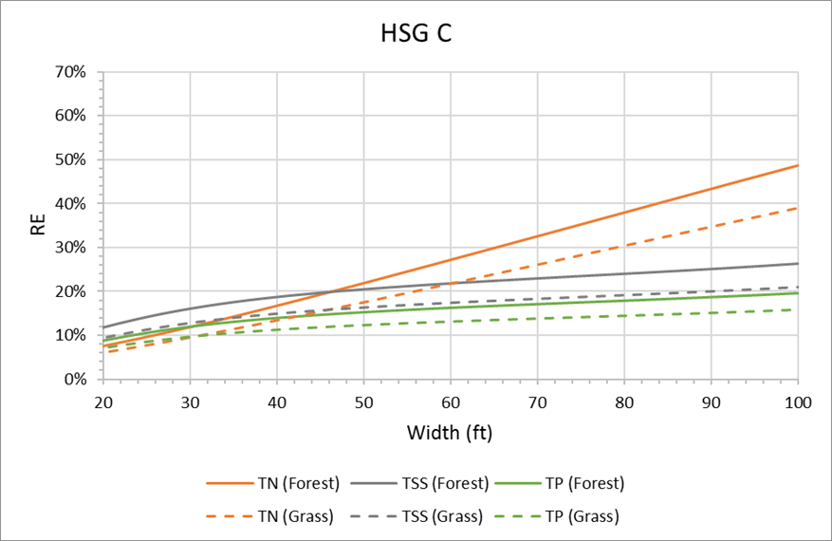
Removal Curves: Hydrologic Soil Group C

Slide 24
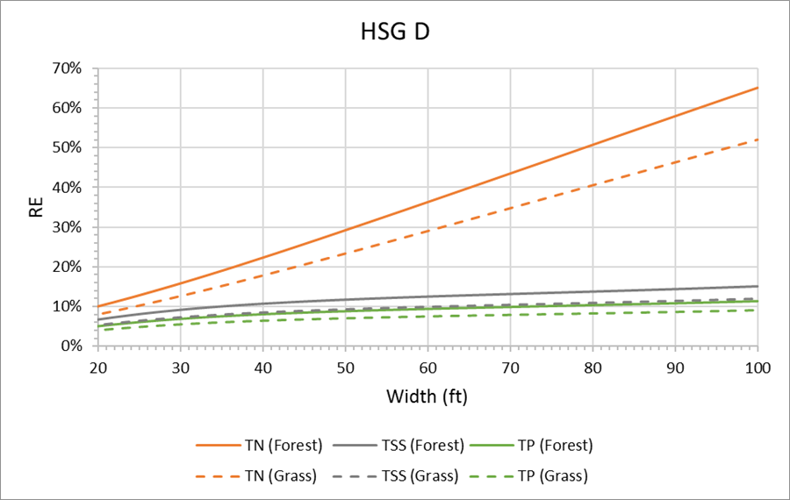
Removal Curves: Hydrologic Soil Group D

Slide 25
Land Use Categories & Pollutant Load Export Rates

Slide 26
Performance Multiplier Based on Slopes up to 15%

Slide 27
When to Use the Curves
Development, redevelopment, & restoration
Ordinances related to buffers
Watershed management planning
Nitrogen management budget
Notes:
This tool is appropriate for land use change projects that
require regulatory permits issued under the NPDES
Stormwater Permit Program for New Hampshire’s MS4
communities. It can be applied in situations in which a
community needs credit for its MS4 permit and there are
opportunities for buffer restoration or construction. It can
also be used to calculate the pollutant load reduction
service from an existing buffer if that information is of
interest to the landowner. This tool cannot be used to
receive credit for existing buffers. It also cannot be
applied to restored or constructed buffers that are
narrower than 20 feet or those on slopes steeper than
15%. Nor can it be used to get additional credit for buffers
wider than 100 feet. However, there is extensive scientific
support for the conclusion that wider buffers support a
variety of other services.

Slide 28
What the Curves Can’t Address
Buffers Wider Than 100 Feet (Although these have great value!)
Buffers Narrower Than 20 Feet
Slopes Steeper Than 15%
Notes:
The panel did not have access to sufficient data or science to support recommendations for calculating removal efficiencies for buffers wider than 100 feet. However, there is extensive scientific support for the conclusion that wider buffers support a variety of services beyond pollutant removal, including the provision of wildlife habitat, flood and storm surge protection, stream migration, and nutrient cycling. The Buffer Options for the Bay (BOB) Project synthesized this science in their Coastal Science Literature Review.
Buffers narrower than 20 feet: While the panel decided the y-intercept of performance curves would occur at a buffer width of 0 feet, they determined the removal efficiency credit would begin at a minimum width of 20 feet. Narrower buffers, while valuable, will not receive credit.
Slopes steeper than 15%: The performance curves are applicable to contributing areas with slopes of up to 5%. To calculate buffer removal efficiency for slopes between 5 and 15%, the panel agreed upon multipliers outlined in Table 3 below. For slopes beyond 15%, there are no recommended removal efficiency curves.

Slide 29
Questions?

