Slide 1
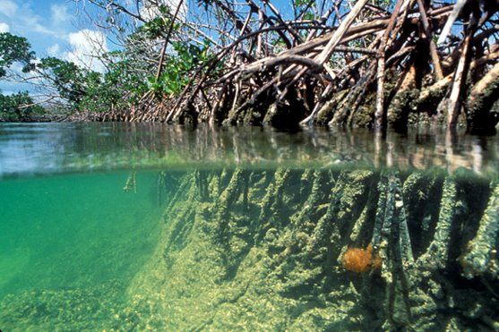
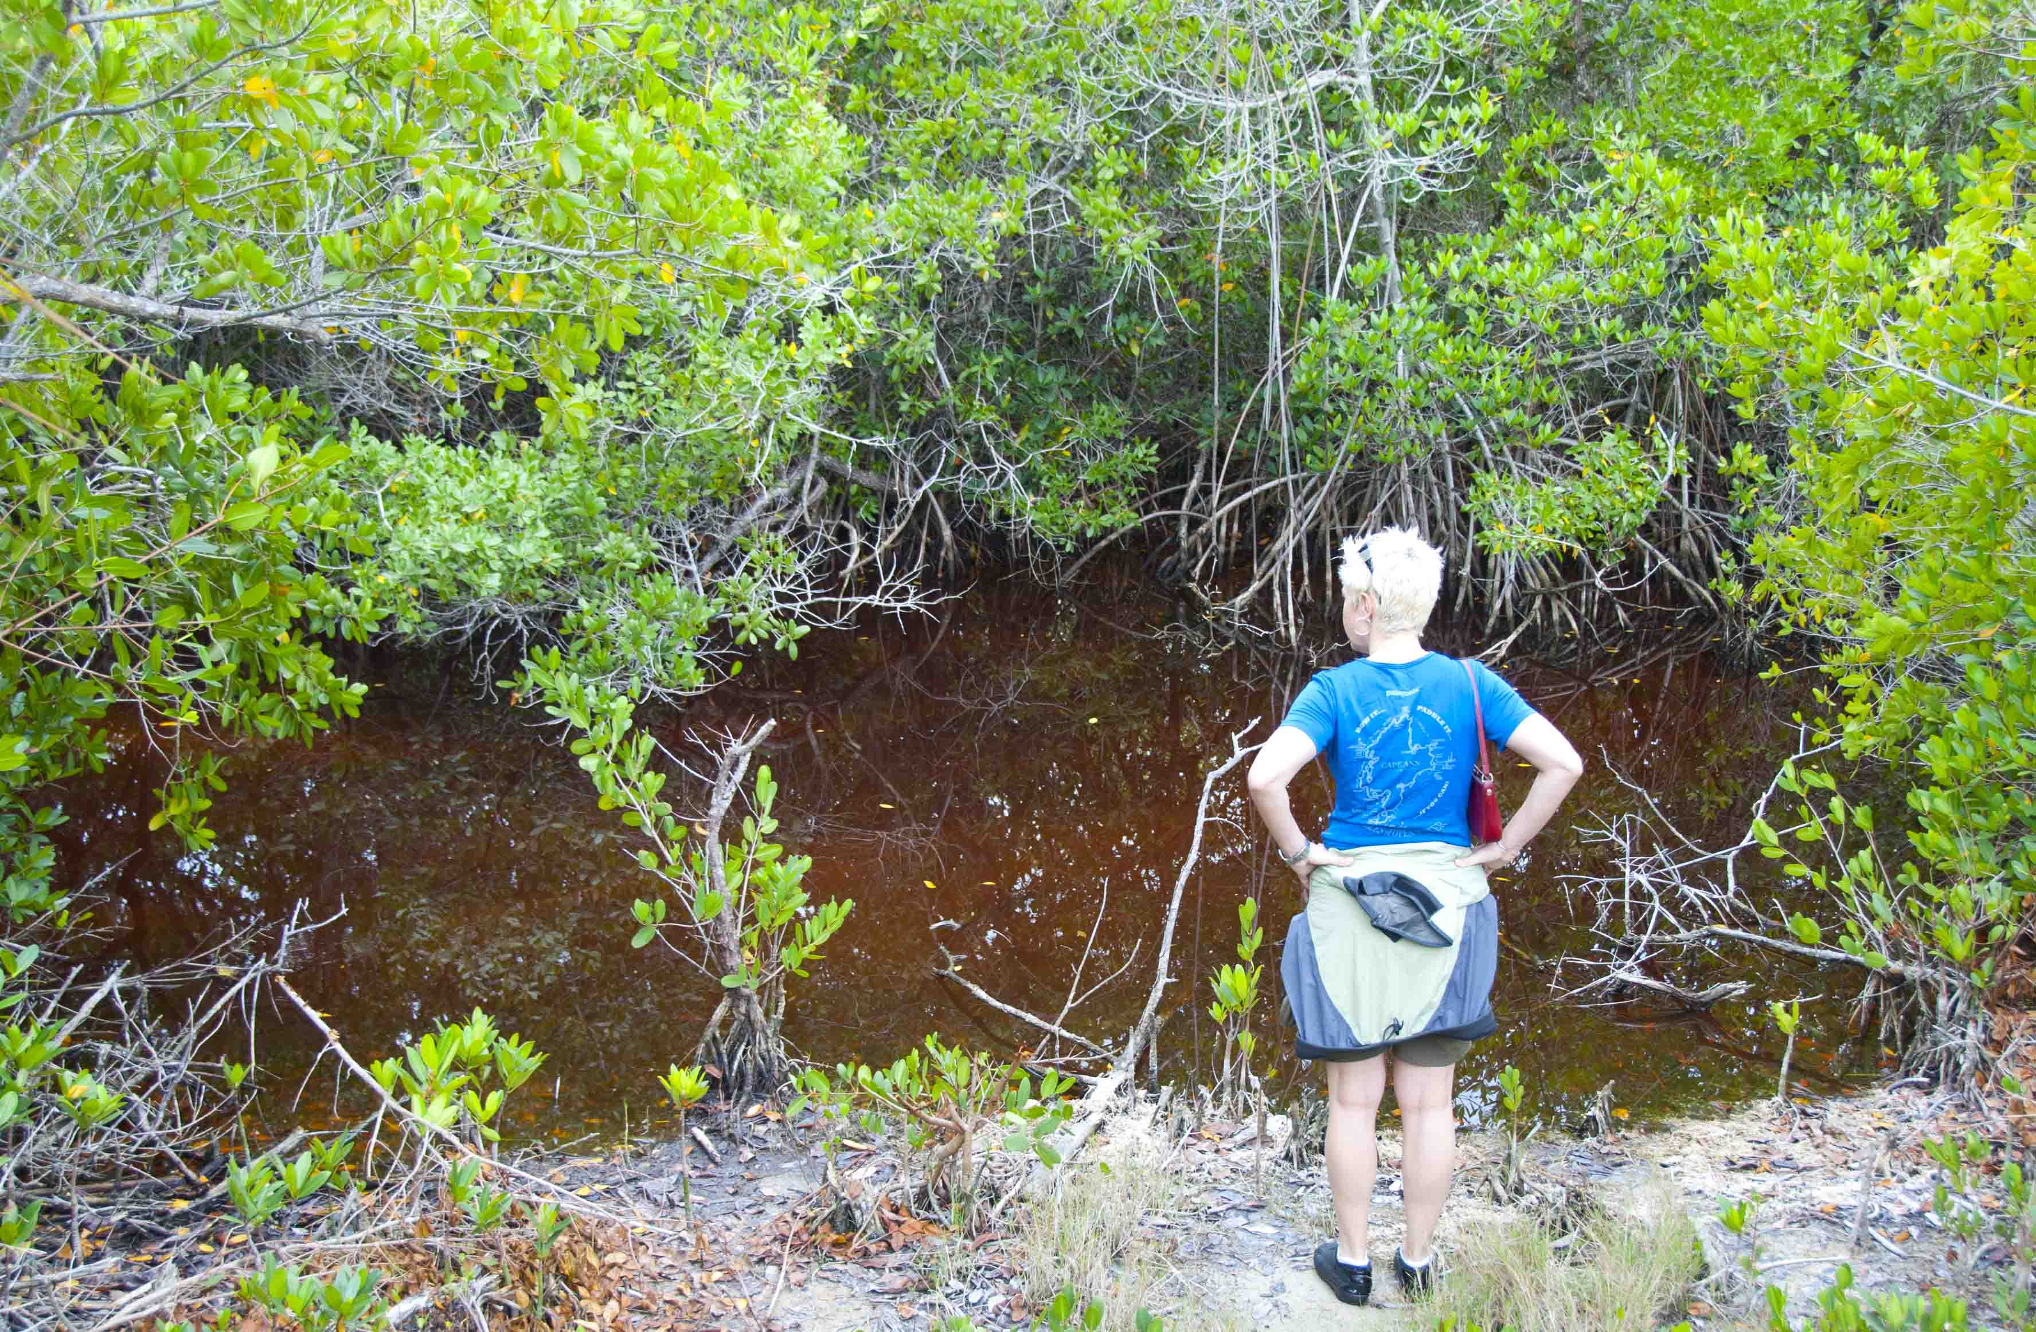
MANGROVE ECOSYSTEM SERVICES
Notes:
Top image: by Unknown author is licensed under CC BY-NC.
Bottom image: by Unknown Author is licensed under CC BY-NC-ND

Slide 2
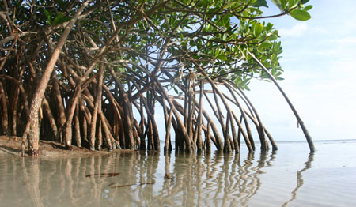
Contents
Introduction and Background
Ecosystem Services
Mangrove Services
Assessments
Monitoring
Mapping
Mangrove ESCMs
Discussion
Notes:
Image: This Photo by Unknown Author is licensed under CC BY-NC-ND

Slide 3
Introduction and Background
Mangrove Ecosystems
Once common, but have since declined mostly due to human activities
Integral to human and wildlife prosperity
Recent push to increase standardization, efficiency, and consistency in restoration efforts
Hugely important to shoreline protection and stabilization
Notes:
Image: https://www.fisheries.noaa.gov/feature-story/noaa-seeks-applications-community-based-habitat-restoration-project-funding

Slide 4
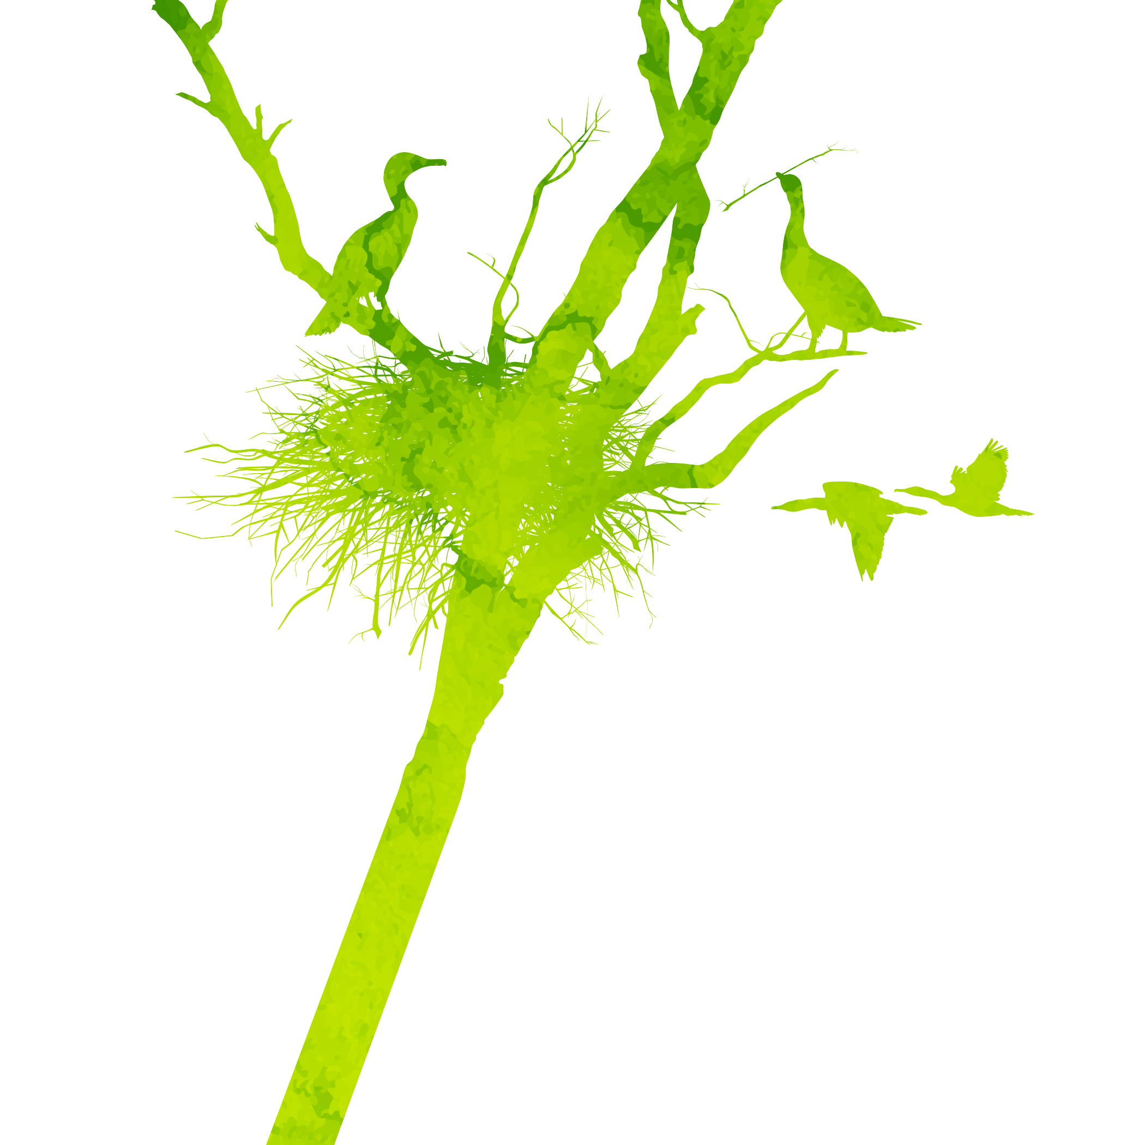
Ecosystem Services (AKA Nature’s Benefits)
Provisioning
Regulating
Cultural
Direct products obtained from nature. Food, materials, etc.
Services nature provides that regulate the wider environment. E.g. water filtering
Indirect benefits that enrich lives. Recreation, species of importance, etc.
Supporting
Indirect services that enable other services to function, such as nutrient cycling.
Notes:
Images-creative commons (licensed under CC BY-NC-ND)

Slide 5
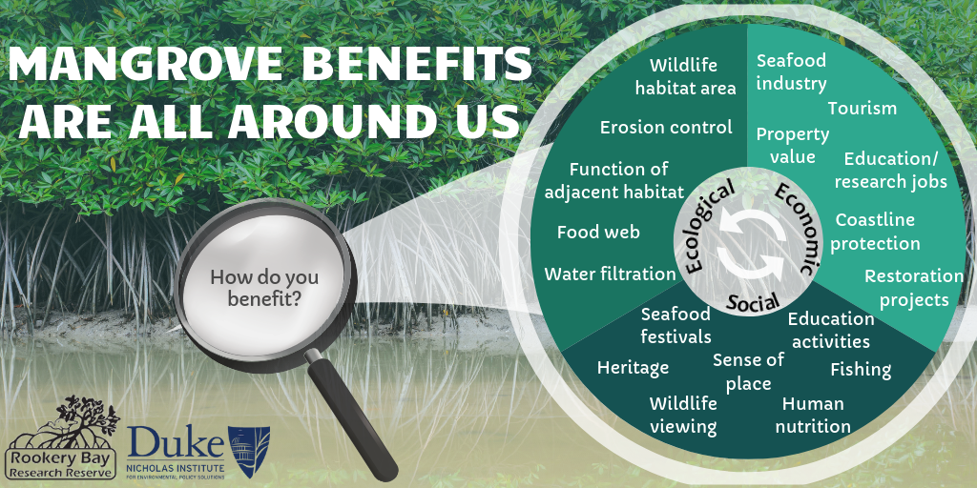

Slide 6
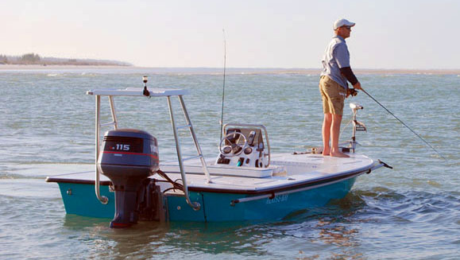
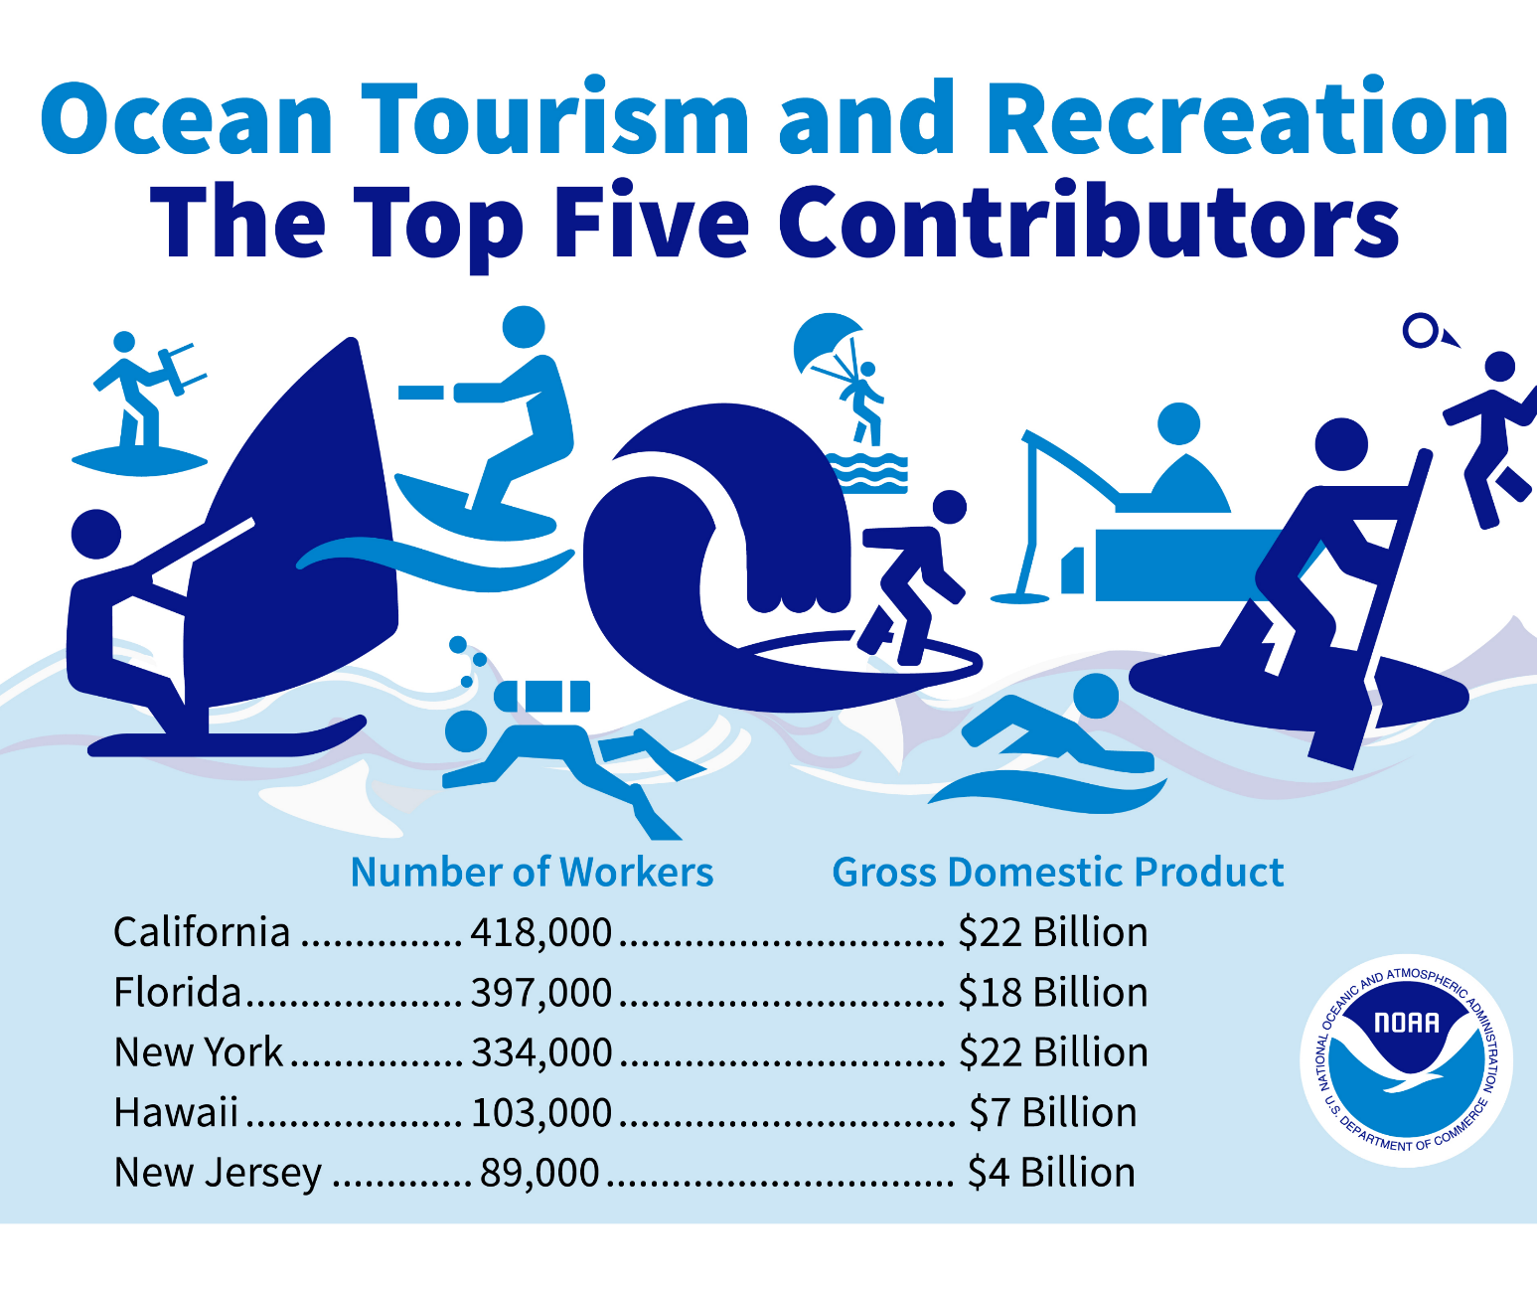
Economic Benefits
One study estimated the total economic value of mangroves at $181 billion¹
Mangroves protect species that are the basis of a $7.6 billion seafood industry, which employs 109,000 people in Florida²
In 2018, 126.1 million people visited Florida, a new record. The tourism industry has an economic impact of $67 billion on Florida's economy³
¹Sarhan, Mahmoud & Tawfik, Rady. (2018). The Economic Valuation of Mangrove Forest Ecosystem Services: Implications for Protected Area Conservation.
²Florida Department of Environmental Protection. (2016). Benefits of Mangroves.
³VisitFlorida. (2018). Research, Estimates of Visitors to Florida.
Notes:
Image: https://rookerybay.org/visit/environmental-learning-center/165-visit/explore-on-your-own/things-to-do/419-fishing.html

Slide 7
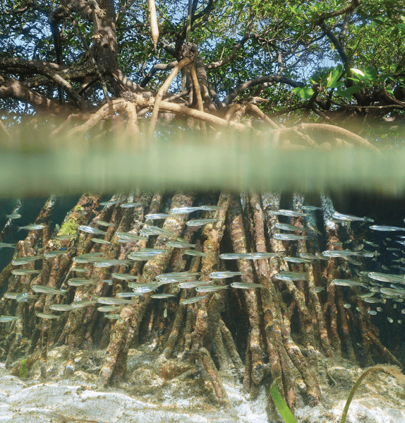
Natural Benefits
Mangrove ecosystems trap and cycle various organic materials, chemical elements and important nutrients.
Roots provide attachment surfaces for various marine organisms. Some filter water through their bodies and, in turn, trap and cycle nutrients.
Provide nursery area and food for a multitude of fish, crustaceans, and shellfish that are important to both commercial and recreational fisherman
Forest branches are rookeries, or nesting areas, for coastal birds
Wide fringes protect uplands from storm winds, waves and floods
Roots prevent erosion by stabilizing shorelines
Filter water and maintain water quality and clarity
Notes:
https://floridadep.gov/rcp/rcp/content/floridas-mangroves

Slide 8
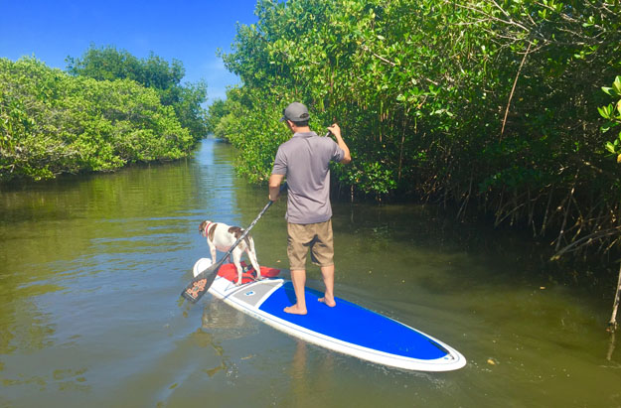
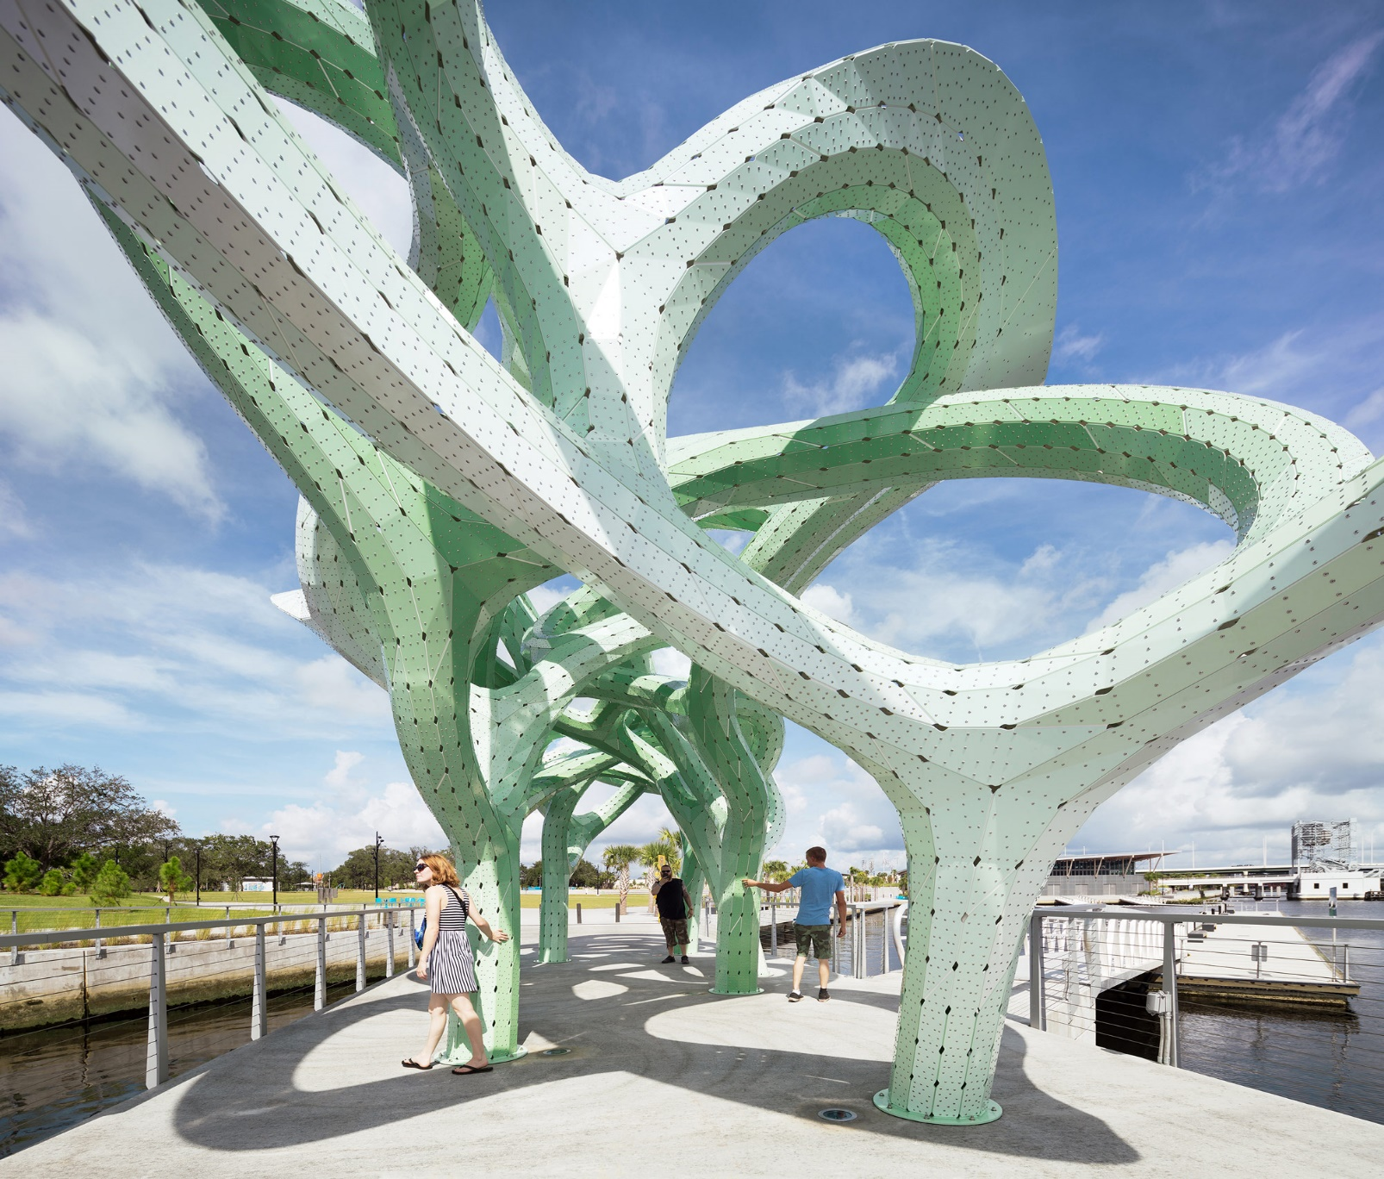
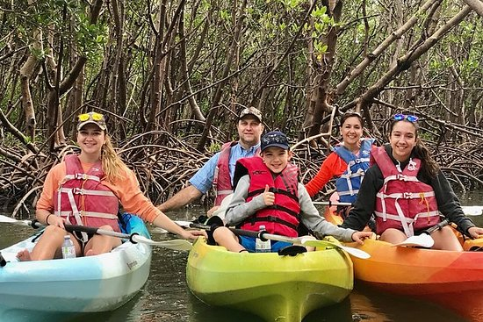
Social Benefits
Notes:
Kayakers: https://www.tripadvisor.com/Attractions-g34467-Activities-c61-t191-Naples_Florida.html
Paddle boarders: http://www.authenticflorida.com/articles/where-to-go/adventure-into-the-magical-world-of-florida-mangrove-tunnels/?back=articles
Art project inspired by FL mangroves: https://www.zerchoo.com/art-design/a-green-tinted-aluminum-canopy-inspired-by-floridas-mangrove-trees/

Slide 9
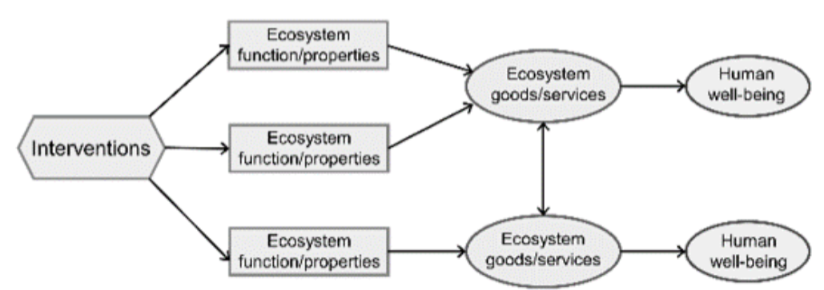
Service Mapping
Deliberate service mapping shows how mangrove restoration makes ecological changes which then result in changes to the social and ecological outcomes we care about.
Illustrates the way that a management intervention cascades through an ecological system to change ecosystem service and other human welfare impacts.
Ecosystem Services
General Models

Slide 10
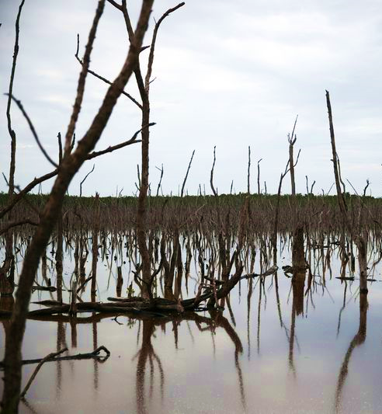
Mangrove Ecosystem Services Conceptual Models
Models can be used for transparency, stakeholder engagement, outreach, and anticipating co-benefits or unintended outcomes of management interventions.
Site-specific models can be used to facilitate understanding of the varied services that these ecosystems provide.
The models provide a framework for developing common ecosystem service metrics that will enable comparison across projects throughout the NERRS and beyond.
Fruit Farm Creek Naples, FL
Notes:
Image: https://www.orlandosentinel.com/news/breaking-news/os-ap-chinese-billionaire-florida-mangroves-20160117-story.html

Slide 11
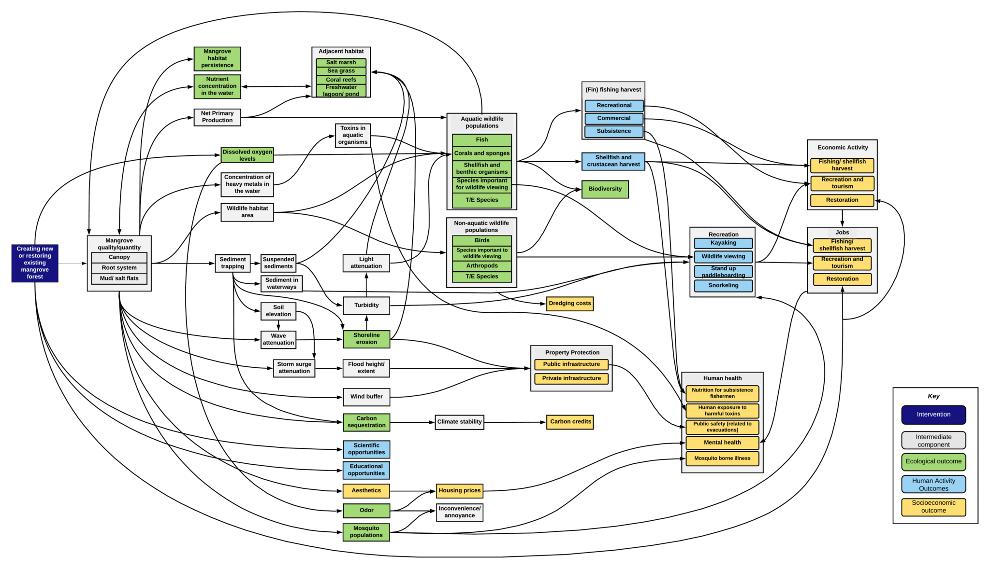
Mangrove Ecosystem Services Conceptual Model
Notes:
Completed model example

Slide 12
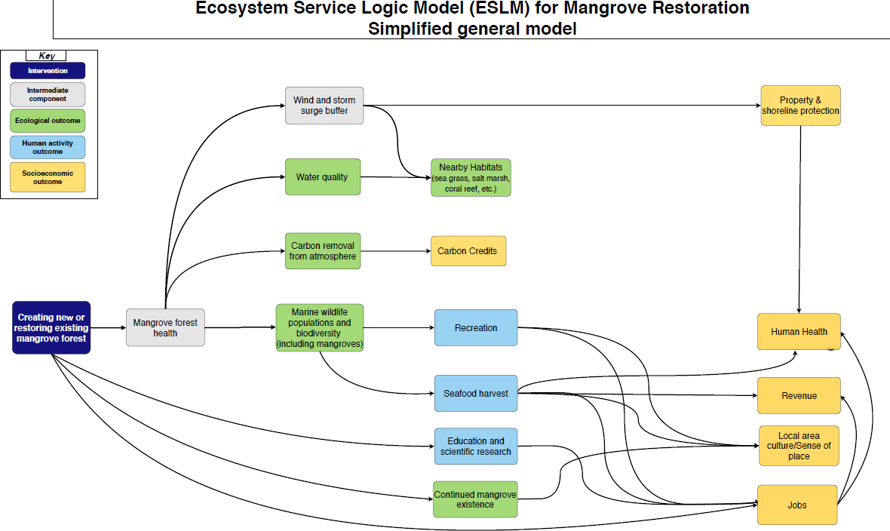
Mangrove Ecosystem Services Simplified Model
Notes:
Simplified model example

Slide 13
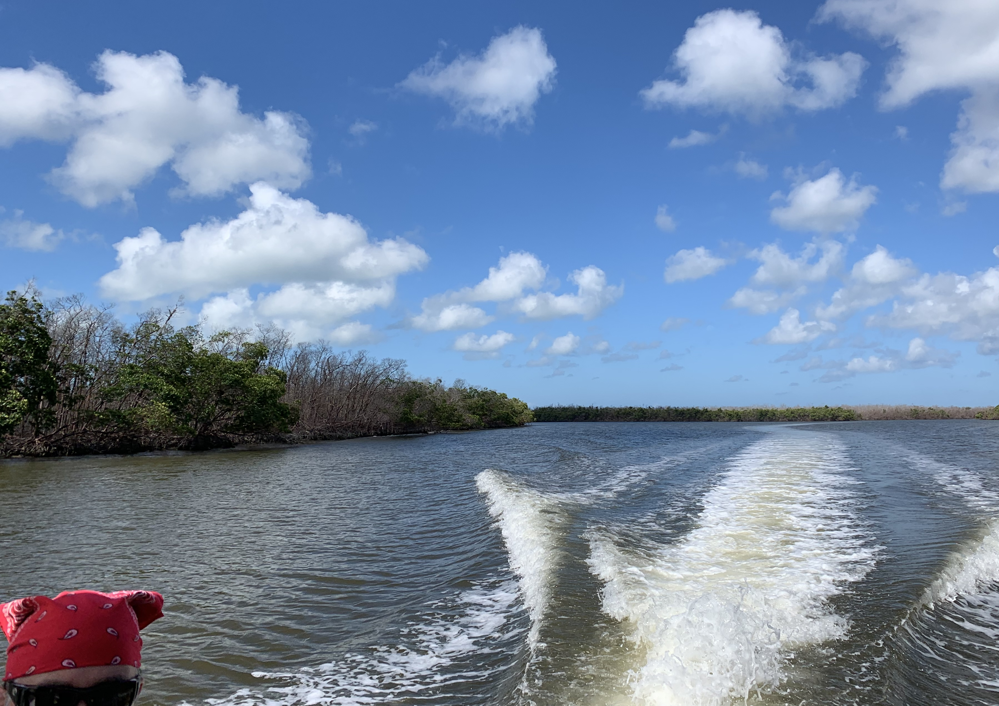
Discussion
Notes:
Image: https://www.trover.com/d/dZDq-rachel-carson-reserve-carteret-county-north-Carolina
Image: http://masonboro.blogspot.com/

