Slide 1
Stormwater
How rain and runoff impact our waterways
Notes:
Ask-- What is stormwater?
A-- stormwater is water in abnormal quantities that results from rain/snow
Key words: stormwater, runoff, pervious surface, impervious surface, infiltration, marine debris, point source pollution, nonpoint source pollution
Anna & Alaina’s stormwater lesson plan: https://drive.google.com/open?id=1poNkiaJncQvPKUeisHtuf1IFl-wBLUad

Slide 2
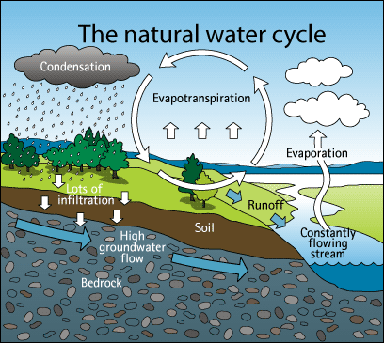
Notes:
How does the natural water cycle change with development?
Picture source: http://www.blueplanet.nsw.edu.au/year-7-and-8-natural-and-urban-water-cycles/.aspx

Slide 3
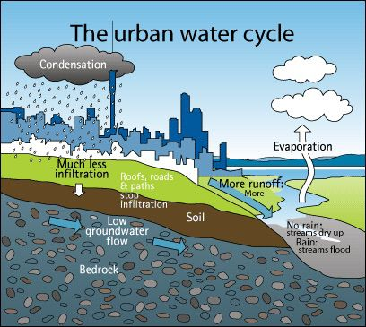
Notes:
We have actually altered our water cycle with development…
Q-- what is stormwater runoff?
A-- rainfall or snowmelt that flows over the ground surface. Created when rain falls on roads, driveways, parking lots, rooftops and other paved surfaces that do not allow water to soak into the ground
What are examples of impervious surfaces? -- roads, side walks, parking lots, roofs
Picture source: http://www.blueplanet.nsw.edu.au/year-7-and-8-natural-and-urban-water-cycles/.aspx

Slide 4
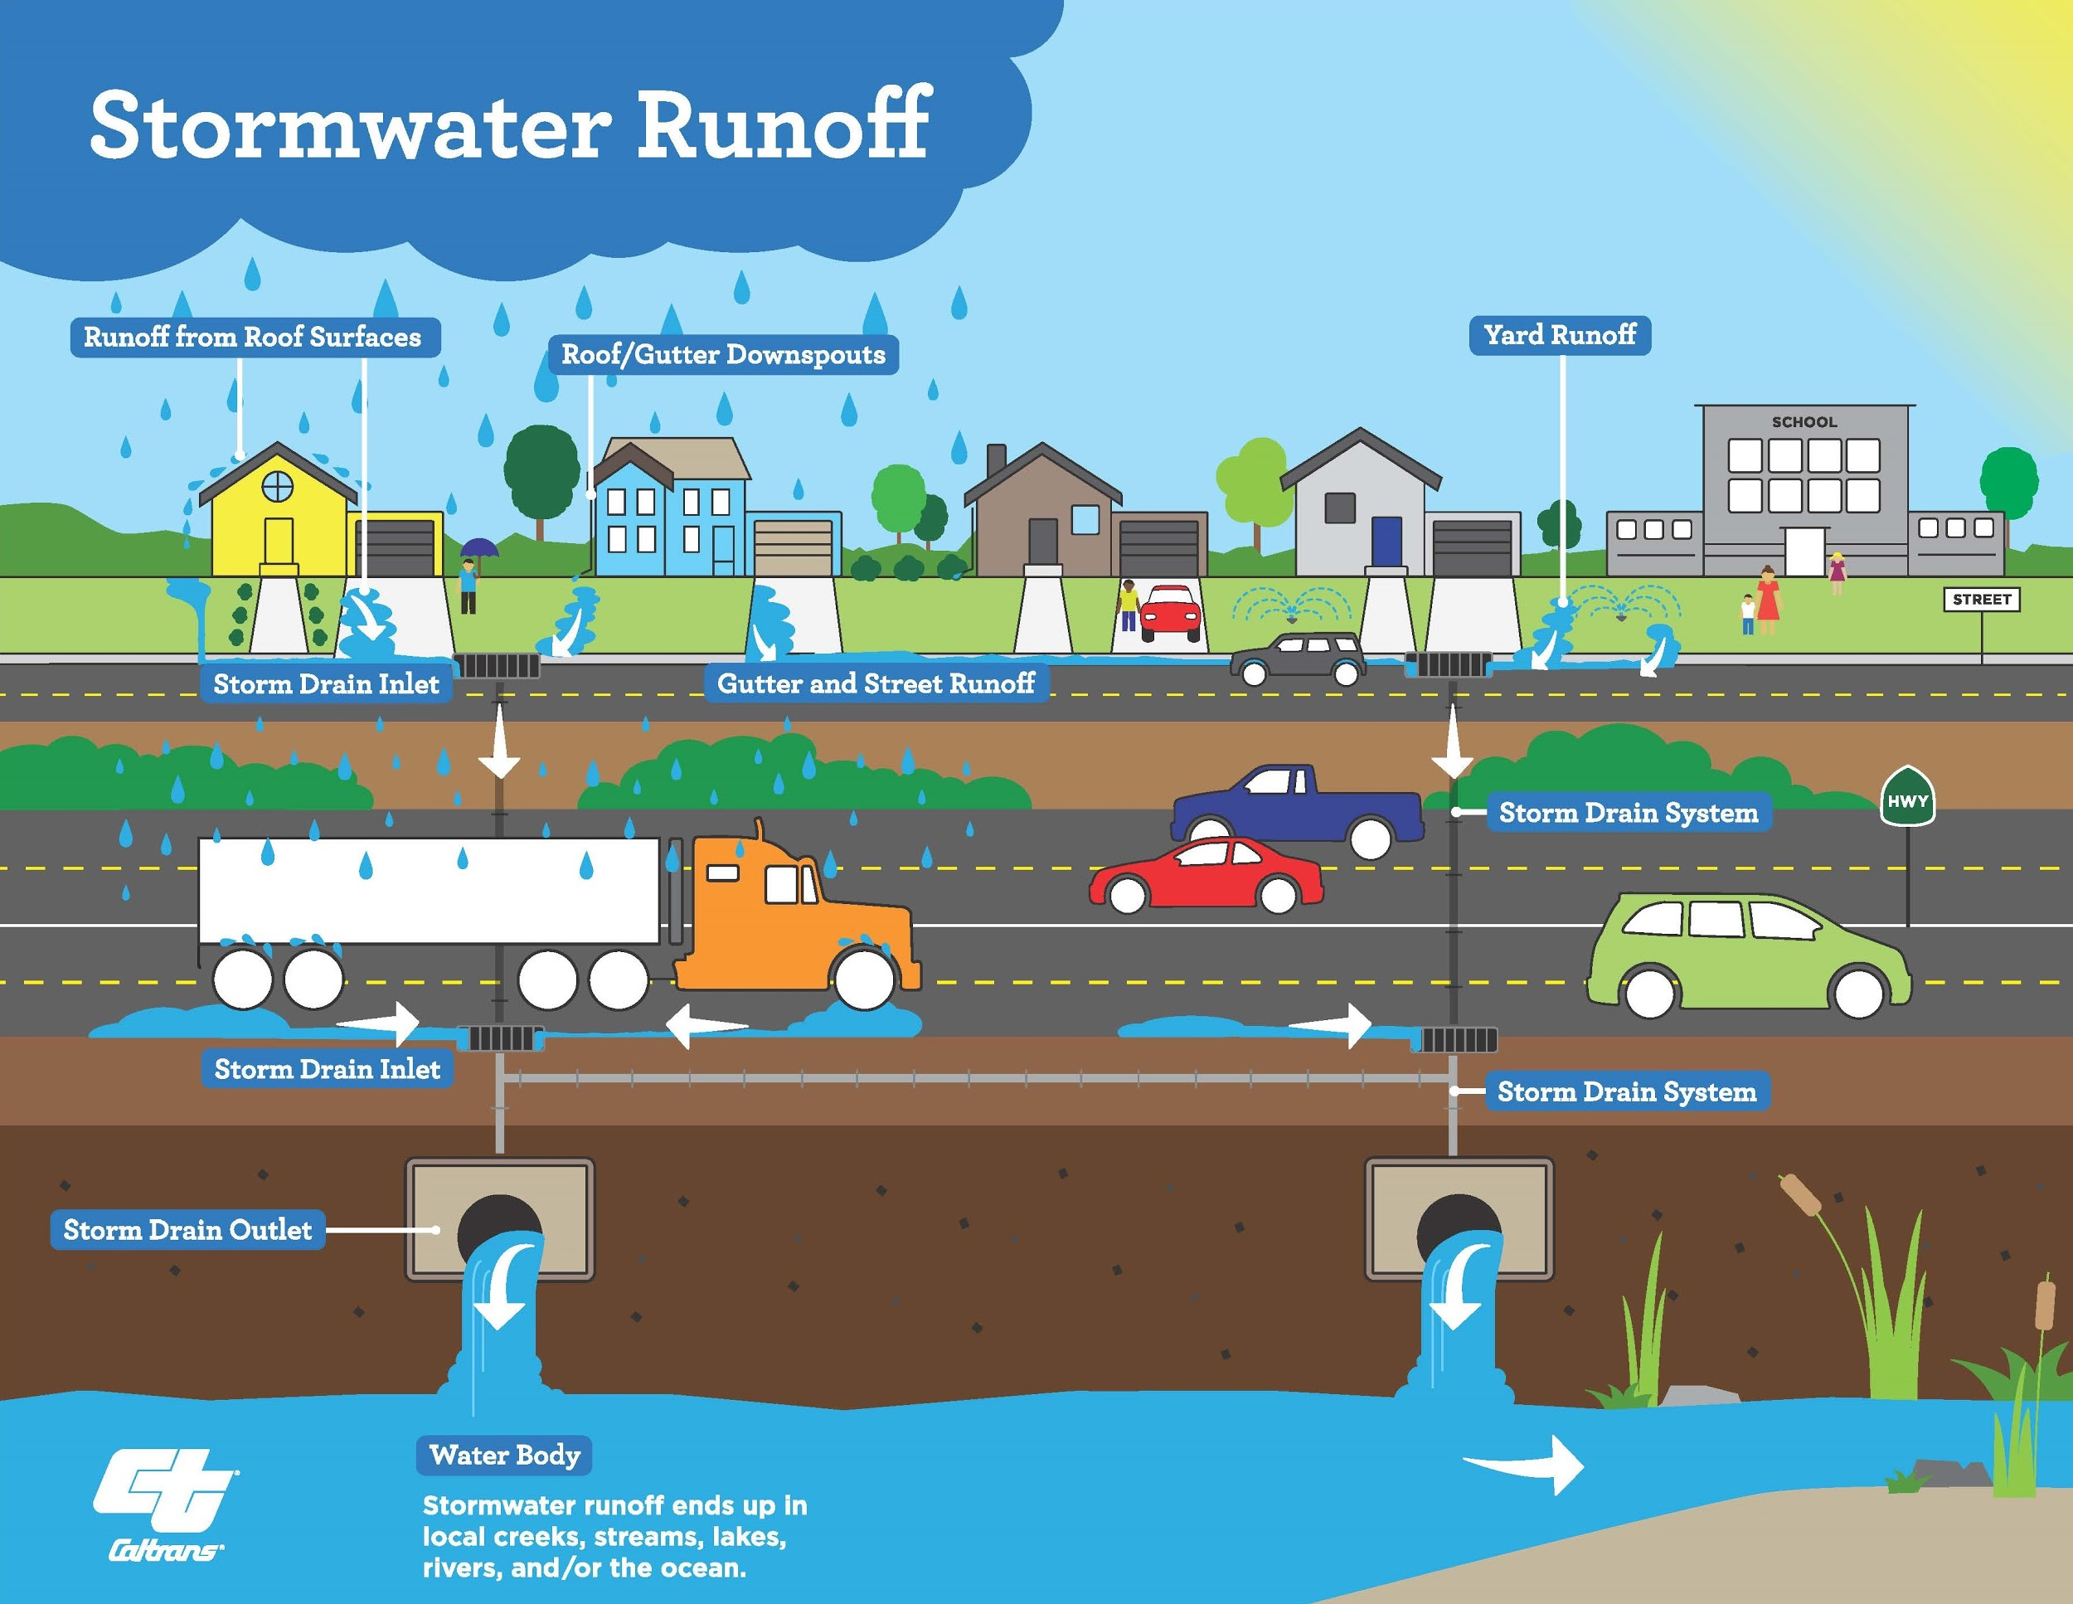
Notes:
Picture source: http://www.cityofwildomar.org/government/departments/public_works/stormwater_quality_and_pollution_prevention

Slide 5
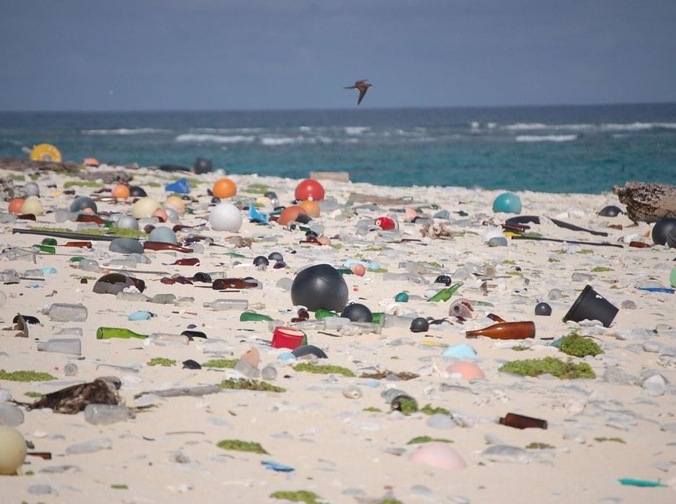
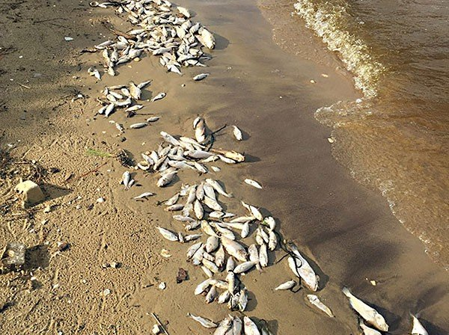
How does stormwater influence water quality?
Changes in temperature, sediment loads, chemicals from vehicles, pesticides, nutrients, bacteria, road salts, heavy metals, debris, etc.
Notes:
Think/Pair/Share
Why is this bad? -- harms fish and other wildlife, results in changes to habitat, reduces recreation, etc.
Of all the stormwater pollutants, we are specifically interested in marine debris… some of which can be land based on ocean based
Article: https://indyweek.com/news/northcarolina/neuse-river-sick-advocates-blame-pork-poultry-industries/

Slide 6
Pervious/Impervious Activity
Split into 4 groups
Grass
Parking lot
Baseball field
Forest
“Test” your surface
Pour water
Time infiltration
Notes:
20 minutes

Slide 7
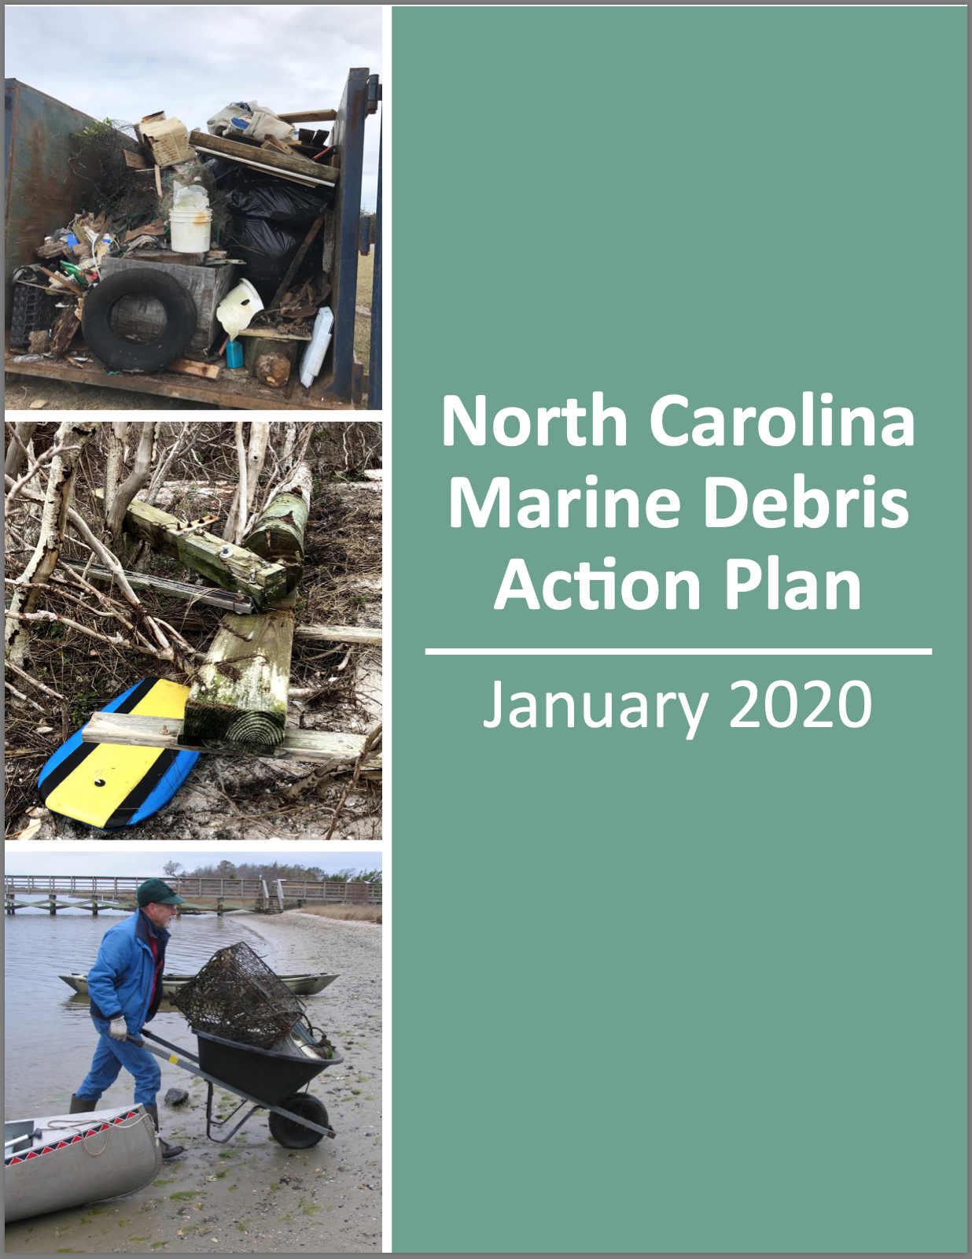
Prevention Methods
Low Impact Development
Marine Debris Action Plans
Clean-Ups
Citizen Science
Notes:
Brainstorm ideas

