Slide 1
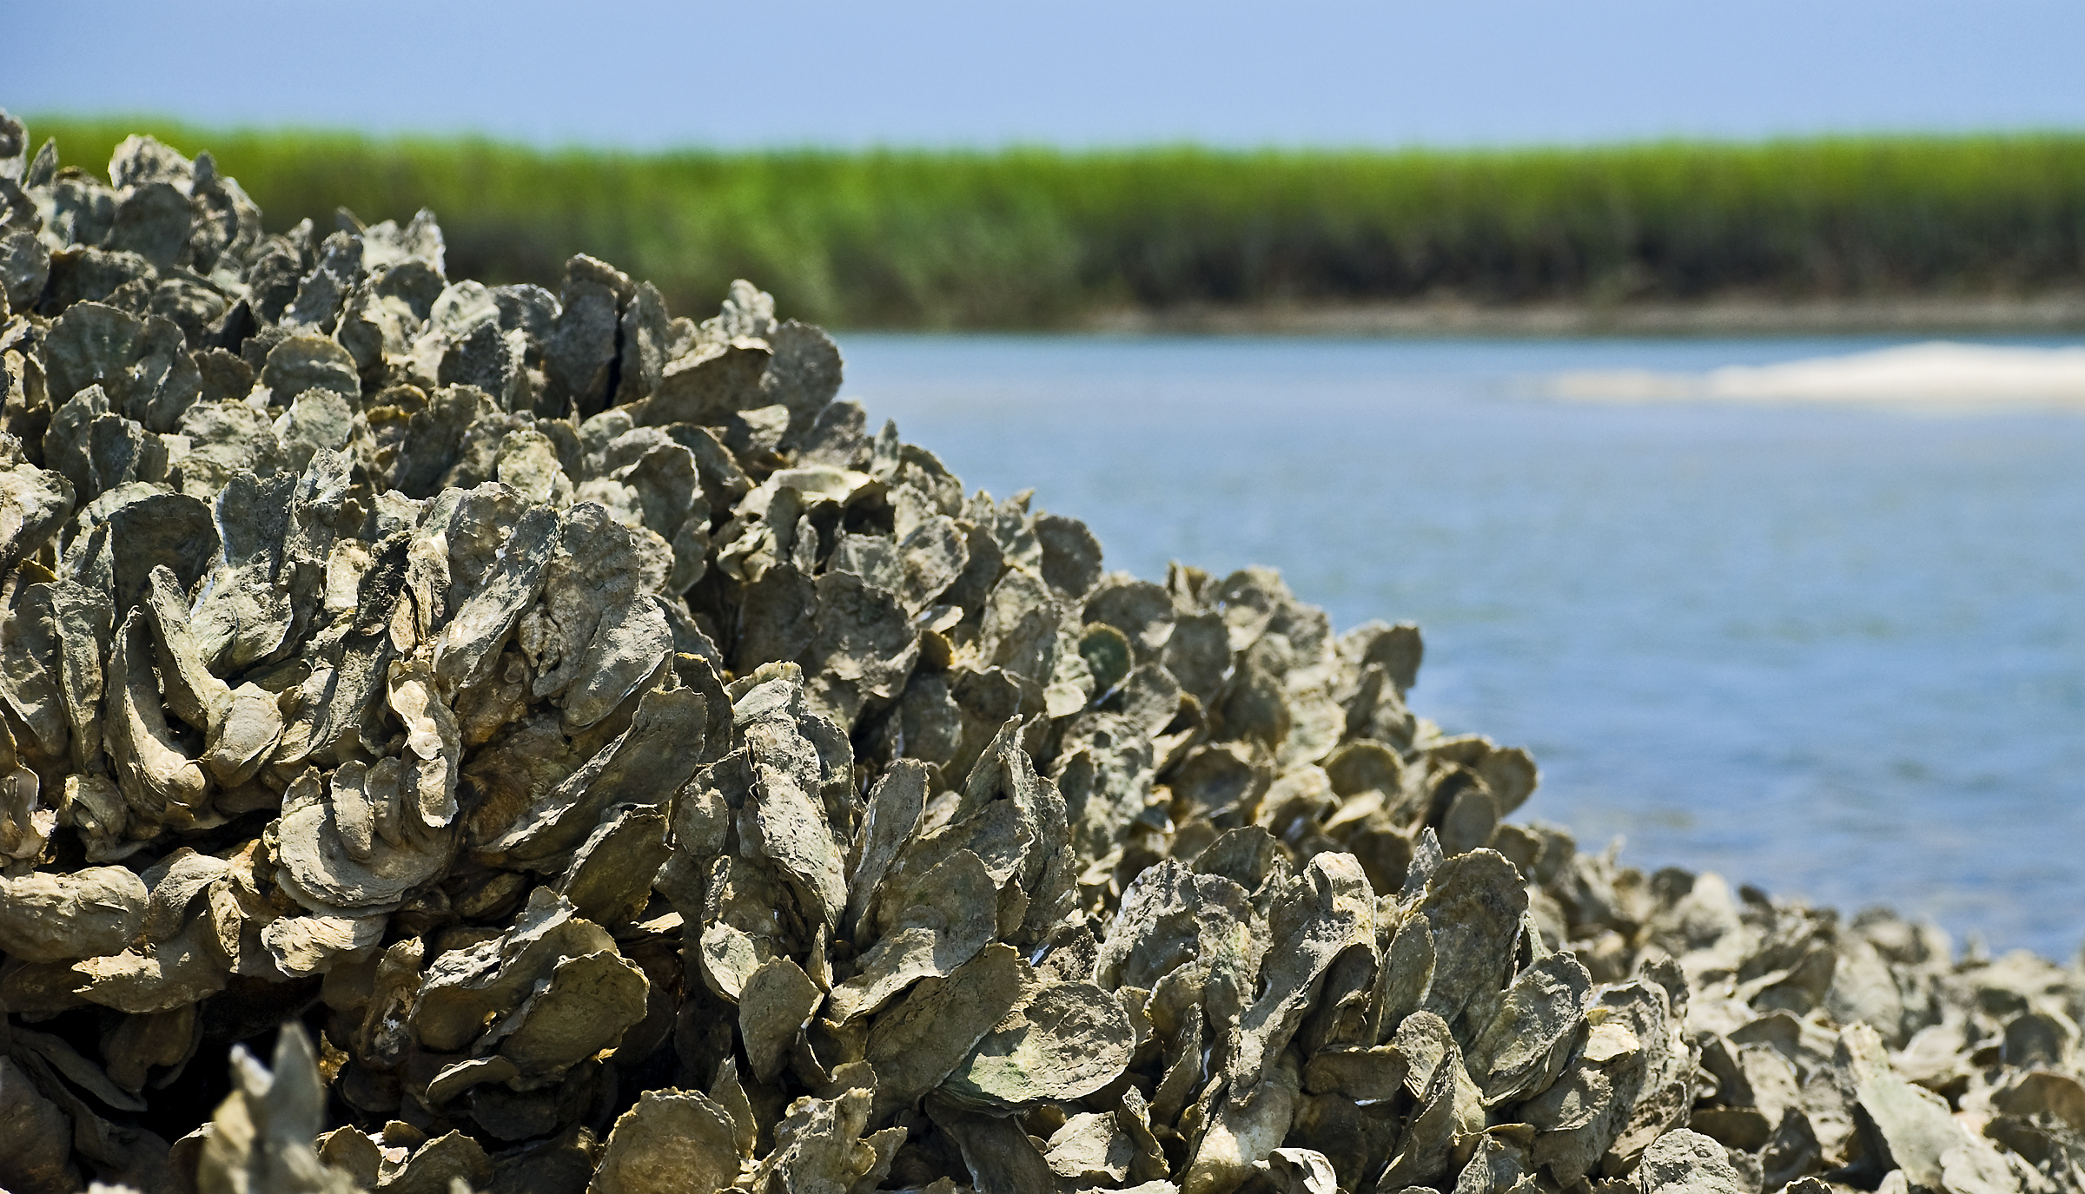
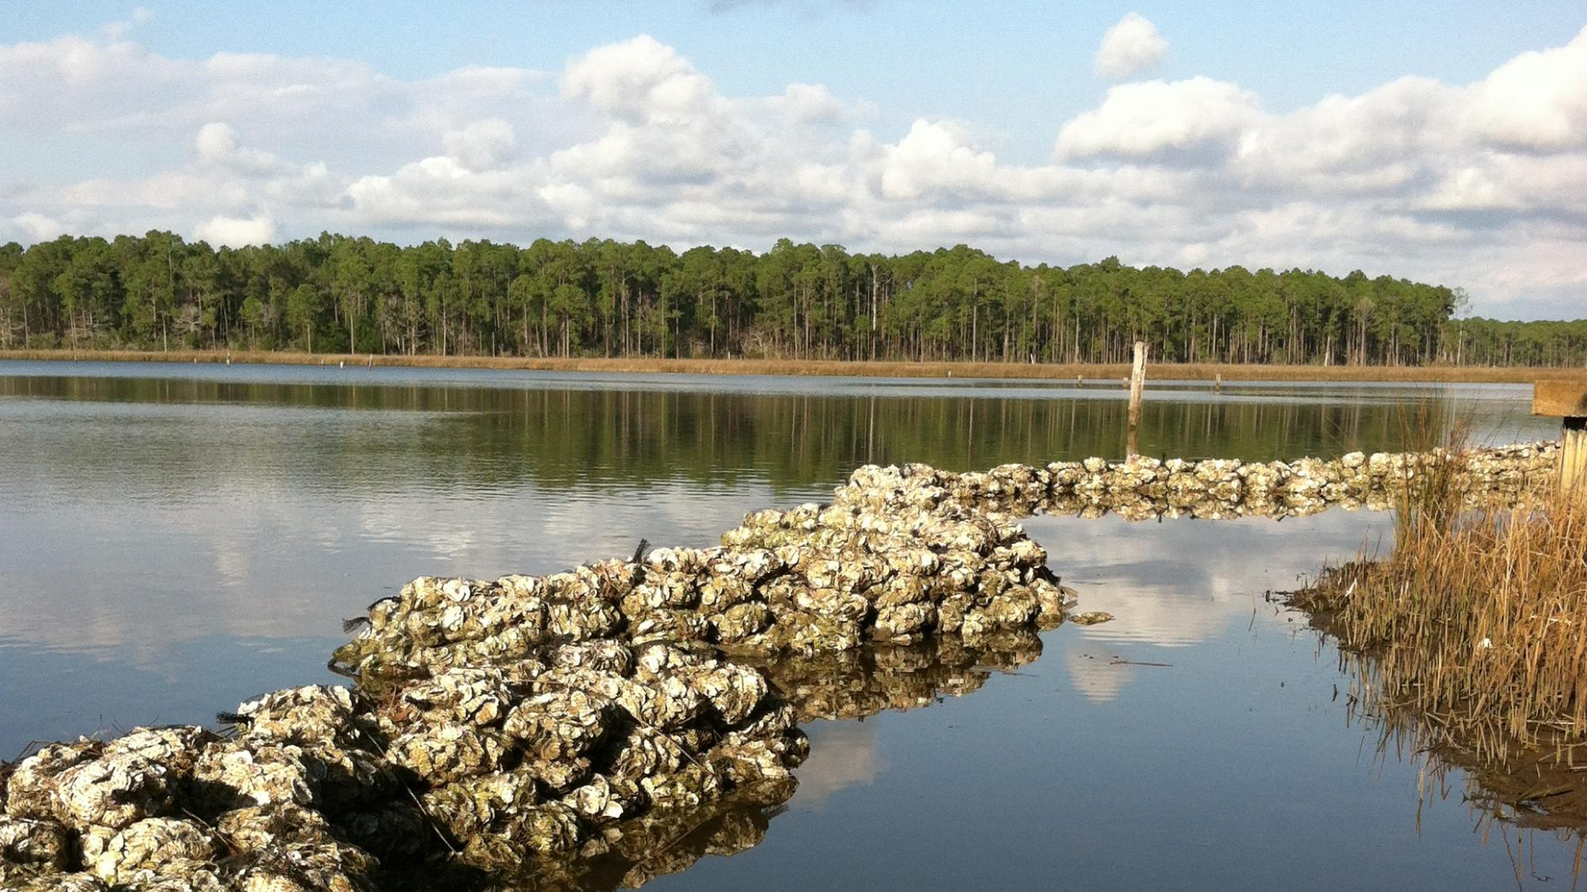
OYSTER REEF ECOSYSTEM SERVICES
Notes:
Image 1:https://www.visitsouthwalton.com/tips-trips/dining-with-a-purpose-local-restaurants-support-oyster-reef-program​
Image 2:https://ktswblog.net/2013/12/04/rebuilding-the-texas-oyster-reef/

Slide 2
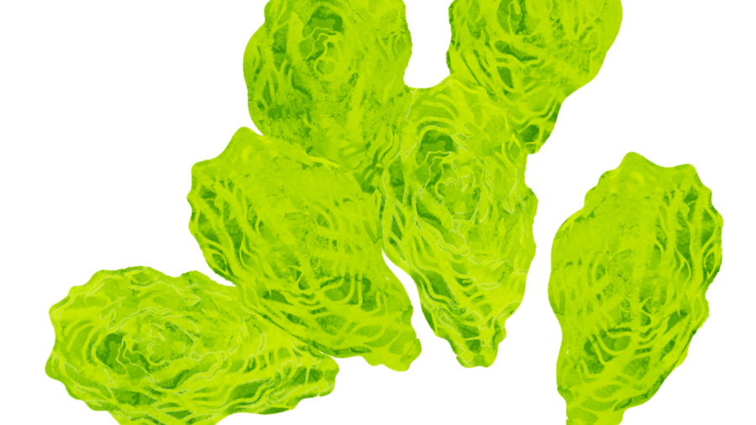
Contents
Introduction and Background
Ecosystem Services
Assessments
Monitoring
Mapping
Oyster ESCMs
Discussion

Slide 3
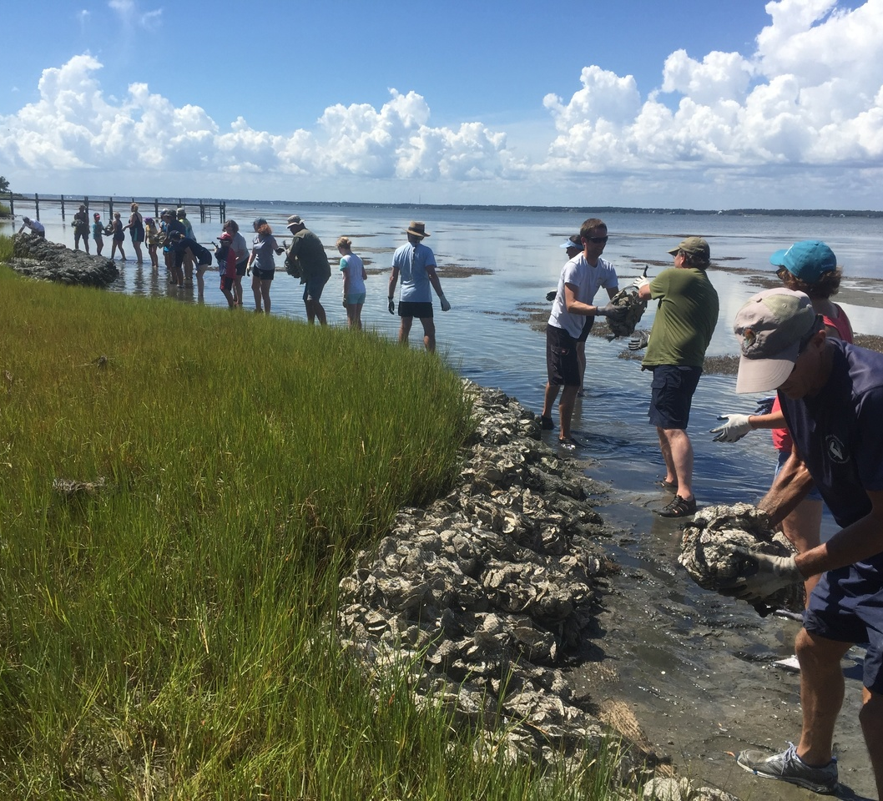
Introduction and Background
Oyster Reefs
Once common but have since declined
Integral to human and wildlife prosperity
Recent push to increase standardization, efficiency, and consistency in restoration efforts
Hugely important to shoreline protection and stabilization
Notes:
Image: Image: https://www.fisheries.noaa.gov/feature-story/noaa-seeks-applications-community-based-habitat-restoration-project-funding

Slide 4
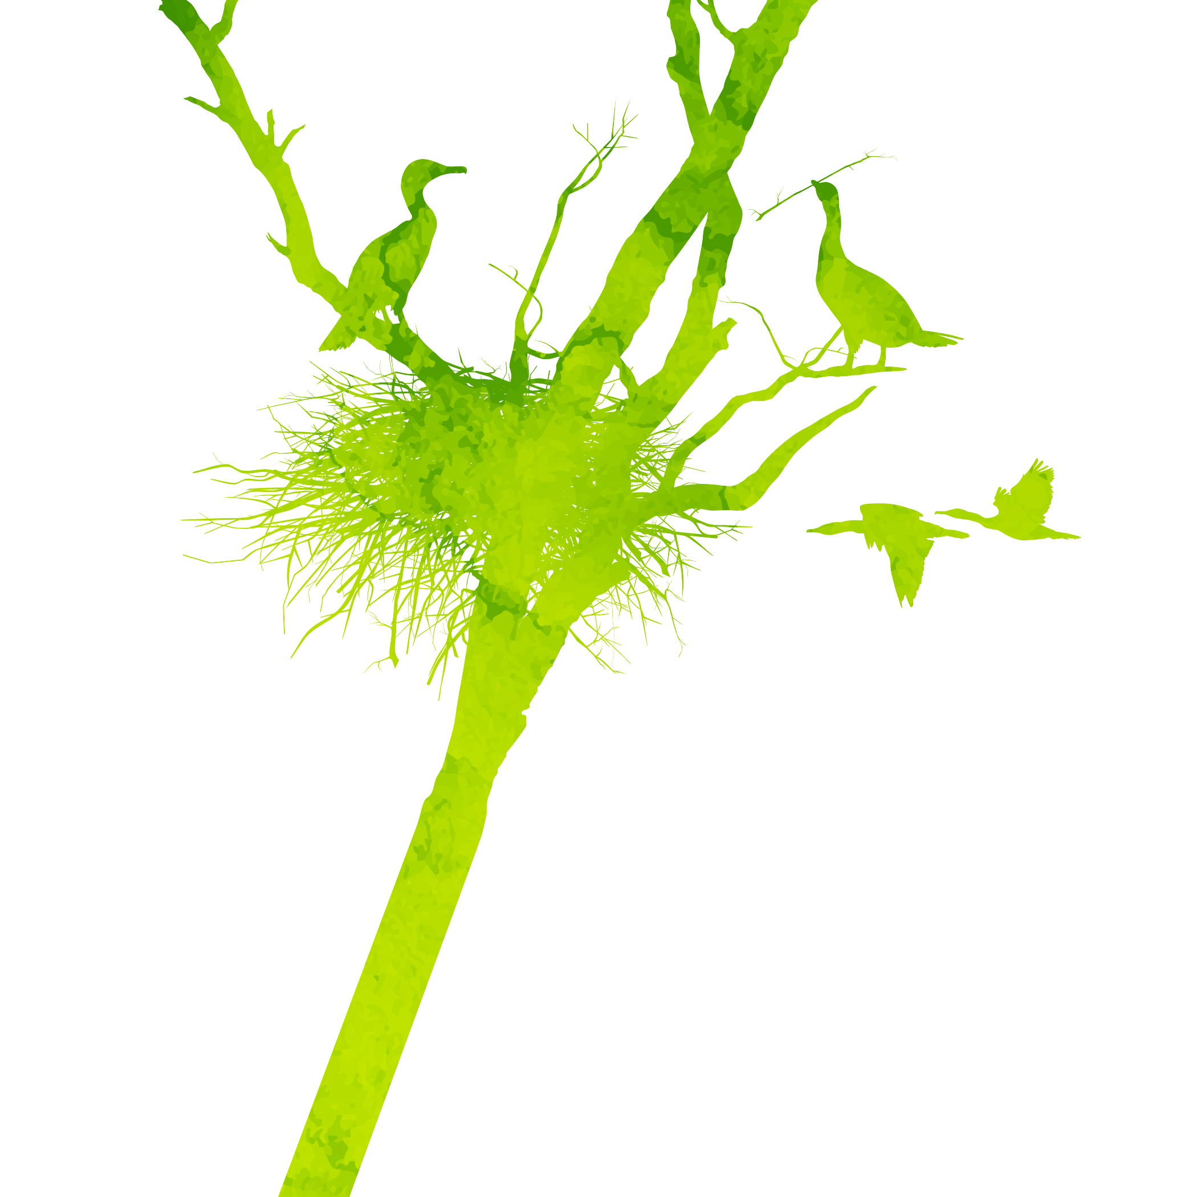
Ecosystem Services (AKA Nature’s Benefits)
Provisioning
Regulating
Cultural
Direct products obtained from nature. Food, materials, etc.
Services nature provides that regulate the wider environment. E.g. water filtering
Indirect benefits that enrich lives. Recreation, species of importance, etc.
Supporting
Indirect services that enable other services to function, such as nutrient cycling.
Notes:
GIF: https://www.youtube.com/watch?v=JvR0RIZd8HU
Other images-creative commons (licensed under CC BY-NC-ND)

Slide 5
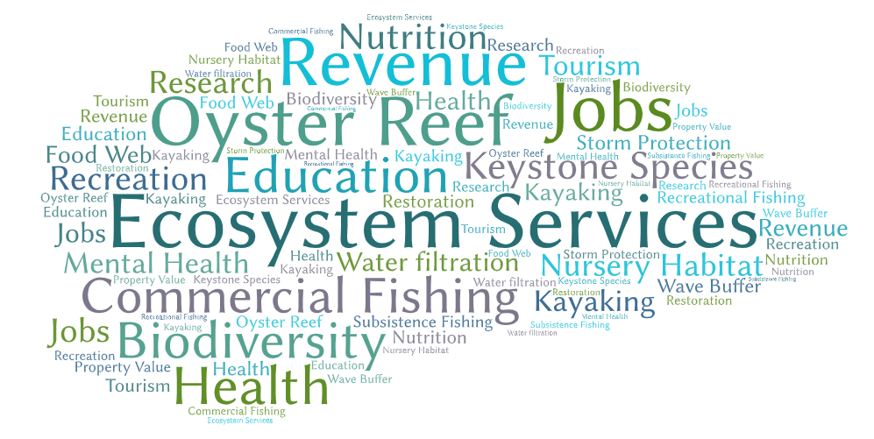
Economic Benefits
North Carolina’s ocean/coastal economy contributed $2.1 billion to state GDP and an estimated 43,385 jobs (NOEP, 2016)
The annual value of preserving the Albemarle-Pamlico’s natural resources is in the range of $113-202 million per year. This study also found the area’s natural resources provide over 36,000 direct jobs, equaling $672 million in wages each year.
Tourism accounts for a huge chunk of the state’s entire economy, bringing over $20 billion per year. Almost a quarter of all tourism occurs on the coast
North Carolina fisheries are dependent on good water quality and habitat. Recent estimates concluded that commercial fishing supported approximately 35,000 jobs and produced $51 million in income statewide.
Notes:
https://ncseagrantncsu.edu/ncseagrant_docs/products/2010s/NC_Ocean_Economy_White_Paper.pdf
(NOEP, 2016) & NC Coastal Federation State of the Oyster 2017

Slide 6
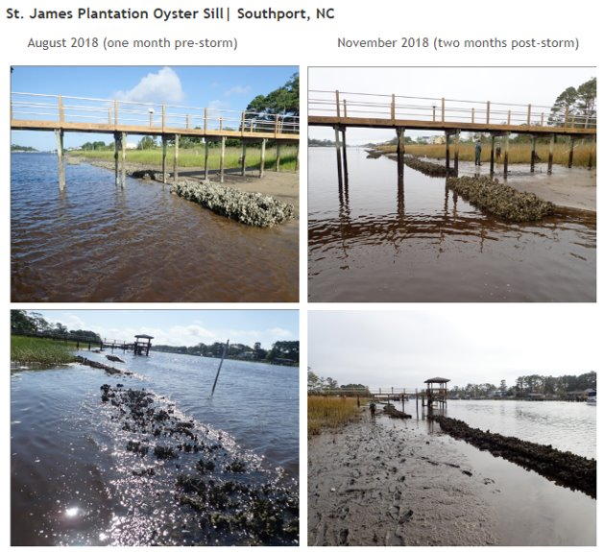
Natural Benefits
Oyster reefs buffer wave energy and trap sediments, which increases shoreline elevation
Improve the overall health of coastal and estuarine ecosystems by providing nursery and foraging habitat for marine organisms and shorebirds
Improve water quality by filtering out pollutants
Notes:
Image: http://portal.ncdenr.org/web/apnep/living-shorelines-ii
The St. James oyster reef shoreline withstood hurricane Florence and was able to protect the spartina behind it. Data concludes that marsh sill living shorelines perform well during large storm events, providing a resilient shoreline stabilization option along North Carolina’s estuarine shorelines.

Slide 7
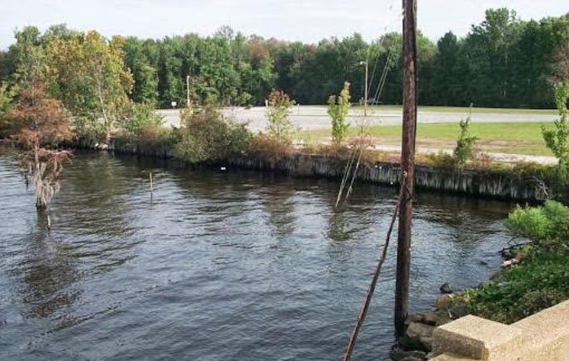
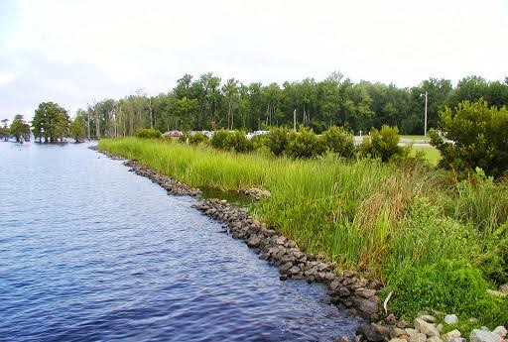
Natural Restoration Benefits
The collective increase in hardening techniques using materials like concrete, metal, wood, or rocks can result in a loss of North Carolina's estuarine habitats.
Implementing living shorelines through, for example, oyster restoration/planting, is a natural technique that not only reduces erosion, but also improve habitat.
Notes:
https://deq.nc.gov/about/divisions/coastal-management/coastal-management-estuarine-shorelines/stabilization/living-shoreline-research/unc-studies
Images: https://coast.noaa.gov/digitalcoast/training/nc-coast.html

Slide 8
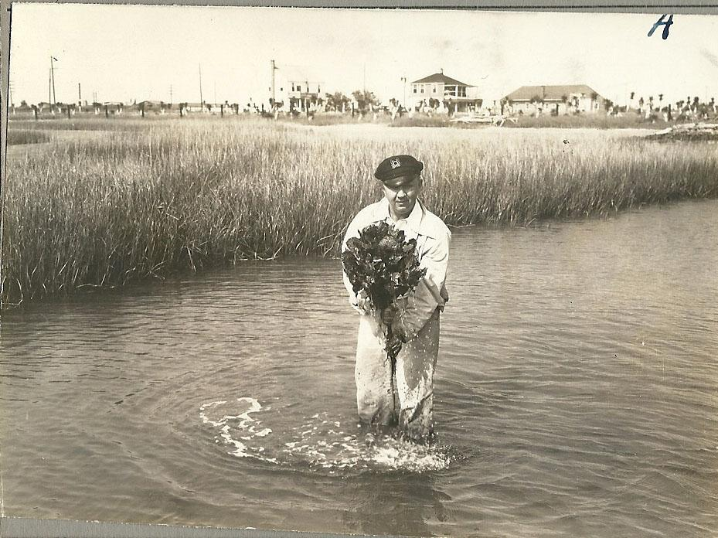
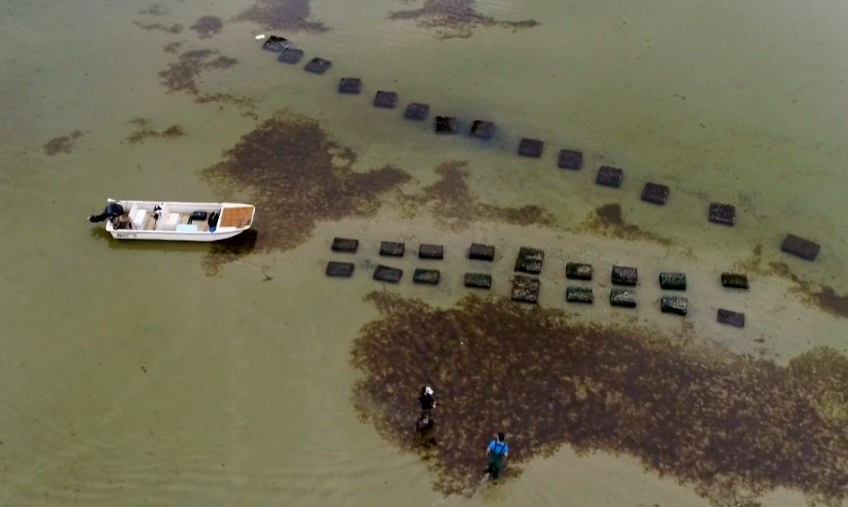
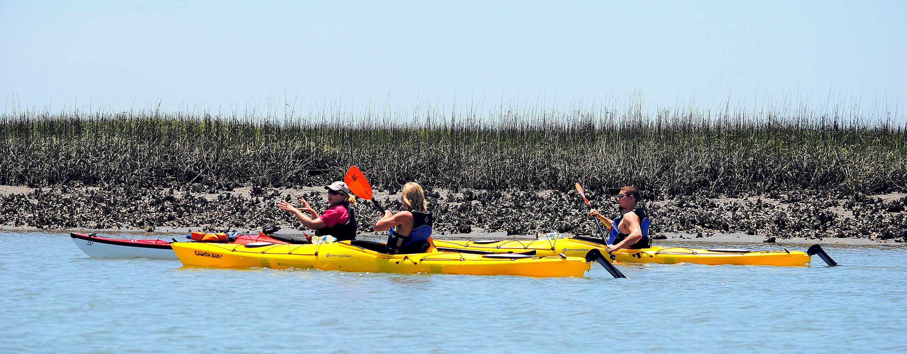
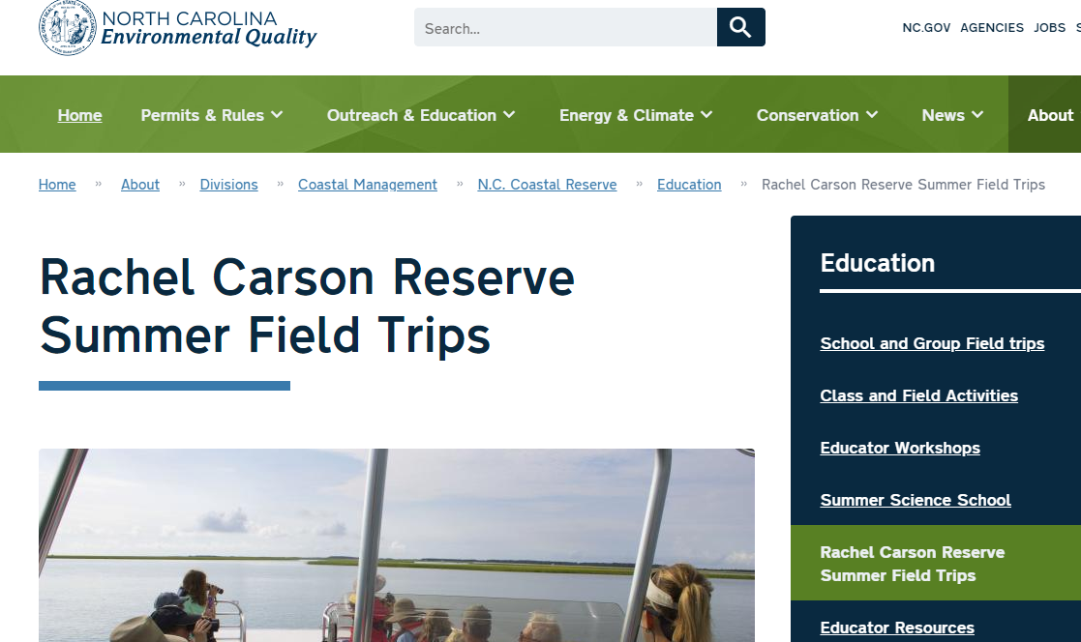
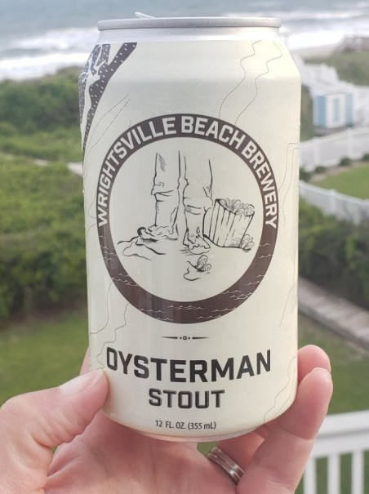
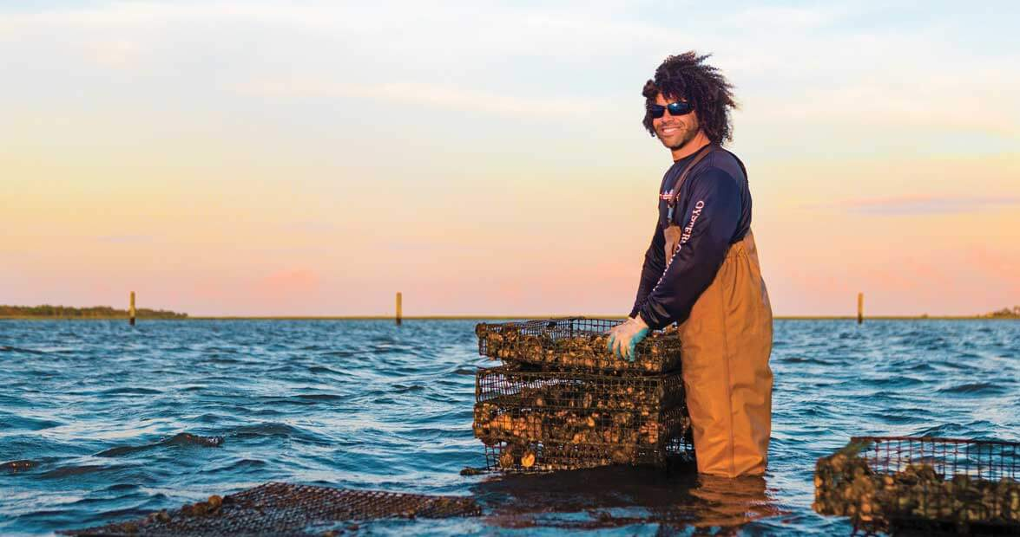
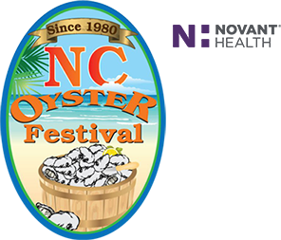
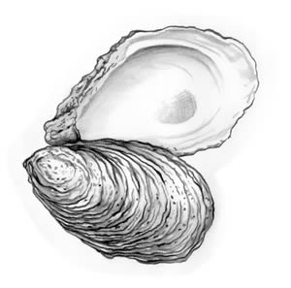
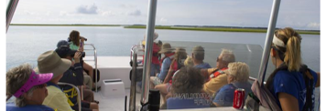
OTHER
BENEFITS
Notes:
Social benefits
Young oysterman: https://www.ourstate.com/an-oystermans-calling/
Old oysterman: A Carteret County oyster farmer. Image from the N.C. Museum of History.

Slide 9
Why Ecosystem Services?
Decades of research and demonstration on the subject
U.S. Executive Offices of the President released a memo “Incorporating Ecosystem Services into Federal Decision Making” by the end of 2016
More recent push for consistency throughout the NERRS
ESCM here to help!

Slide 10
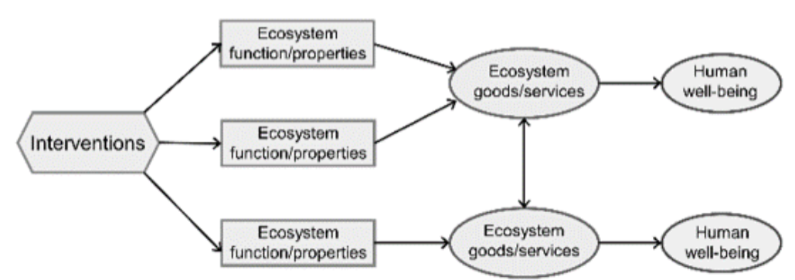
Service Mapping
Deliberate service mapping shows how oyster restoration makes ecological changes which then result in changes to the social and ecological outcomes we care about.
Illustrates the way that a management intervention cascades through an ecological system to change ecosystem service and other human welfare impacts (i.e. living shoreline construction).
Ecosystem services
general models

Slide 11
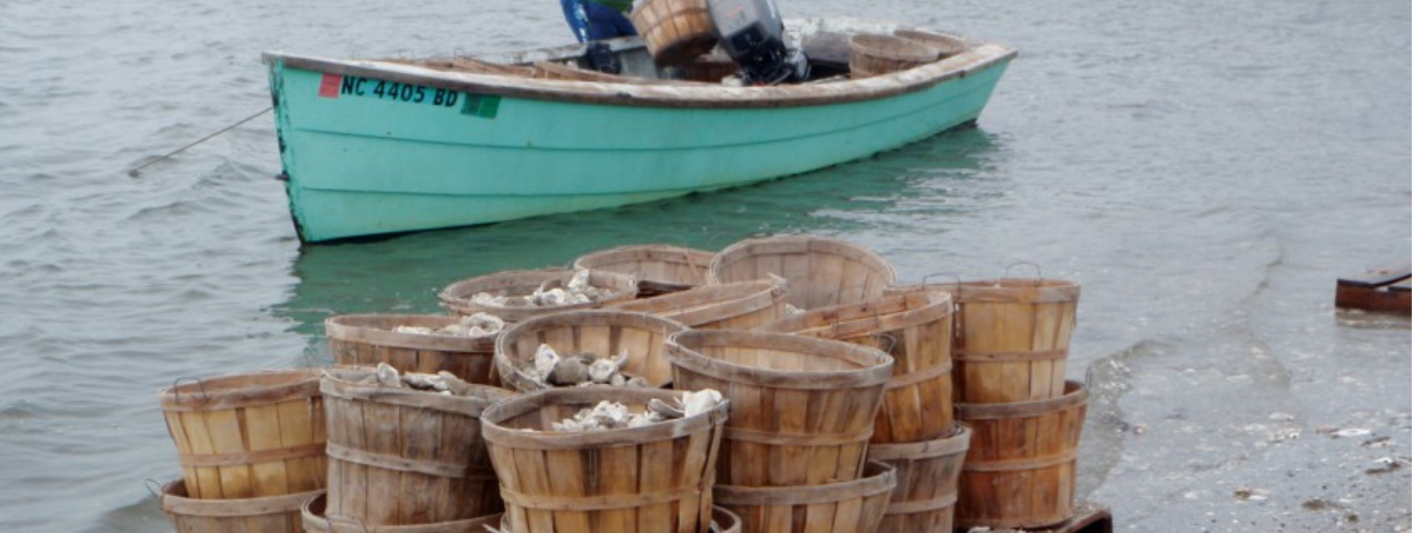
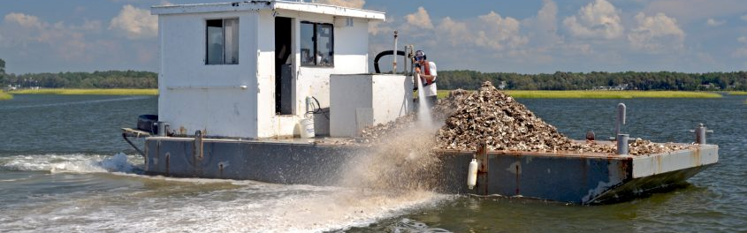
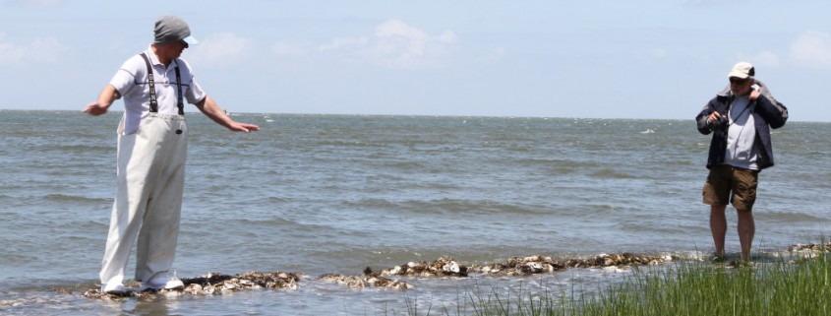
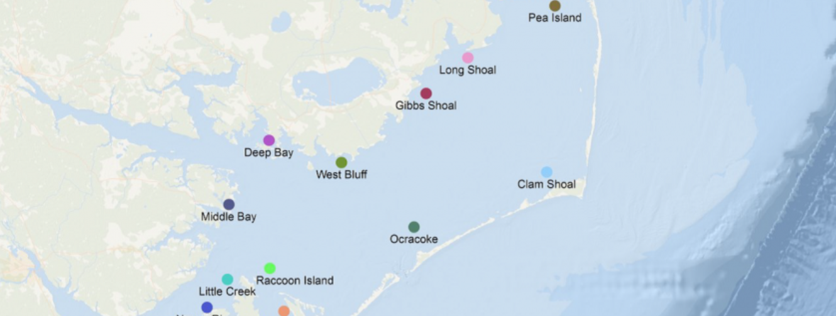
Oyster Ecosystem Services Conceptual Models
ESCM helps streamline with common set of services and metrics, cost effective, decrease duplicate data collection and analysis.
Can be adapted and applied to any site
Models can be used for transparency, stakeholder engagement, outreach, and anticipating co-benefits or unintended outcomes of management interventions.
Site-specific models can be used to facilitate understanding of the varied services that these ecosystems provide.
Common ecosystem service metrics that will enable comparison across projects throughout the NERRS and beyond.
Notes:
Images: https://ncoysters.org/oysters/restoration-map/
From top: Oyster mariculture, clutch planting, patch reefs, and NC oyster sanctuaries.

Slide 12
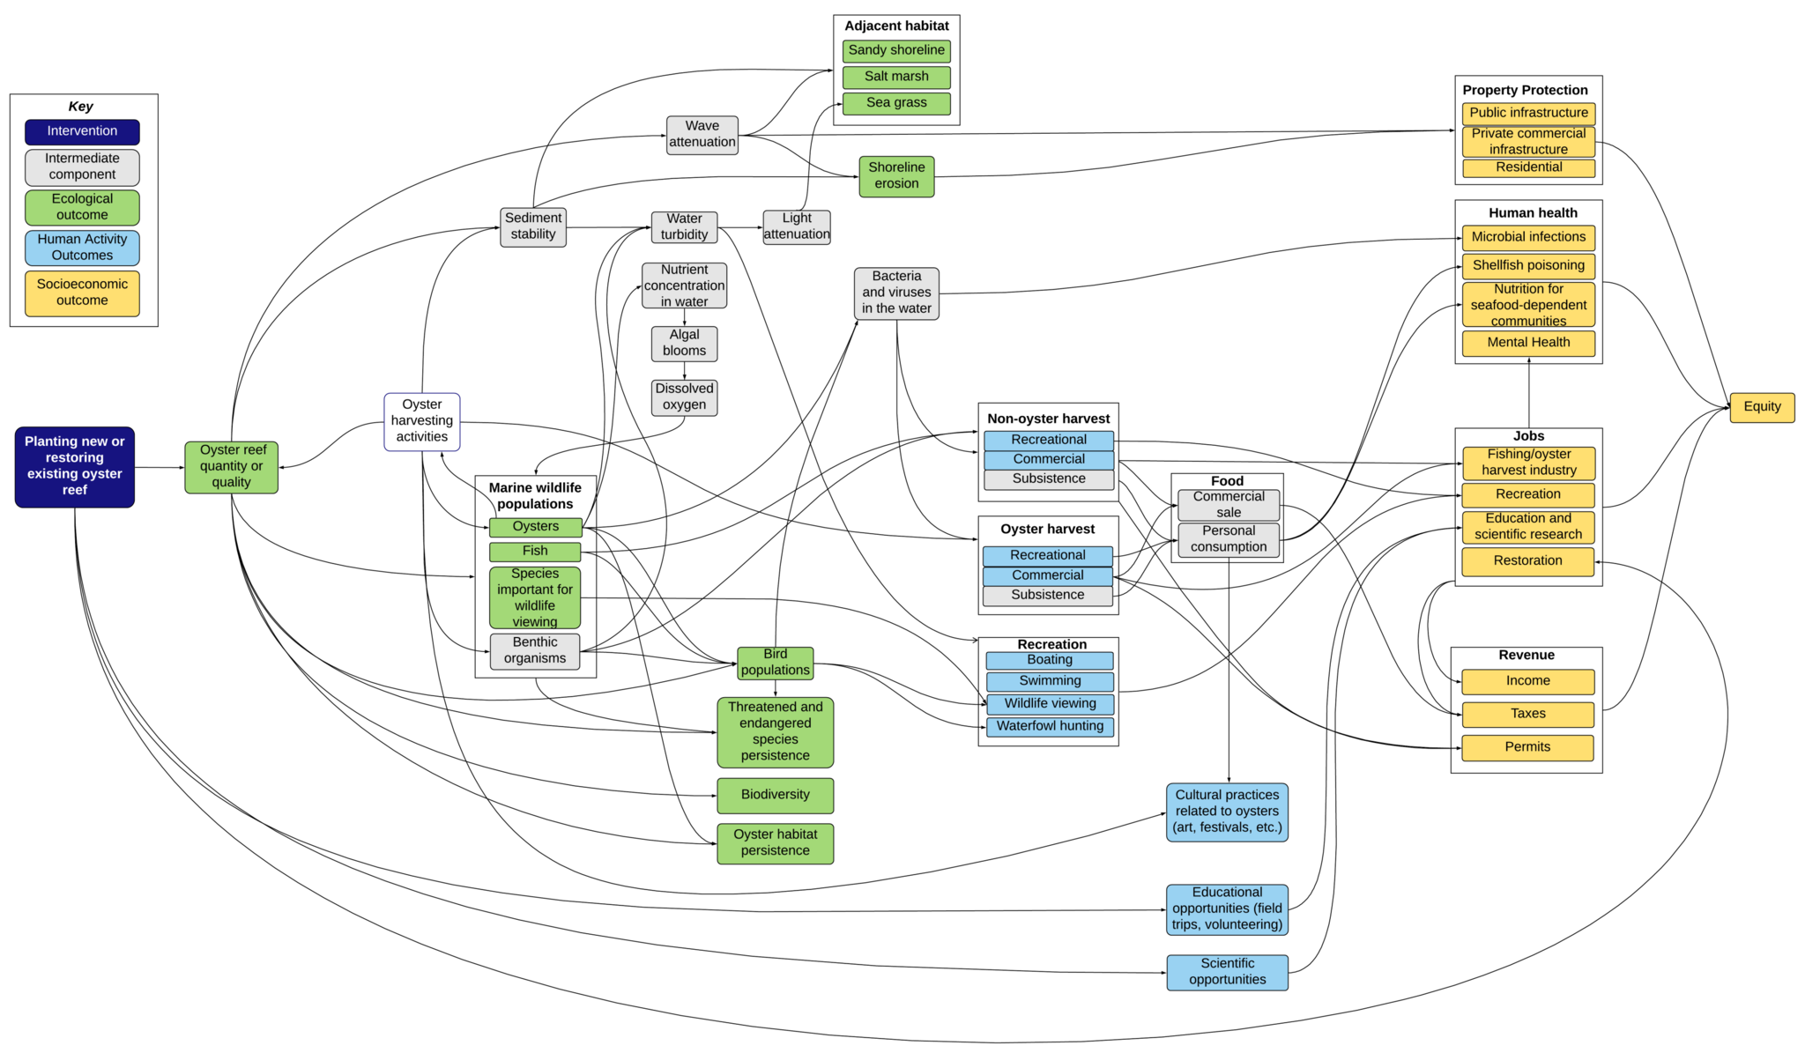
Oyster Ecosystem Services Conceptual
Model
Notes:
What a completed model looks like

Slide 13
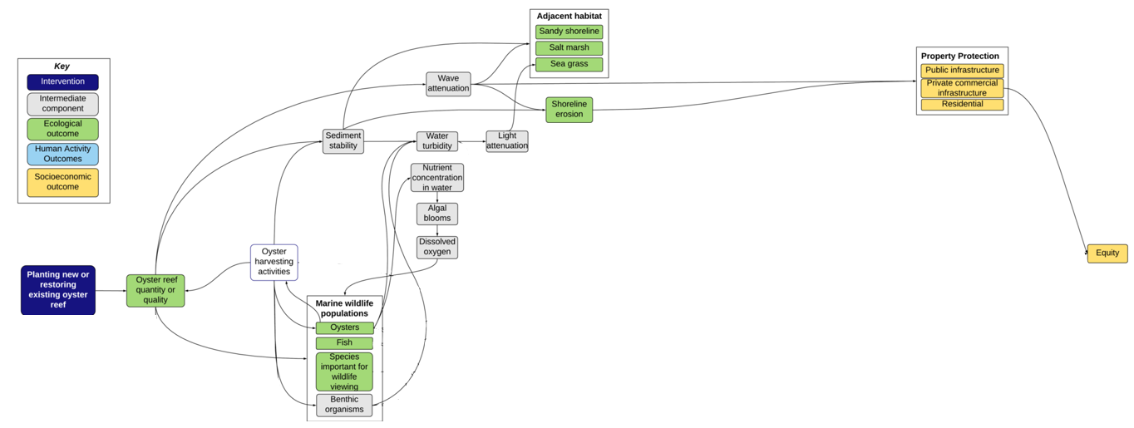
With an ESCM, you can even pull out just a single outcome (property protection for example) and realize all the ecological outcomes that need to precede it. If one of the preceding components is degraded or eliminated, it could affect other outcomes down the line.

Slide 14
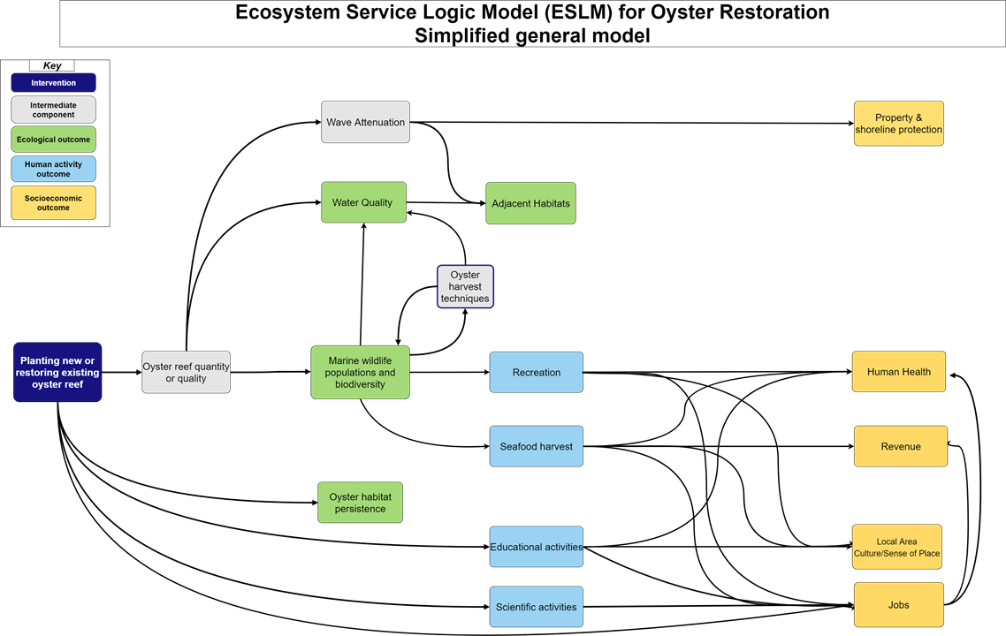
Oyster Ecosystem Services Simplified Model

Slide 15
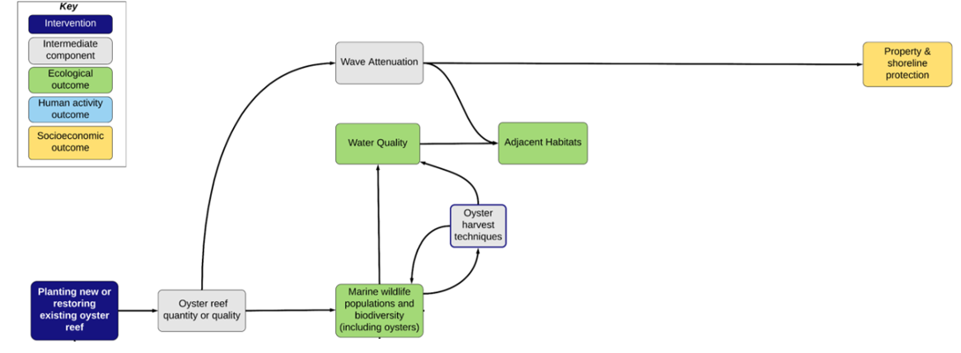
Even with a simplified ESCM, you can pull out just a single outcome (property protection for example) and realize all the ecological outcomes that need to precede it. If one of the preceding components is degraded or eliminated, it could affect other outcomes down the line.
Notes:
Text bigger

Slide 16
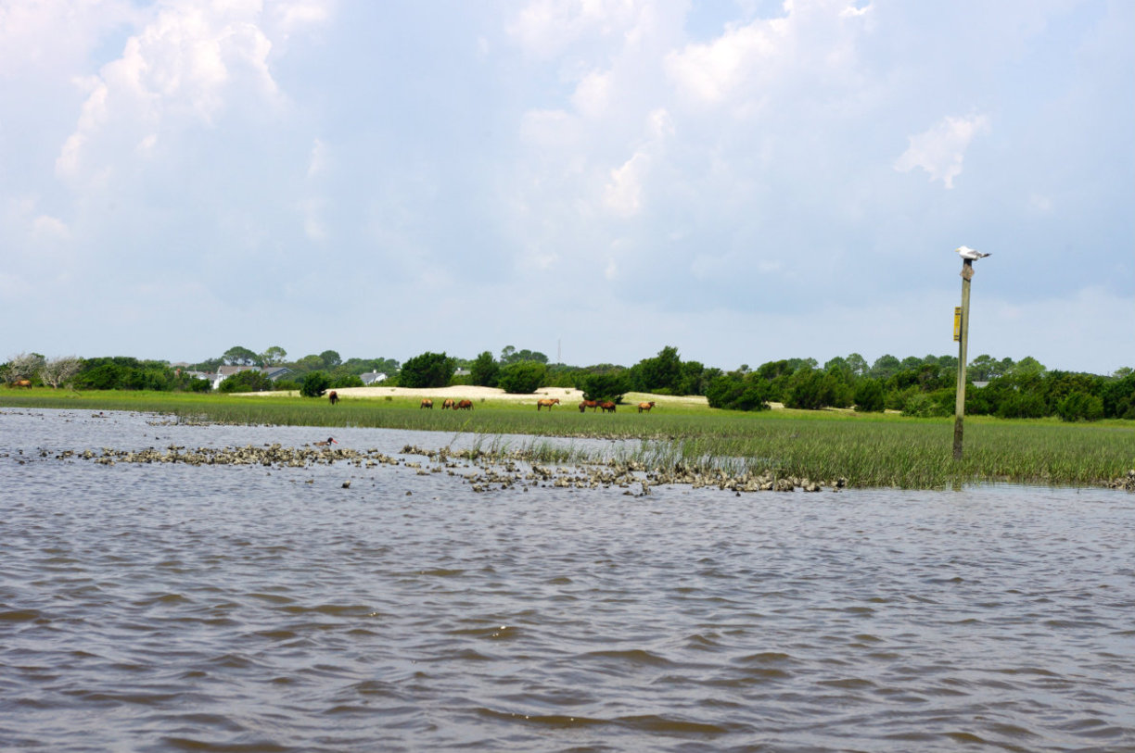
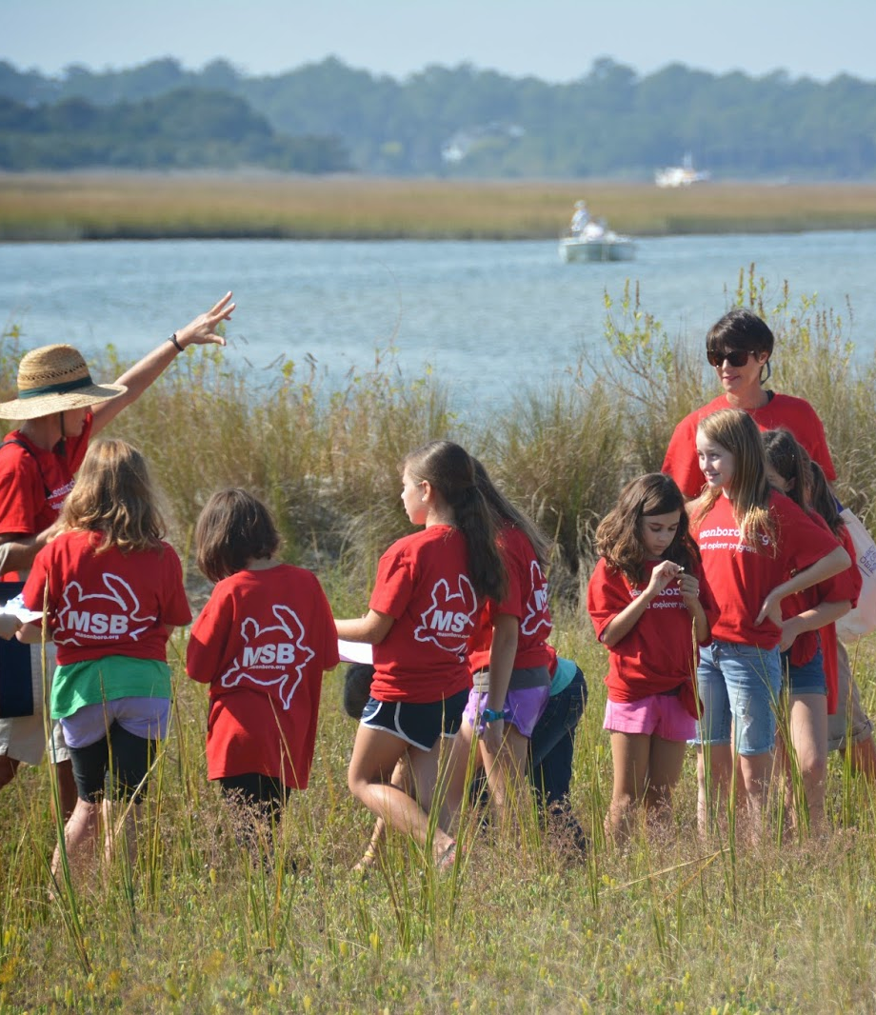
Discussion
Notes:
Image: https://www.trover.com/d/dZDq-rachel-carson-reserve-carteret-county-north-Carolina
Image: http://masonboro.blogspot.com/

