Slide 1
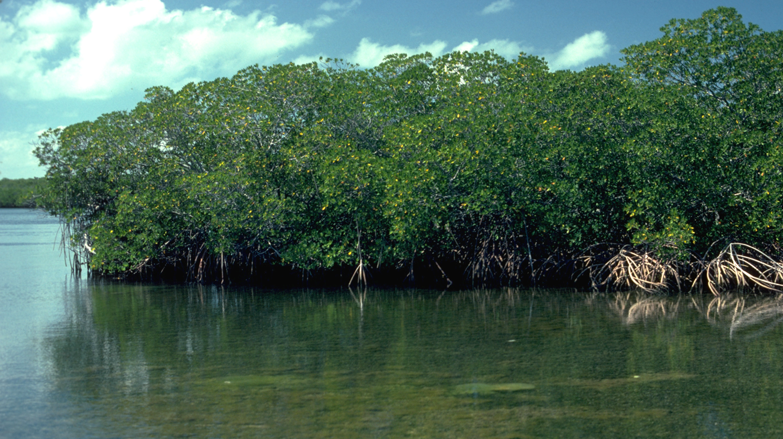
Mangroves
ECOSYSTEM SERVICES: THE KEY TO ESTUARINE HEALTH
Notes:
This Photo by Unknown Author is licensed under CC BY-SA

Slide 2
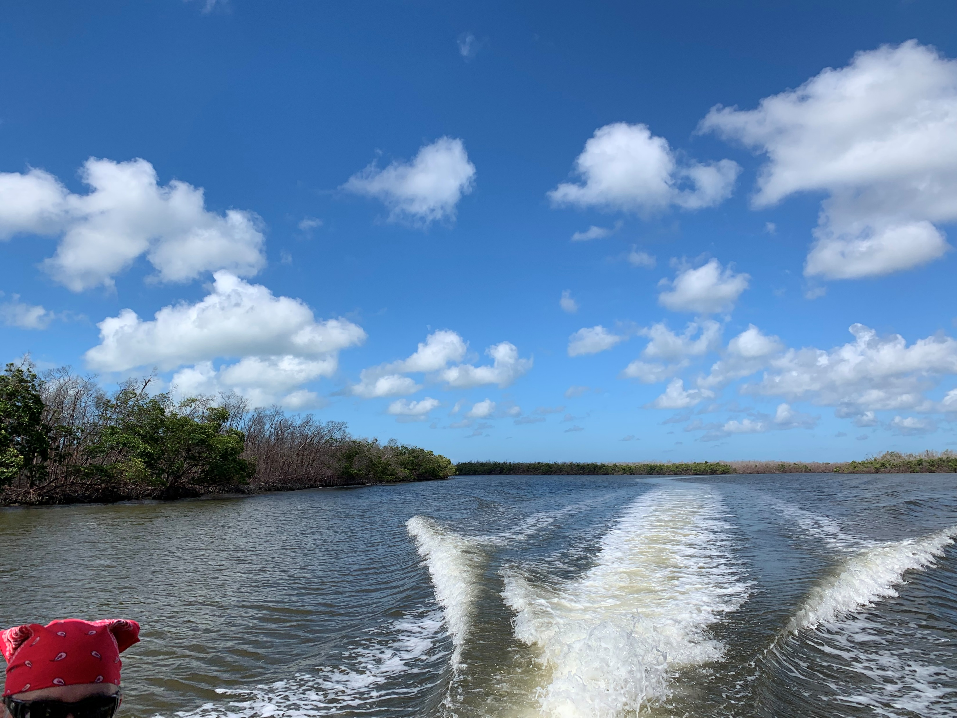
Mangrove Ecosystem Services
What are they?
Why are they important?
Why are they at risk?
What can we do to help?
Notes:
Image: Duke Nicholas Institute, Natalie B. Rodriguez

Slide 3
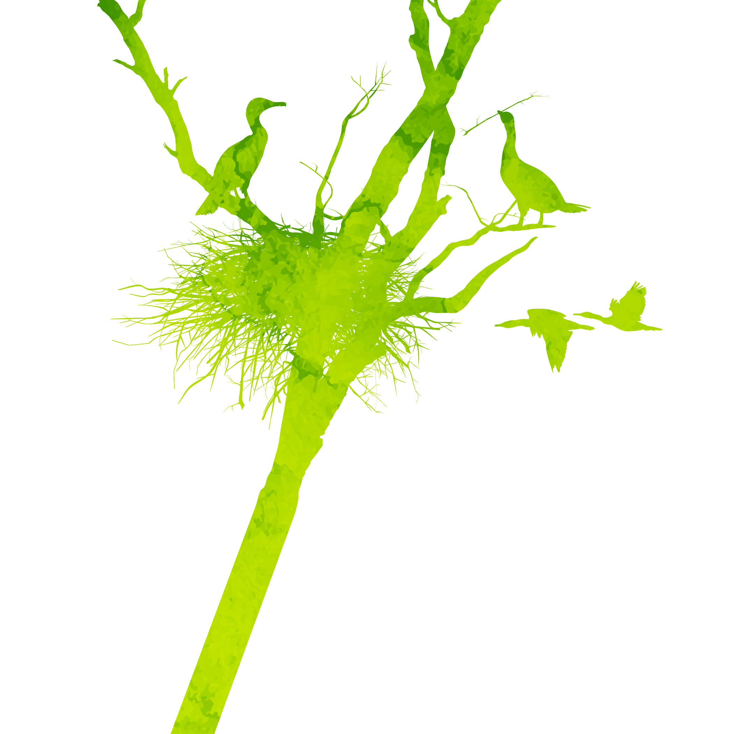
Ecosystem Services (AKA Nature’s Benefits)
Provisioning
Direct products obtained from nature
Regulating
Services nature provides that regulate the wider environment
Cultural
Indirect benefits that can enrich lives
Supporting
Indirect services that enable other services to function
Notes:
Images-creative commons (licensed under CC BY-NC-ND)

Slide 4
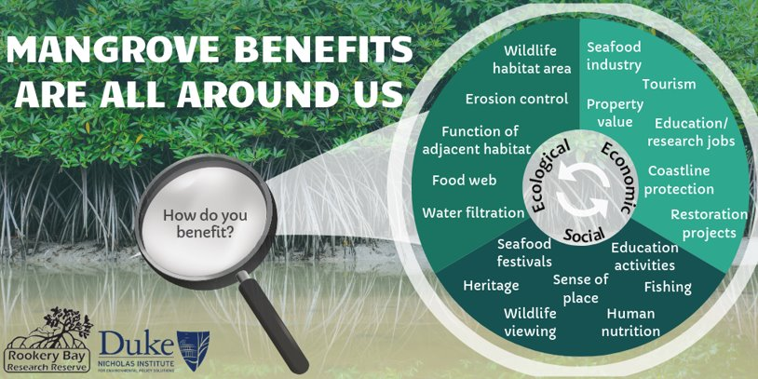
Simply defined, ecosystem services are the direct and indirect benefits that humans receive from nature. ​
Direct- forest products for building or fuel​
Indirect- culture, recreation, revenue, etc. ​
Important to remember that humans and nature are NOT involved in separate systems. Something that happens to one could influence what happens to the other. ​
We rely on nature's benefits and therefore must protect them!
Think about this quote from Conservation International... "humans need nature, but nature doesn't need us" ​

Slide 5
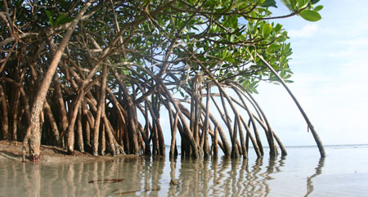
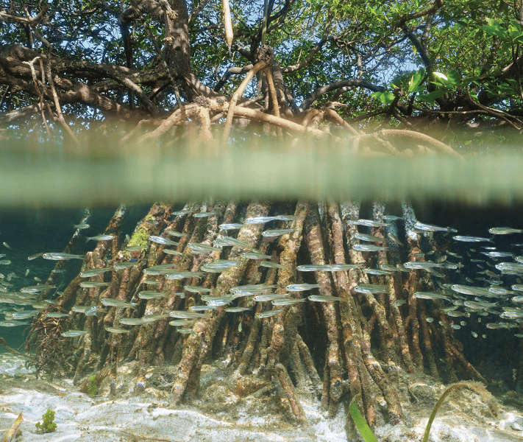
Why are mangroves ecologically important?
Aid in the function of other important habitat
Coral reefs, salt marsh, underwater and shoreline grasses
Provide food and habitat for organisms in and out of water
Improve water quality and clarity
Absorb excess nutrients, trap and cycle organic material
Reduce erosion, protect shorelines
Nursery area for aquatic and land species

Slide 6
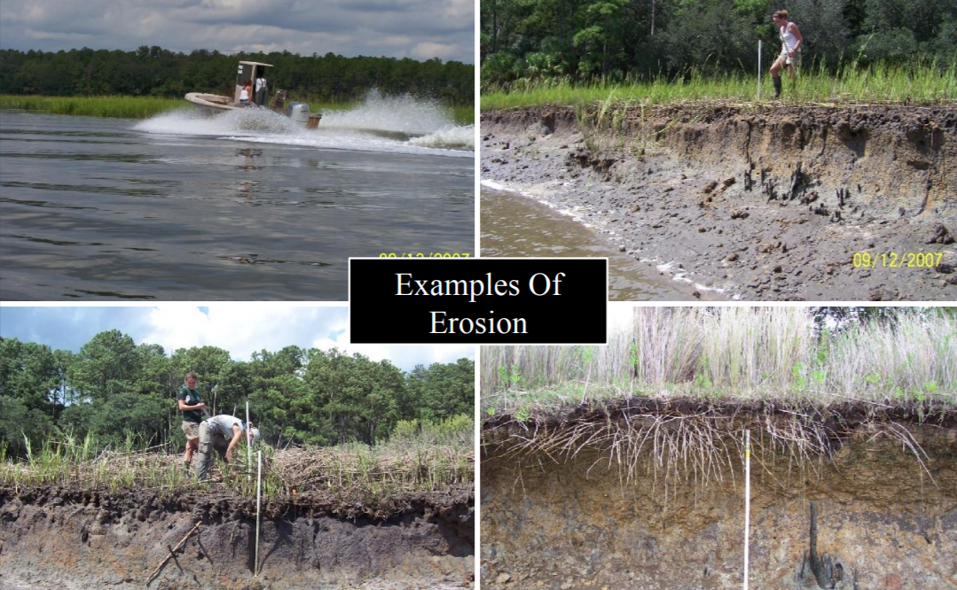
Notes:
https://coast.noaa.gov/data/estuaries/pdf/an-ode-to-the-oyster-oyster-reefs-powerpoint.pdf

Slide 7
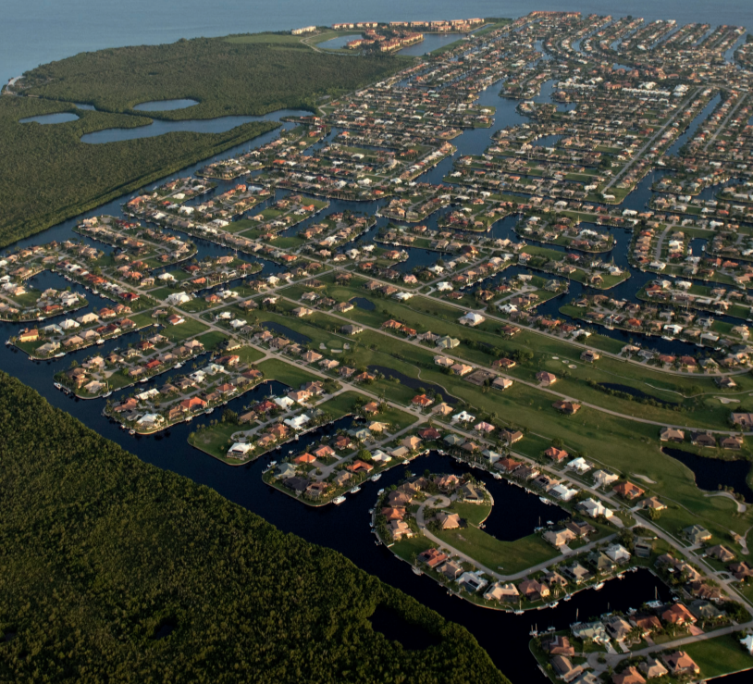
Why are mangroves economically important?
Provide jobs
Commercial fisherman, educator, scientist, tourism/recreation guide, restoration professional, etc.
Tourism and recreation revenue
Kayaking, wildlife watching, nature walks, paddle boarding, boating, fishing
Natural breakwaters
Property and infrastructure (roads, utilities, etc.) protection
Seafood source/commercial and subsistence fishing
Restaurants, festivals, nutrition, etc.
Coastal restoration projects
Notes:
Image: https://www.conservationgateway.org/ConservationPractices/Marine/crr/library/Documents/GlobalMangrovesRiskReductionTechnicalReport10.7291/V9DV1H2S.pdf
Losada, I. J., P. Menéndez, A. Espejo, S. Torres, P. Díaz-Simal, S. Abad, M. W. Beck , S. Narayan, D. Trespalacios, K. Pfiegner, P. Mucke, L. Kirch. 2018. The global value of mangroves for risk reduction. Technical Report. The Nature Conservancy, Berlin.

Slide 8
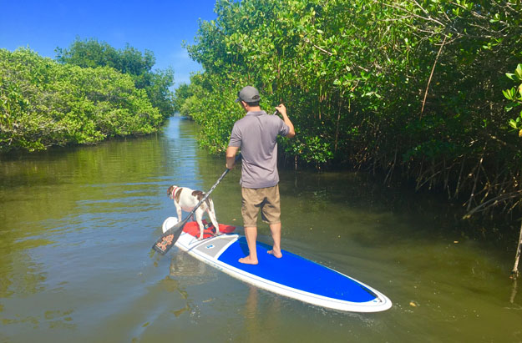
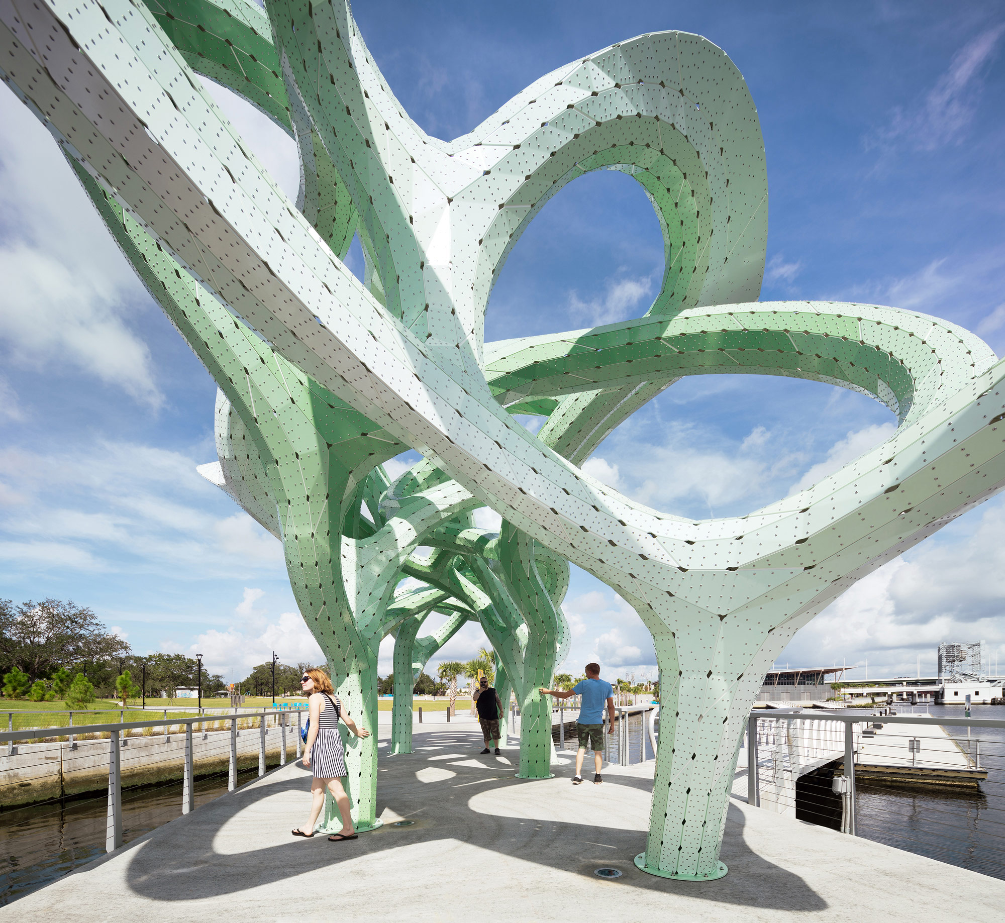
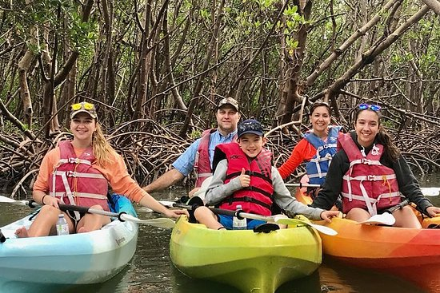
Social Benefits
Recreation
Culture
Heritage
Sense of place
Art material/ inspiration
Festivals
Notes:
Kayakers: https://www.tripadvisor.com/Attractions-g34467-Activities-c61-t191-Naples_Florida.html
Paddle boarders: http://www.authenticflorida.com/articles/where-to-go/adventure-into-the-magical-world-of-florida-mangrove-tunnels/?back=articles
Art project inspired by FL mangroves: https://www.zerchoo.com/art-design/a-green-tinted-aluminum-canopy-inspired-by-floridas-mangrove-trees/

Slide 9
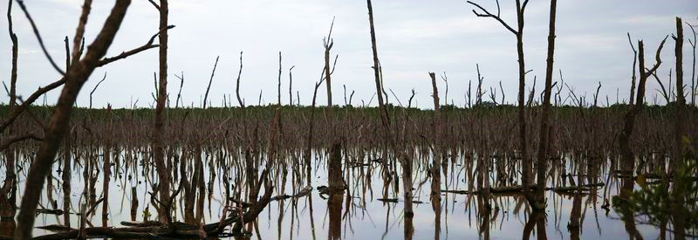
Threats to Mangroves
Fruit Farm Creek Naples, FL
Coastal urbanization poses a large threat to mangroves
Dredging, filling, chemical runoff, etc.
Any alteration in natural water (tidal) flow can affect salinity (Fruit Farm Creek)
Environmental changes can also lead to increased invasive species
Increased frequency or intensity of storms
Notes:
https://www.fws.gov/verobeach/msrppdfs/mangroves.pdf
Image: https://www.orlandosentinel.com/news/breaking-news/os-ap-chinese-billionaire-florida-mangroves-20160117-story.html

Slide 10
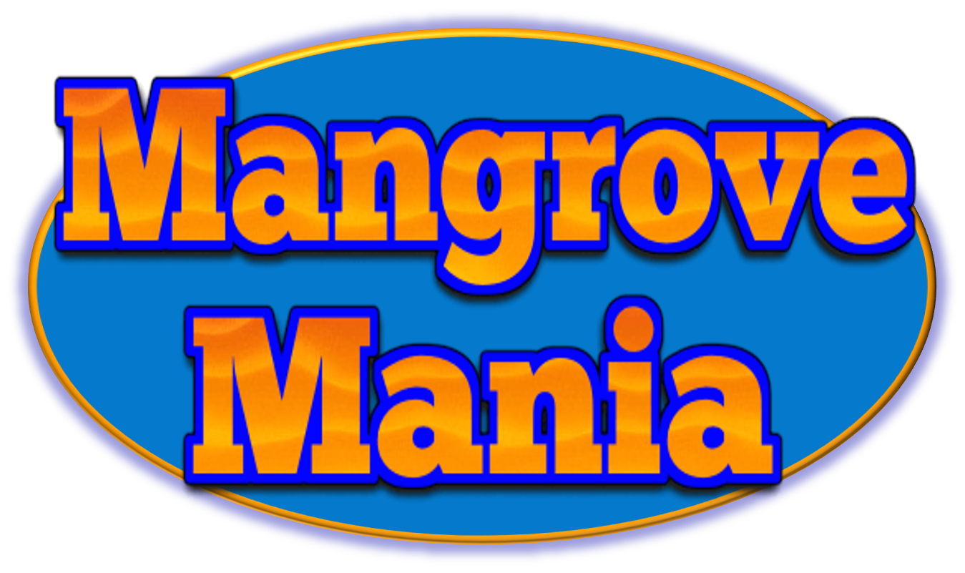
Split into even teams
1-Score keeper, 2-team captains (will give team answers)
Pick a number 1-10 or flip a coin to see who goes first
See question, huddle and write down potential answers for a minute or two
Two X, then other team goes
Every round 100 points available (except 5)
__________
Last round each team write down 10 things in 1 minute!
Each ✓ = 10 points
Most points wins!

