Slide 1
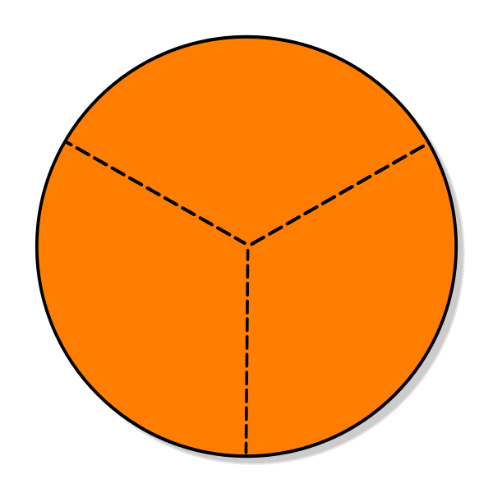
Put the ecosystem service/benefit in its correct slice (some may overlap)
Ecologic Social
Economic
Seafood industry
Ecotourism
Food web
Erosion control
Biodiversity
Recreation
Jobs
Sense of place
Wildlife habitat area
Art material/inspiration
Wind/wave buffer
Carbon storage
Decomposition
Commercial fishing
Restoration efforts
Fish nursery
Property value
Aesthetics
Subsistence fishing
History/heritage
Education
Rookery
Adjacent habitat support
Dissolved oxygen levels
Scientific opportunity/ research

Slide 2
Bingo hints…think about how mangroves might relate to these symbols:
$
Jobs, culture, ecologic factors, research, tourism, education, health, habitat, coastal resilience, etc.
Notes:
Hints. There are more options than those listed.

Slide 3
Bingo Rules
Find (or imagine) something that…
Fill in what you saw or have learned before
Can be anything within the mangrove ecosystem (mangrove forest & surrounding waters)
Each box MUST have something filled in to count
Options for bonus points with extra details/descriptions (up to teacher)
Can repeat answers
Can use ‘mangrove’ in the answer but need elaboration
Can be in groups (depending on class)
Ask for help

Slide 4
 | B | I | N | G | O
1 | Provides food to humans: | Has economic value ($): | Can be a group/ social activity: | Can help reduce erosion: | Can be used as raw materials (for building or fuel etc.):
2 | Provides part of/ a recreation activity: | Could be a restoration opportunity: | Betters water quality: | Can be used as a source of energy: | Offers a physical activity opportunity:
3 | Can inspire art: | Could be a community activity: |  | Helps buffer waves: | Bird sighting:
4 | Is surrounding habitat: | Fish sighting: | Provides a recreation job: | Provides an education opportunity: | Helps commercial fishing industry:
5 | Shellfish/ crustacean sighting: | Is involved in nutrient cycling: | Could be a science project idea: | Something you like about this habitat: | Mammal sighting:
Ecosystem Services!
FREE SPACE
Find (or imagine) something that…
FREE SPACE

Slide 5
Put the ecosystem service/benefit in its correct slice (some may overlap)
Ecologic Social/Cultural
Economic
K
E
Y
Food web
Erosion control
Biodiversity
Wildlife habitat area
Adjacent habitat support
Wind/wave buffer
Dissolved oxygen levels
Carbon storage
Decomposition
Fish nursery
Rookery
Seafood industry
Recreation
Sense of Place
Art material/ inspiration
Aesthetics
History/heritage
Subsistence fishing
Seafood industry
Tourism
Erosion control
Jobs
Wind/wave buffer
Commercial fishing
Restoration efforts
Property value
Aesthetics
Scientific opportunity/research
Ecotourism
Education
Seafood industry
Ecotourism
Food web
Erosion control
Biodiversity
Recreation
Jobs
Sense of place
Wildlife habitat area
Art material/inspiration
Wind/wave buffer
Carbon storage
Decomposition
Commercial fishing
Restoration efforts
Fish nursery
Property value
Aesthetics
Subsistence fishing
History/heritage
Education
Rookery
Adjacent habitat support
Dissolved oxygen levels
Scientific opportunity/ research
Notes:
This Photo by Unknown Author is licensed under CC BY-SA

Slide 6
KEY
Bingo hints…think about how mangroves might relate to these symbols:
Water quality
Storm surge protection
Boat fishing/tour captain Education opportunities
$
Revenue, good economy
Bird watching
Shellfish habitat
Swimming
Wildlife viewing
Large fish catch/viewing
Kayaking
Erosion prevention
Science/research jobs
Fish nursery
Shellfish for food
Art inspiration
Restaurant goods
Nutrient cycling
Festivals
Science
Research
Human nutrition
Tourism
Restoration
Restaurant jobs
Boating
Hiking/Nature walks
Jobs, culture, ecologic factors, research, tourism, education, health, habitat, coastal resilience, etc.
Notes:
Hints. There are more options than those listed.

Slide 7
K
E
Y
 | B | I | N | G | O
 | Provides food to humans: Fish Shellfish | Has economic value ($): Wood Property protection Fish/food Jobs Ecotourism Restoration | Can be a group/ social activity: Kayaking Nature walks Paddle boarding Fishing Boating | Can help reduce erosion: Roots-trap sediment Nearby habitats- sea grass, oysters | Can be used as raw materials (for building or fuel etc.): Wood (any tree parts)
 | Provides a recreation activity: Kayaking Swimming Paddle boarding Fishing Boating | Could be a restoration opportunity: Dead/sick mangrove removal Plant new mangroves | Betters water quality: Sediment trapping Filter pollutants Reduce algae | Can be used as a source of energy: Burn for fuel Consuming organisms that inhabit the area | Offers a physical activity opportunity: Kayaking Nature walks Paddle boarding Fishing Swimming
 | Can inspire art: Pretty much anything | Could be a community activity: Restoration Clean-up Nature walks/ viewing |  | Helps buffer waves: Roots | Bird sighting: Any
 | Is surrounding habitat: Salt marsh Sea grass Coral reefs Freshwater lagoon/pond | Fish sighting: Any | Provides a recreation job: Kayaking Paddle boarding Fishing Boating Any guided tours | Provides an education opportunity: RBNERR Ecotourism Field-trips Many others | Helps commercial fishing industry: Nursery grounds Improves water quality Tourism
 | Shellfish sighting: Any | Is involved in nutrient cycling: Roots absorb nutrients Organisms decompose | Could be a science project idea: Wide range | Something you like about this habitat: Any | Mammal sighting: If none, just put a correct answer
Ecosystem Services!
FREE SPACE
Find or imagine something that… (Each box MUST have sometime filled in to count…Can repeat answers and use ‘mangrove’ in the answer…More details=better)
FREE SPACE
Notes:
There may be more answers than the key contains. Up to teachers discretion.

