Slide 1
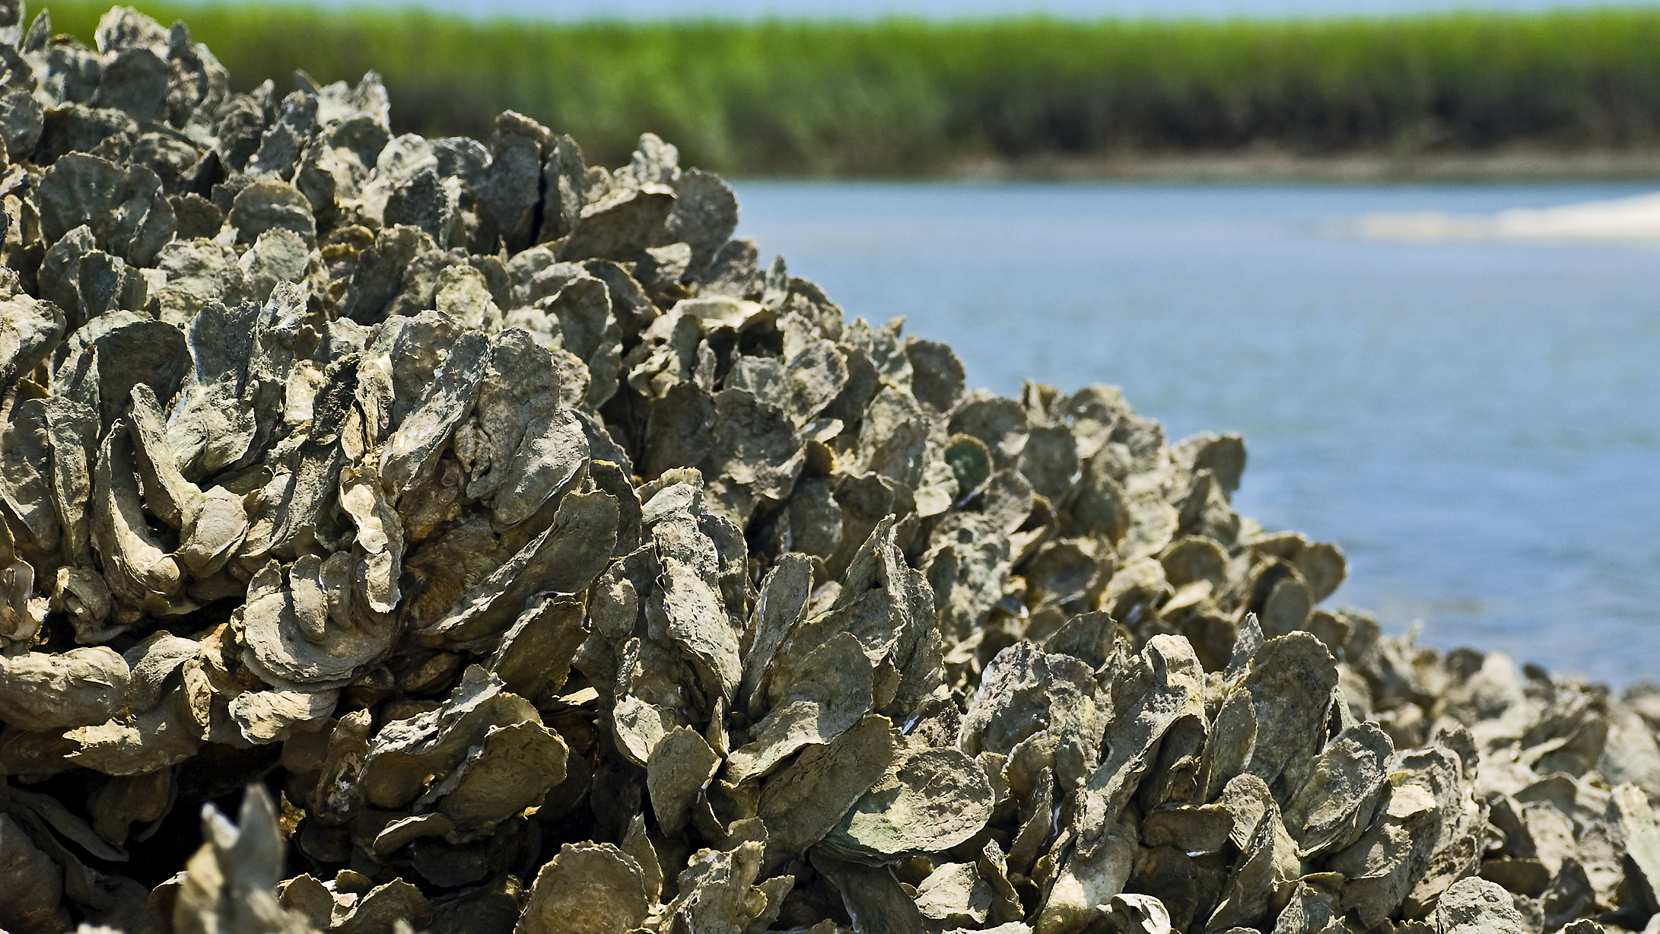
Oyster Reefs
ECOSYSTEM SERVICES: THE KEY TO ESTUARINE HEALTH
Notes:
Image 1: https://www.visitsouthwalton.com/tips-trips/dining-with-a-purpose-local-restaurants-support-oyster-reef-program

Slide 2
Oyster Reefs
What are they?
How are they made?
Why are they important?
Why are they at risk?
What can we do to help?
Notes:
Image: Duke Nicholas Institute, Natalie B. Rodriguez

Slide 3
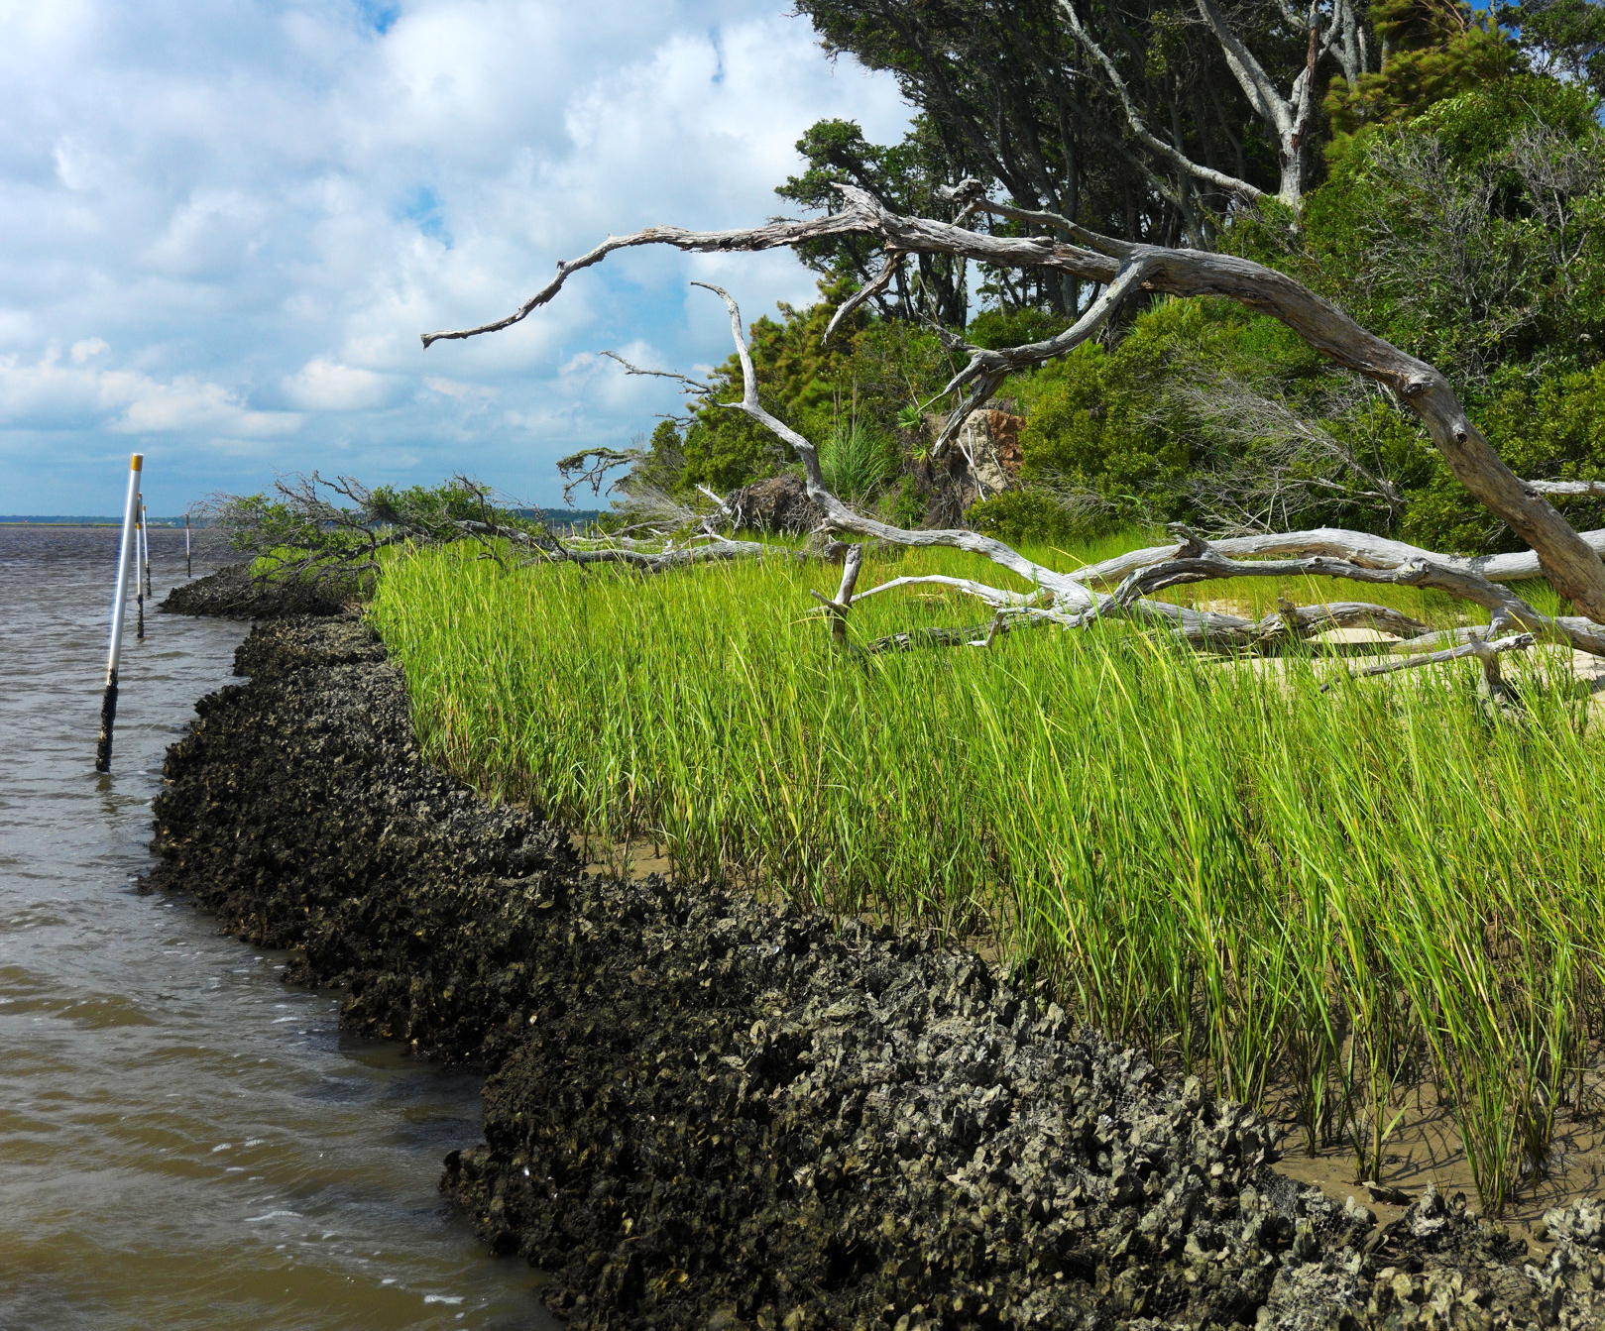
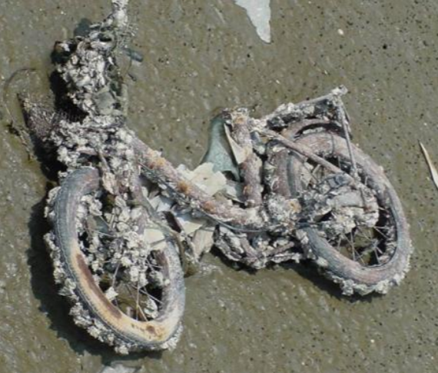
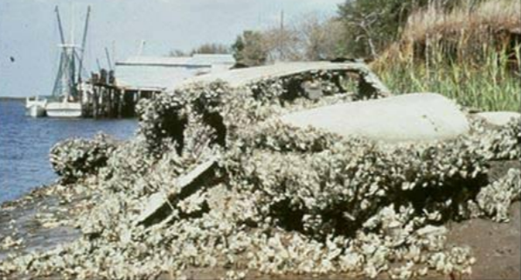
Habitat
Common in coastal areas
Grow on hard to firm surfaces, both intertidally (only underwater part of the time) and subtidally (always underwater).
Mangroves, salt marsh, sea grasses often nearby
Notes:
Top image: https://www.coastalreview.org/2019/04/state-permitting-for-marsh-sills-simplified/
Bottom images: https://coast.noaa.gov/data/estuaries/pdf/an-ode-to-the-oyster-oyster-reefs-powerpoint.pdf

Slide 4
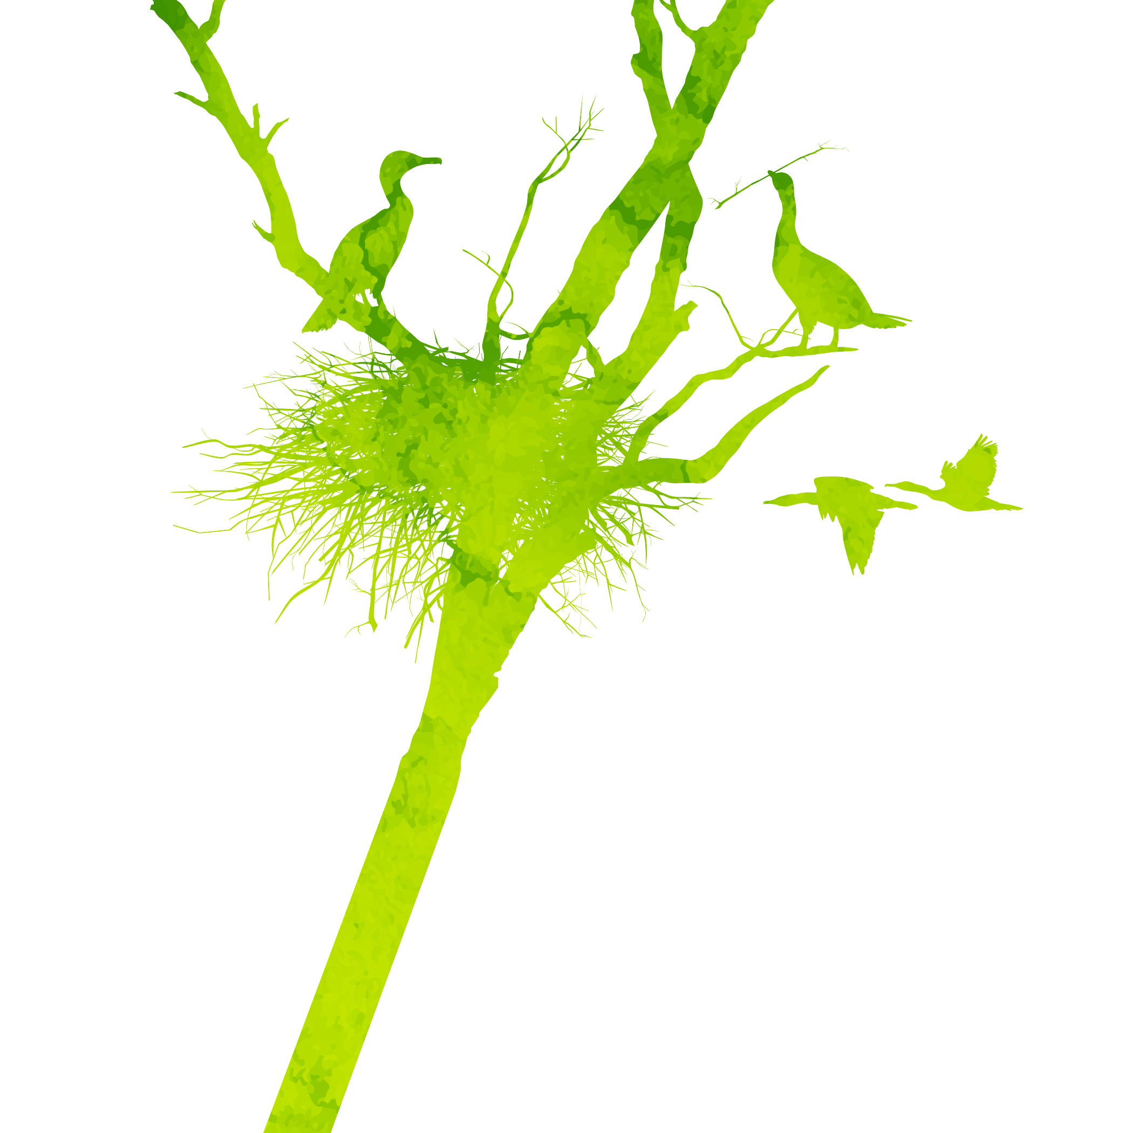
Ecosystem Services (Aka Nature’s Benefits)
Provisioning
Direct products obtained from nature
Regulating
Services nature provides that regulate the wider environment
Cultural
Indirect benefits that can enrich lives
Supporting
Indirect services that enable other services to function
4
Notes:
GIF: https://www.youtube.com/watch?v=JvR0RIZd8HU
Other images-creative commons (licensed under CC BY-NC-ND)

Slide 5
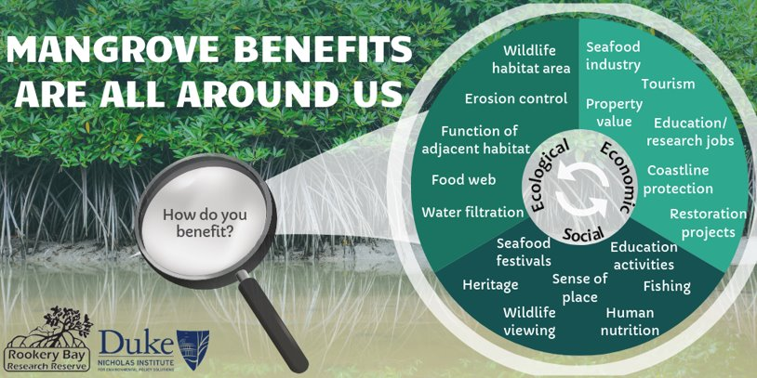
Simply defined, ecosystem services are the direct and indirect benefits that humans receive from nature. ​
Direct- forest products for building or fuel​
Indirect- culture, recreation, revenue, etc. ​
Important to remember that humans and nature are NOT involved in separate systems. Something that happens to one could influence what happens to the other. ​
We rely on nature's benefits and therefore must protect them!
Think about this quote from Conservation International... "humans need nature, but nature doesn't need us" ​

Slide 6
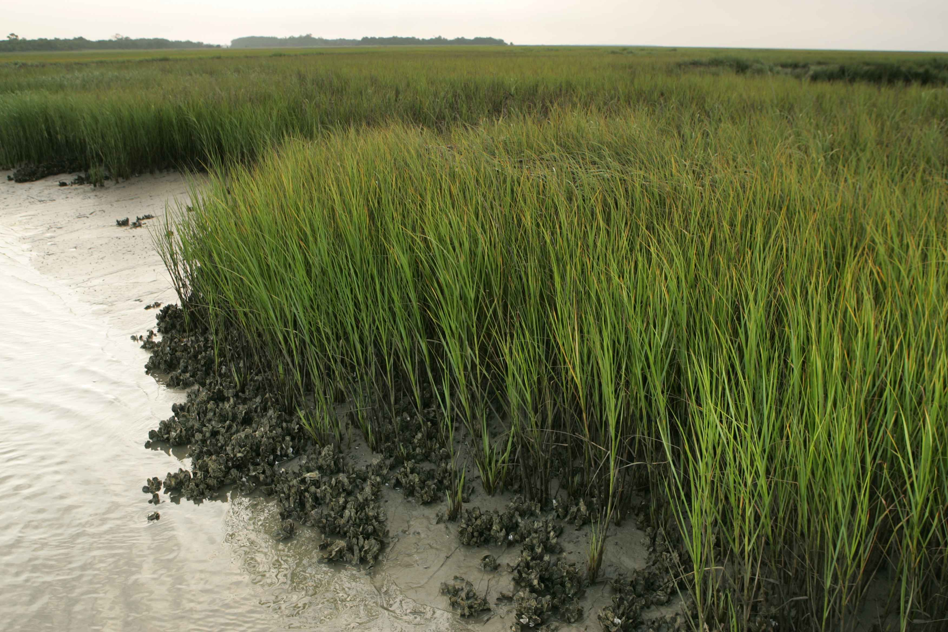
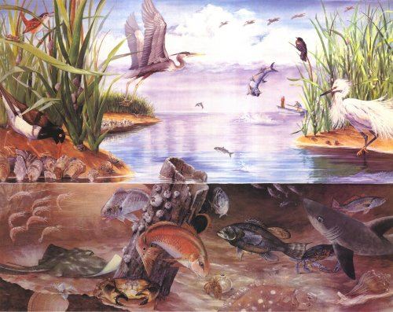
Why are oyster reefs ecologically important?
Provide food and habitat for organisms in and out of water
Improve water quality and clarity
Filter sediments and pollutants
Good for nearby habitat like mangroves, underwater and shoreline grasses, and salt marshes
Reduce erosion, protect shorelines
‘Keystone species’
Notes:
Top image: This Photo by Unknown Author is licensed under CC BY-SA
Bottom image: http://score.dnr.sc.gov/deep.php?subject=2&topic=15

Slide 7
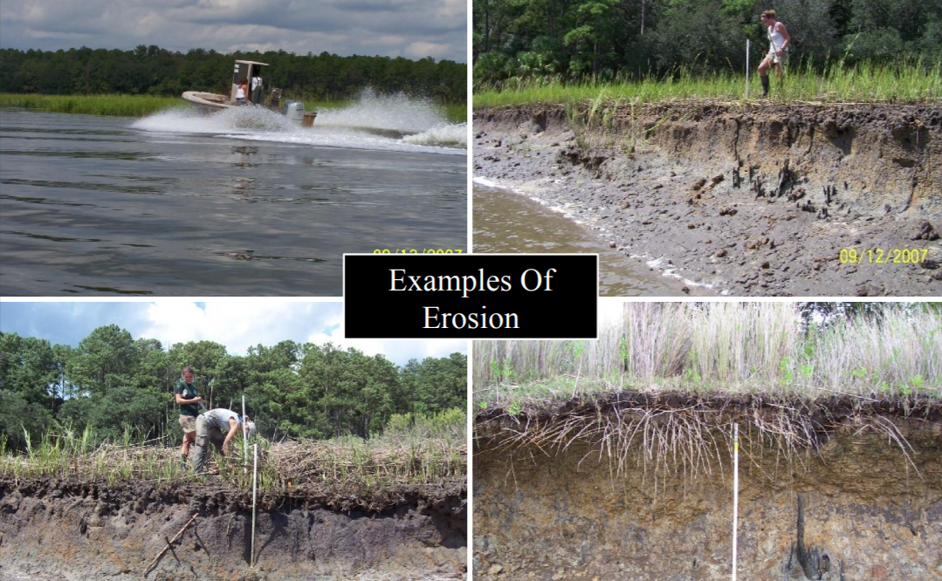
Notes:
https://coast.noaa.gov/data/estuaries/pdf/an-ode-to-the-oyster-oyster-reefs-powerpoint.pdf

Slide 8
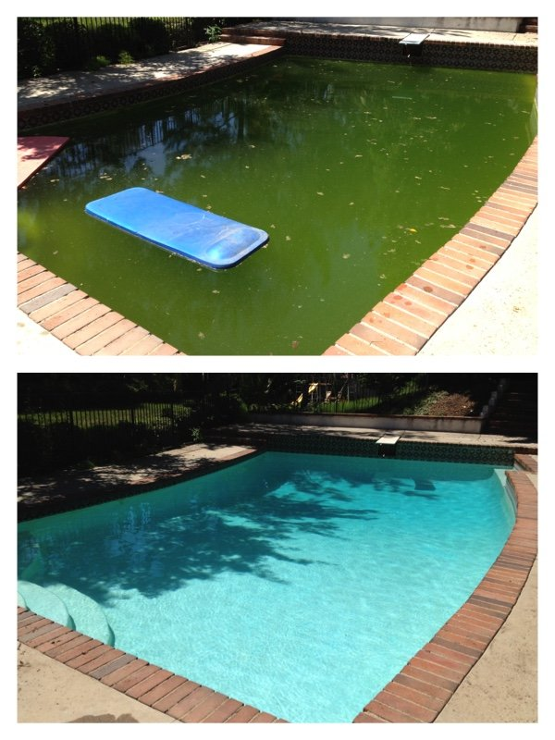
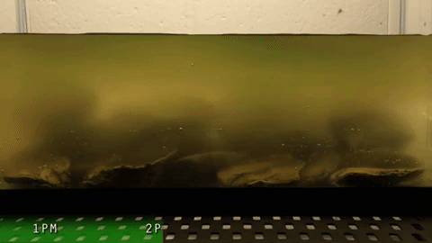
Before
Where would you rather swim?
After
*Oysters can filter as much as 50 gallons a day!
Notes:
Oyster Images/GIF and quote: https://www.youtube.com/watch?v=JvR0RIZd8HU
Pools: https://www.yelp.com/biz_photos/cabana-boys-pool-care-granada-hills-3?select=nIwjwW_mLClEDWdyH945Yw

Slide 9
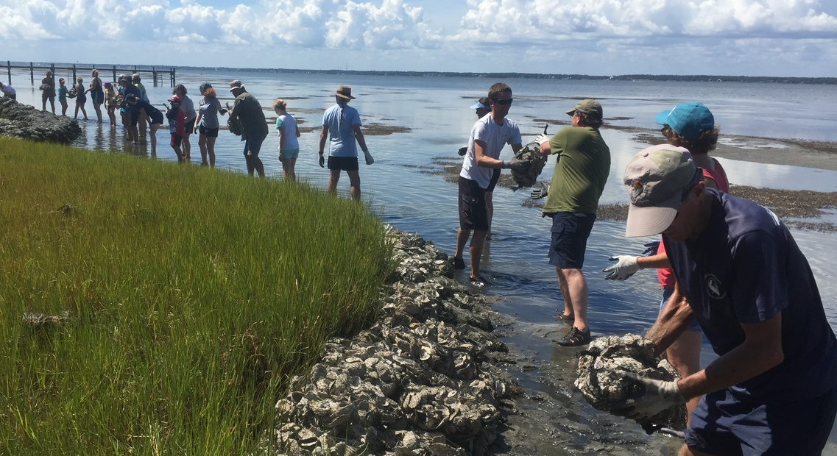
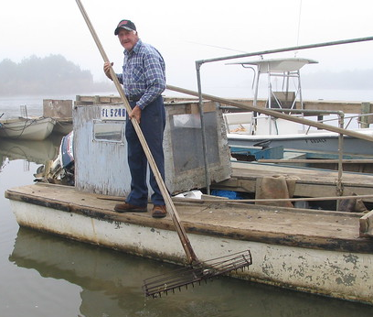
Why are oyster reefs economically important?
Provide jobs
Commercial fisherman, educators, scientists, tourism/recreation guides, restoration professionals, etc.
Tourism and recreation revenue
Kayaking, wildlife watching, nature walks, paddle boarding, boating, fishing
Natural breakwaters
Property and infrastructure (roads, utilities, etc.) protection
Seafood source/nursery for large fish
restaurants, festivals, nutrition, etc.
Coastal restoration projects
Notes:
Top image: https://www.fisheries.noaa.gov/feature-story/noaa-seeks-applications-community-based-habitat-restoration-project-funding
Bottom image: This Photo by Unknown Author is licensed under CC BY

Slide 10
History/heritage, Sense of place (pride), Festivals, Art
CULTURE
Notes:
Restoration as a social activity, recreation, heritage, culture, education, science, sense of place, seafood festivals
Young oysterman: https://www.ourstate.com/an-oystermans-calling/
Old oysterman: A Carteret County oyster farmer. Image from the N.C. Museum of History.

Slide 11
A common story…
Notes:
The Chesapeake Bay Program
The Chesapeake Bay faced large oyster loss due to certain industry booms. North Carolina faced/is facing this same outcome.

Slide 12
NC Restoration
Notes:
Left image: https://ncoysters.org/wp-content/uploads/2018/06/State-of-the-Oyster-2017-Progress-Final.pdf
Right images: https://coast.noaa.gov/digitalcoast/training/nc-coast.html
Left shows oyster sanctuaries in North Carolina. Here, they are left to thrive. The right image shows people working on a restoration project, laying down shell bags to create oyster reef.

Slide 13
Split into even teams
1-Score keeper, 2-team captains (will give team answers)
Pick a number 1-10 or flip a coin to see who goes first
See question, huddle and write down potential answers for a minute or two
Two X, then other team goes
Every round 100 points available (except 5)
__________
Last round each team write down 10 things in 1 minute!
Each ✓ = 10 points
Most points wins!

